Slide 1
Treated vs Non-Treated Timber Thinning and the Effects of Fire

Slide 2
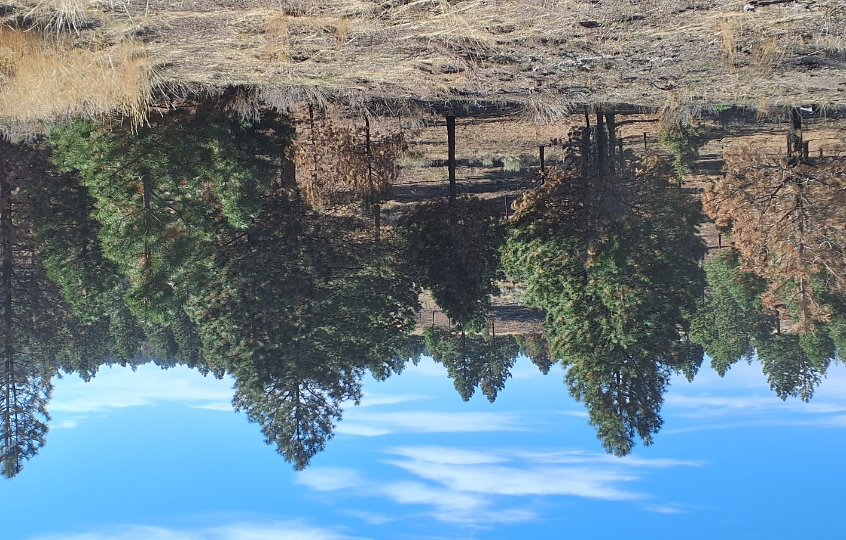
With the proper thinning and spacing of trees, you can see healthier, more mature trees with abundant amounts of green remaining. The smaller trees succumbed to the heat, but a healthy forest stand remains. With less high heat, fuel load, and scorching; perennials, forbs, and native plants will return and thrive the following spring.

Slide 3
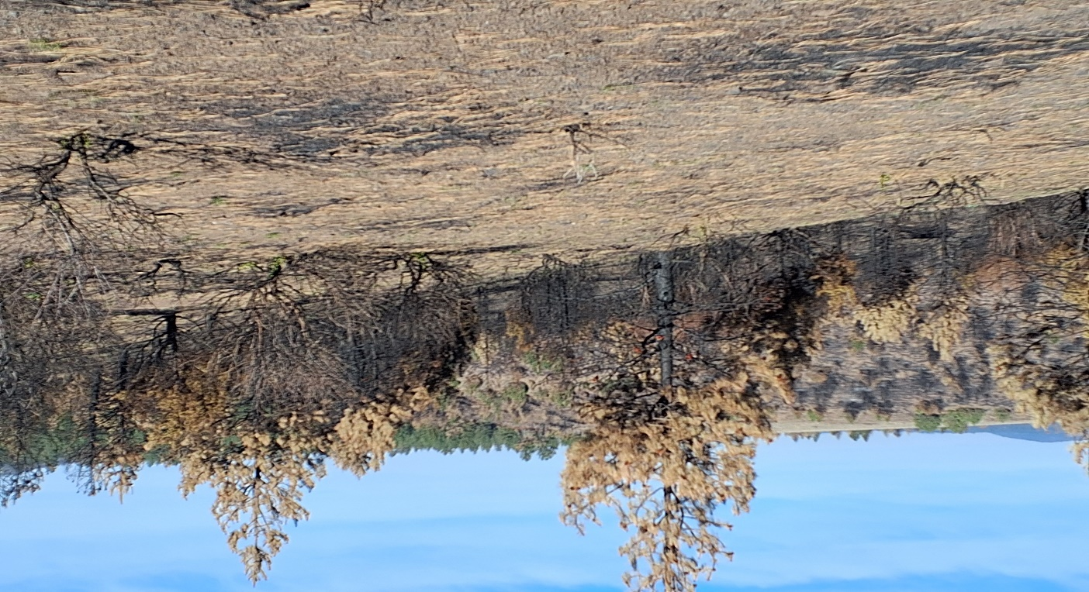
The untreated canyon and hillside are denser and provide a much hotter fuel load. In this scenario, the soil is singed, killing perennial grasses, forbs, and plants creating the perfect conditions for IAG such as medusa head and cheatgrass. Approx. 0.70 inches of rain fell after the fire and cheatgrass had begun to sprout.

Slide 4
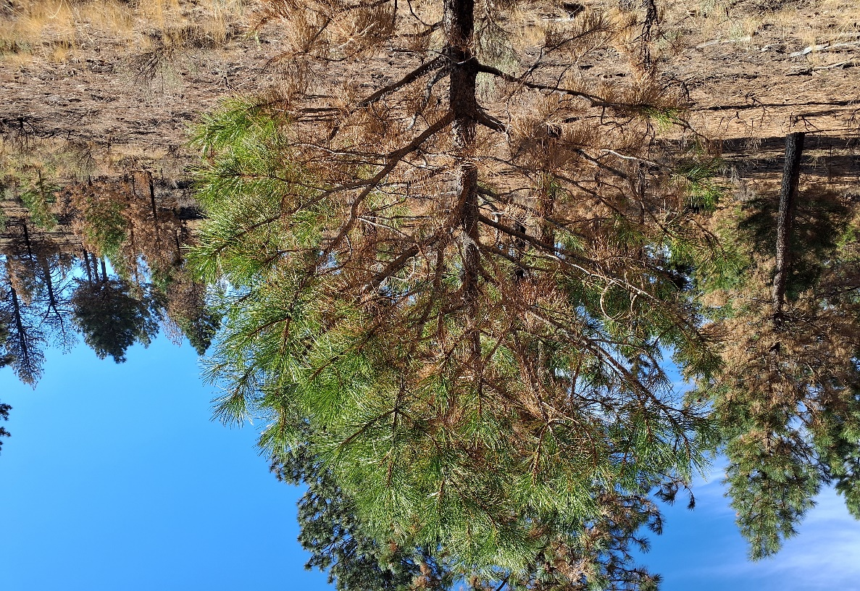
Pine trees can sustain 50% of damage and continue to survive and grow.

Slide 5
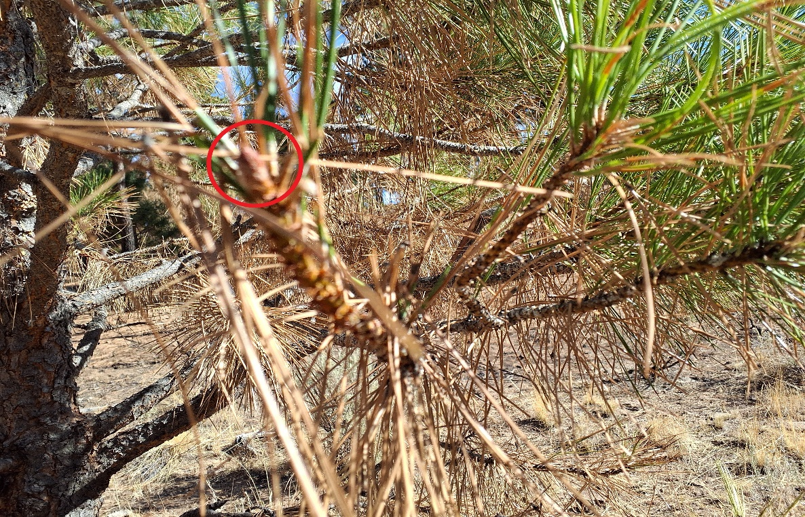
2-months post-fire, a new Apical bud emerges from the previous burned tree picture.

Slide 6
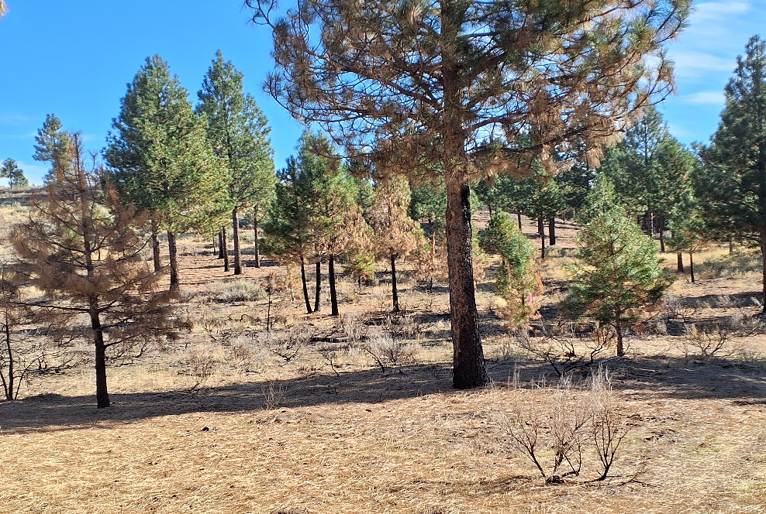
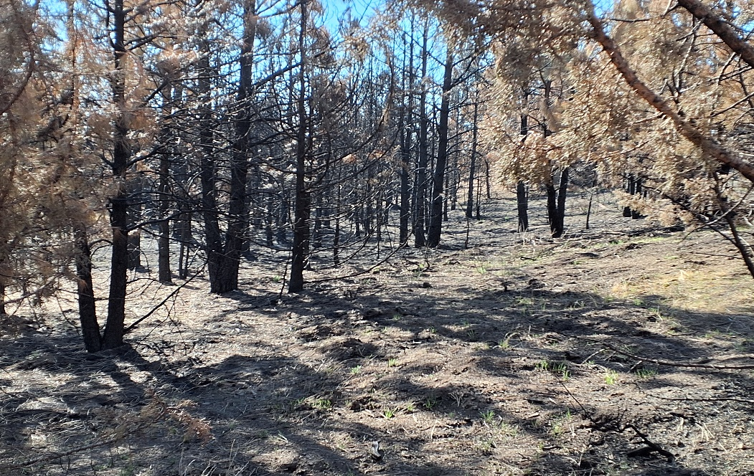
Side-by-side comparison photos, these pictures represent the worst-case scenario. It was over 100° days, and no fire suppression support was available on the days the fire burned through this area.

Slide 7
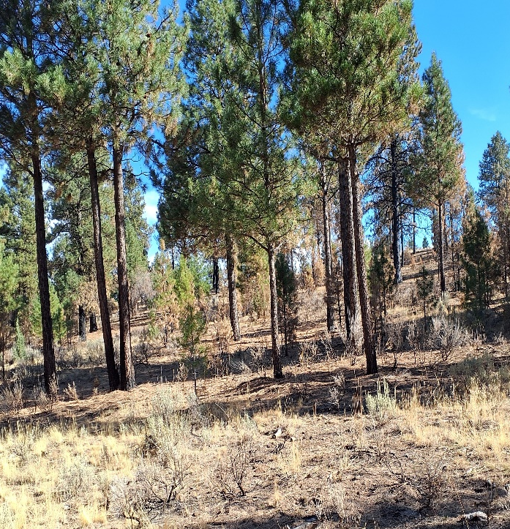
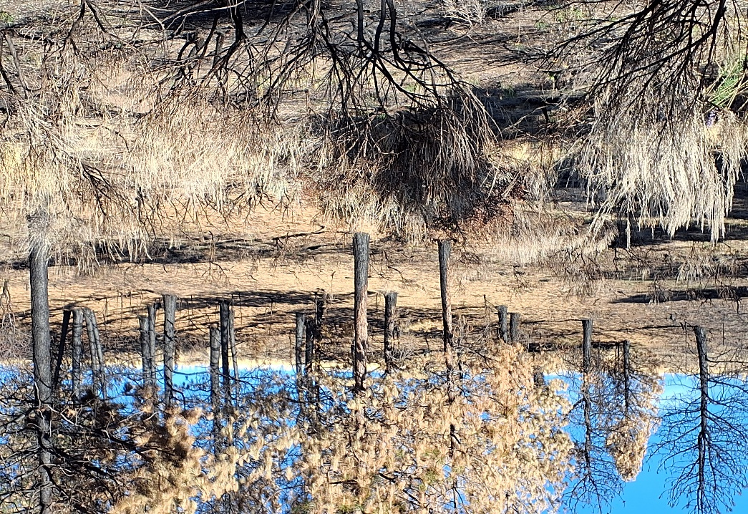

Slide 8
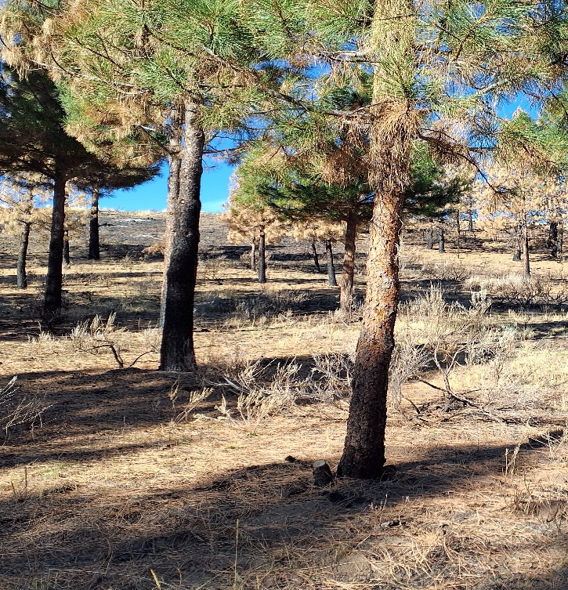
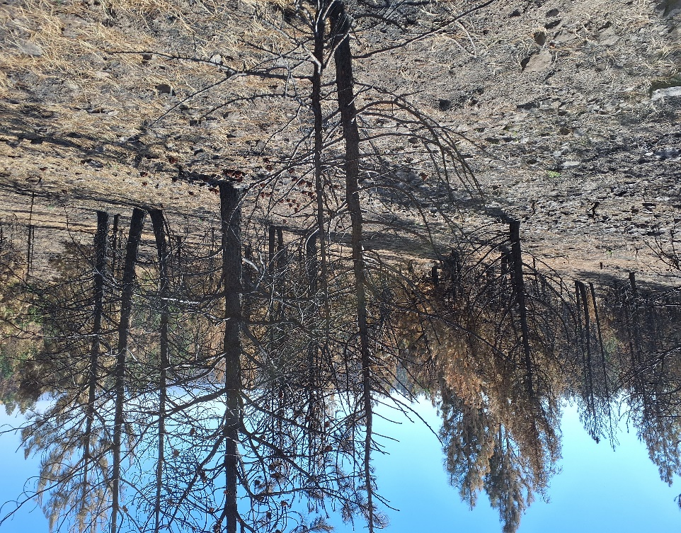

Slide 9
