Slide 1
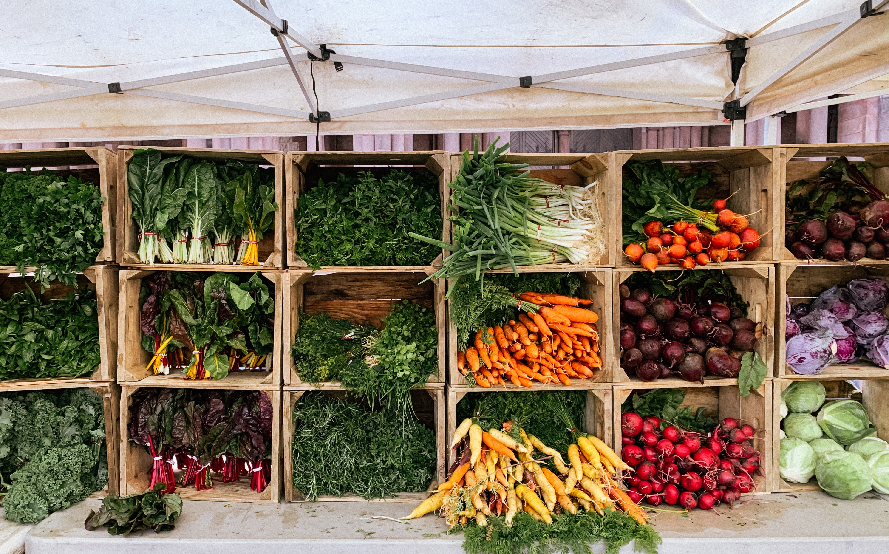
NACD Project: “Strengthening Grassroots Leadership & Capacity to Scale Climate Smart Systems and Facilitate Historically Underserved Producers’ Access to Markets”
USDA Partnerships for Climate Smart Commodities
October 2022

Slide 2

Current Status
USDA announced 70 awards for up to $2.8 billion
NACD’s funding ceiling is up to $90 million
Negotiations with USDA are scheduled for October 20; programming and funding are therefore subject to change
Awardees are not authorized to incur pre-award costs

Slide 3
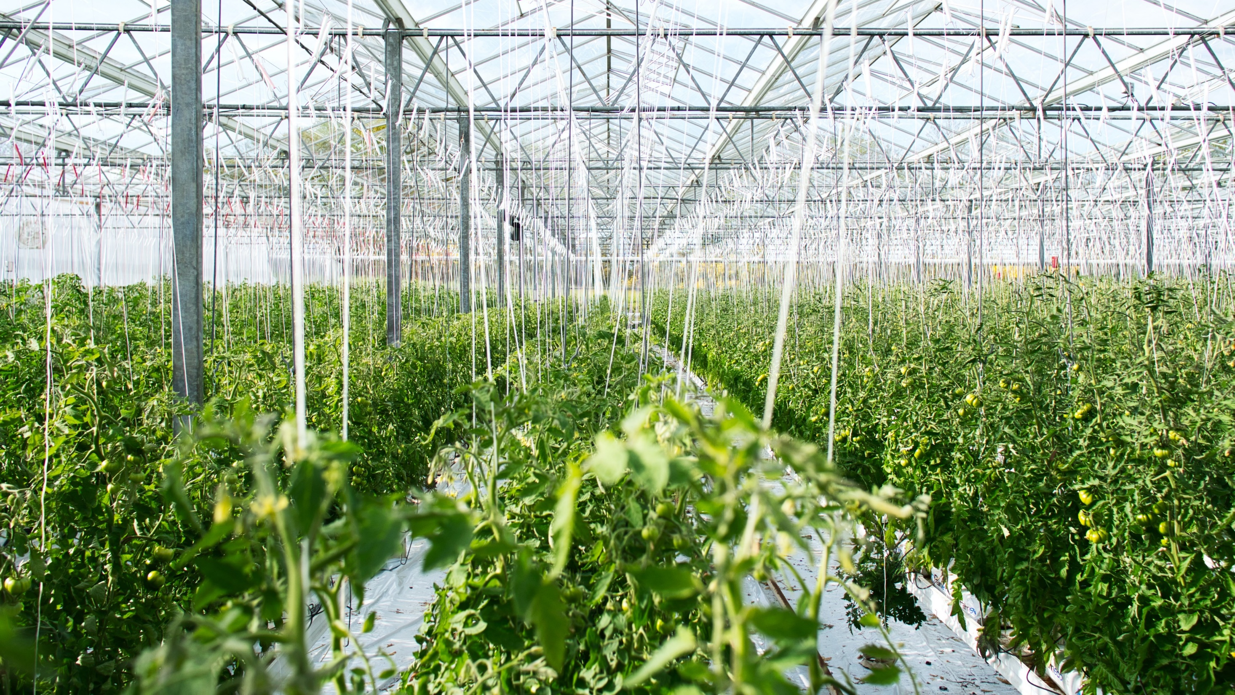
USDA Objectives
Support the production and marketing of climate-smart commodities through a set of pilot projects that provide voluntary incentives to producers and landowners, including early adopters to:
  Pilot implementation of climate-smart production practices, activities, and systems working lands on a large-scale, including meaningful involvement of small and historically underserved producers,
  Measure/quantify, monitor and verify carbon and GHG benefits associated with these practices, and
  Develop markets and promote the resulting climate-smart commodities.

Slide 4
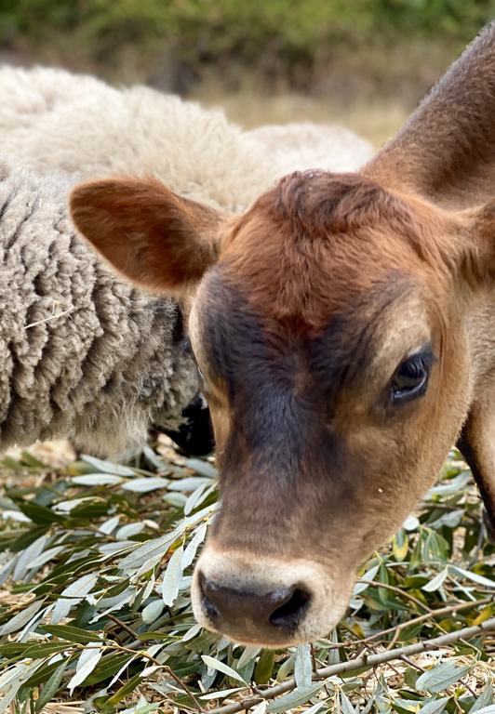
NACD Project Objectives
USDA’s historic investment in the production of climate-smart commodities will spur demand; however, markets must be developed and sustained over time. NACD, through its project partners and network of 3,000 conservation districts, will advance grassroots efforts that ensure producers and local communities are prepared to meet growing demand and have access to climate-smart commodity markets.
Our goal is to leave no producer behind.
Generate interest and momentum within individual communities across the nation.
Spur individual action via technical assistance, conservation planning, and financial assistance incentives.
Provide sound data to inform producers’ decision-making processes.
Cultivate trust building in and growth of conservation systems, implementation, and markets.

Slide 5

NACD Programming
Advance Pilots to Scale Climate-Smart Practices | Carbon and GHG Quantification & MMRV | Market Facilitation & Access
NACD Pass-Through Grant Program Emphasis on innovative pilots and projects Funding for technical and financial assistance Includes local, state, or regional market facilitation and access Requires quantification and MRV plans Significant equity and access components Enhanced Technical Assistance Model | Data democratization initiative with HabiTerre (Farm Carbon reports) HabiTerre Quantification Modeling and comparison to COMET (producers may also utilize another model or ecosystem service) Remote sensing to support monitoring and verification of practices | National programming and educational opportunities to keep associations and districts informed of evolving trends, standards, and market opportunities Stakeholder roundtables with the goal of advancing equity, access, and inclusions National information sharing hub for grant and project opportunities Expanded outreach to market players

