Slide 1
NRCS Oregon Updates
OREGON
Jay Gibbs | October 2023
Notes:
GO TO VIEW > MASTER > SLIDE MASTER TO EDIT THE IMAGES ON THE TITLE AND DIVIDER SLIDES
RIGHT CLICK ON THE INDIVIDUAL IMAGES TO CHANGE THE IMAGE

Slide 2
$246,301 / day (EQIP, CSP, RCPP, JC)

Slide 3
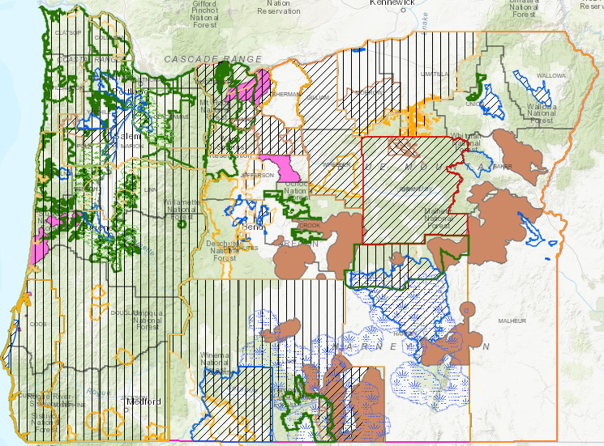
Oregon’s Strategic Approach

Slide 4
FY23 Farm Bill Program Highlights
EQIP
578 contracts
$32M obligated
216,983 acres
CSP
167 contracts
$25M obligated
586,636 acres

Slide 5
Inflation Reduction Act (IRA)
FY23 was the first year for IRA funding
For FY24, we anticipate approximately $31M in financial assistance
About $20M for IRA EQIP
About $11M for IRA CSP
To obligate IRA funding in Oregon, we have 6 active IRA- EQIP fund pools:
Forestland
Cropland
Energy
Animal Feeding Operations
Rangeland
Pastureland

Slide 6
FY23 Most Popular EQIP Practices
Brush Management
Forest Stand Improvement
Woody Residue Treatment
Watering Facility
Livestock Pipeline
Irrigation Pipeline
Irrigation Water Conveyance
High Tunnel System
Fence
Herbaceous Weed Treatment

Slide 7
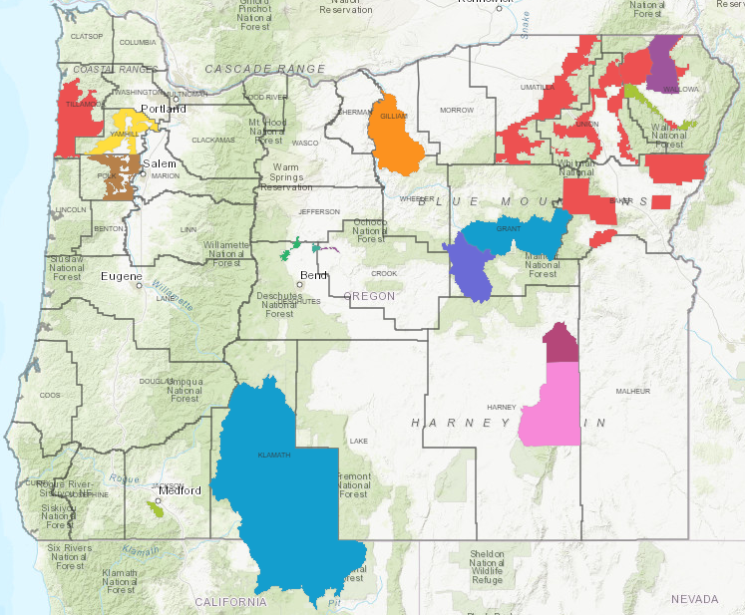
FY23 Collaborative Projects
Joint Chiefs
4 Projects
$3.5M obligated
27 contracts
RCPP
20 active projects
$5.4M obligated
70 landowner contracts

Slide 8
FY23 Watershed Program Highlights
Oregon has the most active watershed program in the nation
Since FY17, NRCS Oregon has commit $160M in FA and TA through the watershed program (PL566) to 30 different planning efforts with 28 Sponsoring Local Organizations
In FY23, NRCS Oregon secured and allocated $23.8M in watershed program funding

Slide 9
FY23 Agreements & Partnerships
99 active agreements worth $197M (Fed $’s plus Partner $’s)
Federal $’s : $153M
Partner $’s : $43.5M
Oregon has about 75 partner positions funded through agreements

Slide 10
Video
https://www.youtube.com/watch?v=xYmQTAUwkFk

