Slide 1
NRCS Oregon Updates
OREGON
Ron Alvarado | November 2022
Notes:
GO TO VIEW > MASTER > SLIDE MASTER TO EDIT THE IMAGES ON THE TITLE AND DIVIDER SLIDES
RIGHT CLICK ON THE INDIVIDUAL IMAGES TO CHANGE THE IMAGE

Slide 2
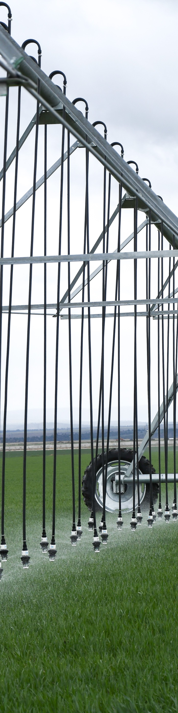
Inflation Reduction Act (IRA)
Single largest investment in climate and clean energy solutions in American history
About $20 billion of IRA funds will NRCS nationally, to include:
  $8.45B for the Environmental Quality Incentives Program
  $4.95B for the Regional Conservation Partnership Program
  $3.25B for the Conservation Stewardship Program
  $1.4B for the Agricultural Conservation Easement Program
  $1B for the Conservation Technical Assistance Program
Funding will be a different “flavor”
Coordinated joint effort to strategically invest Oregon’s IRA funds with partners
Notes:
**Put the funding into perspective** Compare funds to what we usually get in funding
The IRA is a once-in-a-generation investment, representing the single largest investment in climate and clean energy solutions in American history.
For the USDA, the IRA will help producers stay on the farm, prevent producers from becoming ineligible for future assistance, and promote climate-smart agriculture by increasing access to conservation assistance.
Approximately $20 billion of IRA funds will support the Natural Resources Conservation Service’s conservation programs nationally, to include:
$8.45 billion for the Environmental Quality Incentives Program
$4.95 billion for the Regional Conservation Partnership Program
$3.25 billion for the Conservation Stewardship Program
$1.4 billion for the Agricultural Conservation Easement Program
$1 billion for the Conservation Technical Assistance Program
This additional conservation programming investment will help farmers, ranchers and forest landowners implement expanded conservation practices that reduce greenhouse gas emissions and increase carbon sequestration.
We are still waiting to learn how much Oregon NRCS will receive from the total IRA funds for NRCS. While we wait, we are strategizing our conservation investments in anticipation for this additional funding to come our way this fiscal year.

Slide 3
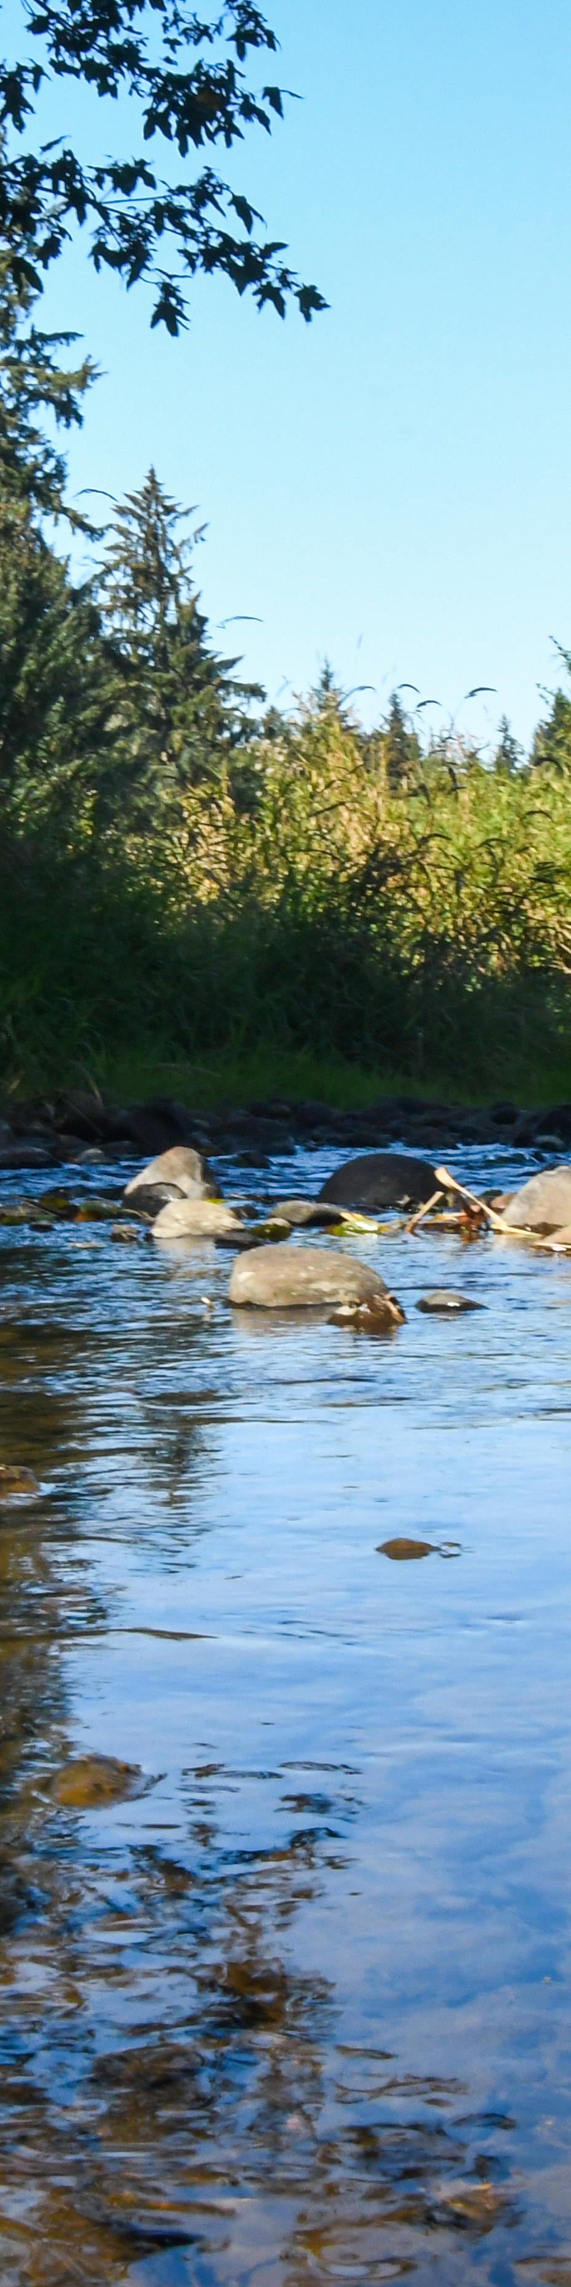
FY22 Program Highlights
EQIP
449 contracts
$22.2M obligated
142,637 acres
CSP
121 contracts
$22M obligated
775,770 acres
Joint Chiefs
4 Projects
$3M obligated
25 contracts
RCPP
21 active projects
Over $3.5M obligated
75 landowner contracts
Notes:
Facts and figures for FY22 :
EQIP, CIS - In FY22, NRCS Oregon implemented 68 Conservation Implementation Strategies (CIS’s); 70% of which harnessed at least one climate-smart practice.
RCPP - In FY22, Oregon received a total of $11M for four new RCPP projects, with partner matching funds of $18.5M; all four projects target water or wildfire. Since the start of RCPP in 2015, NRCS Oregon has invested over $160M with partners, across 32 projects covering more than 200,000 acres with 600 landowner contracts.
CSP - 121 CSP total classic and renewal contracts, Obligated $21.9M ($8.6M for Renewals and $13.3M for Classic). CSP Classic contracts were spread across 775,770 acres.
21 active RCPP projects
75 landowner contracts
Obligated over $3.5 M

Slide 4

RCPP Highlight
Oregon received $11M for 4 new RCPP projects with partner matching funds of $18.5M
All four projects support climate resiliency priority
New projects include:
  Western Oregon Cascades Recovery Effort Climate-Smart Reforestation and Recovery Assistance
  Tualatin Basin Habitat Conservation Partnership
  Oregon Sage-Grouse Habitat Conservation Strategy
  McKay Creek On-Farm Modernization

Slide 5
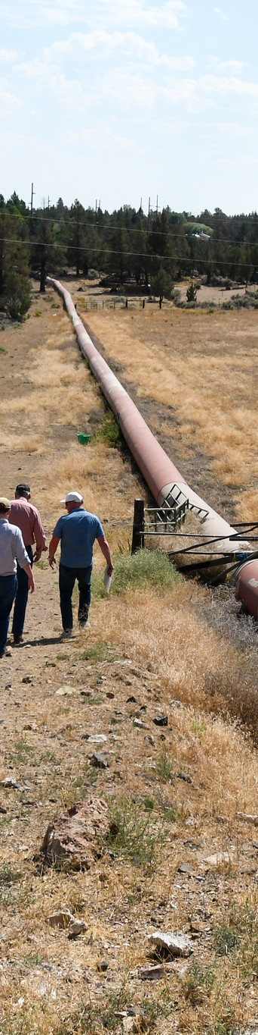
FY22 Program Highlights
Watershed Programs
28 active watershed planning efforts
26 local sponsors
$14.8M allocated for planning, design and construction
Easement Programs
Received 8 Ag Land Easement applications, obligated for $7.3M
Additional Ag Land Easement award of $6.7M
Additional Wetland Reserve Easement award of $22.7M
Notes:
In FY22, NRCS Oregon had noteworthy success with ACEP. After significant interest in both ALE and WRE and receiving a record number of applications for ALE, NRCS Oregon requested additional funding to meet the demand. NRCS Oregon was awarded an additional $6.7M for ALE, allowing us to work with landowners to protect 14,736 acres of working lands. Additional WRE funds of $22.7M will allow us to continue our work with The Nature Conservancy, private landowners and other partners to protect the remaining 10,735 acres of the 30,539 Sycan Marsh preserve in Klamath Basin. The preserve is home to thousands of birds, threatened fish and aquatic species.

Slide 6
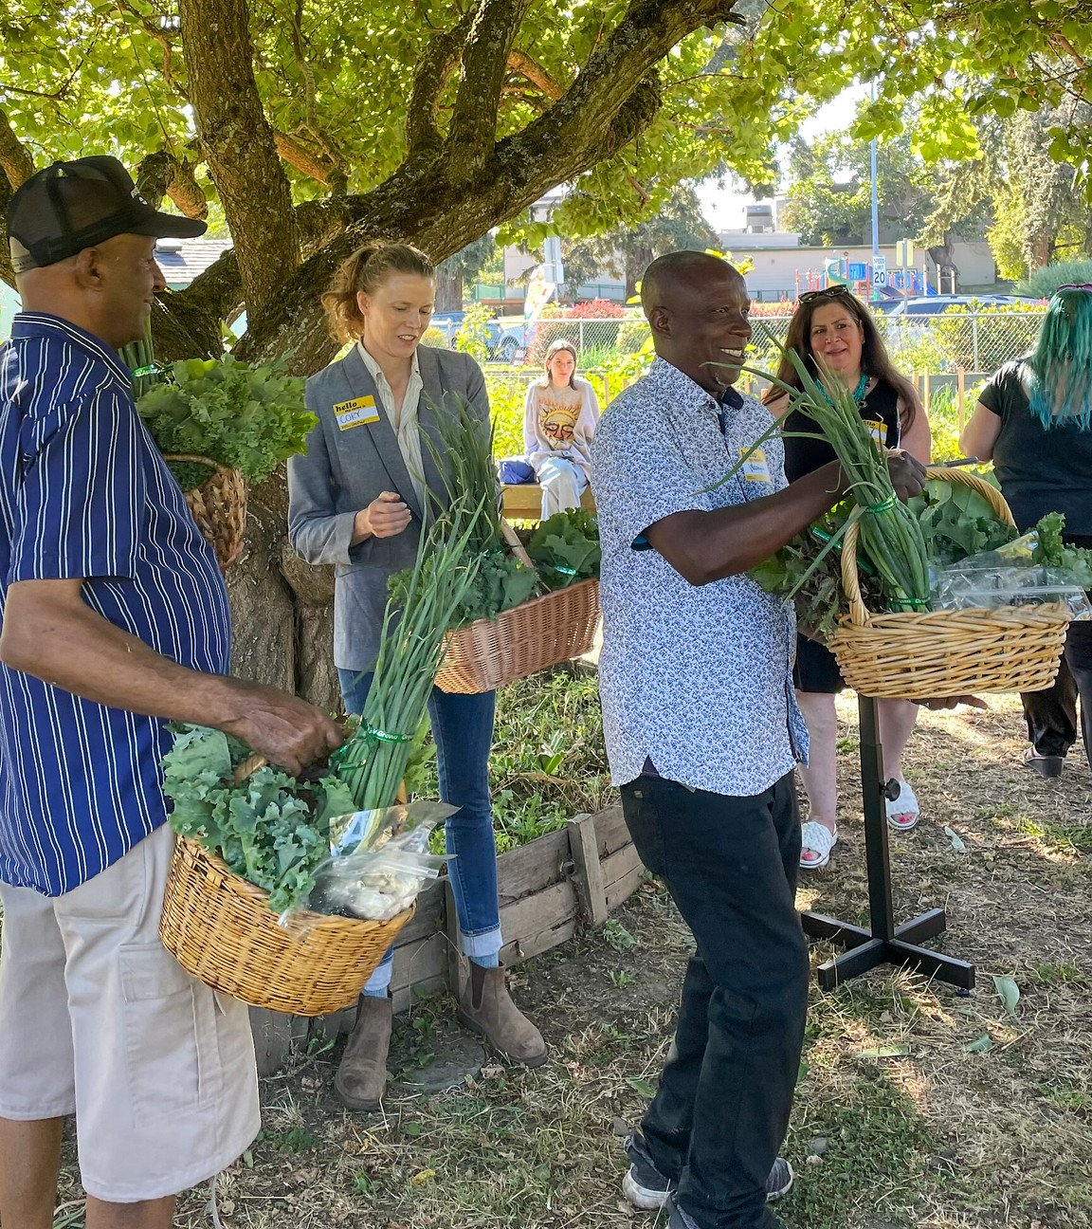
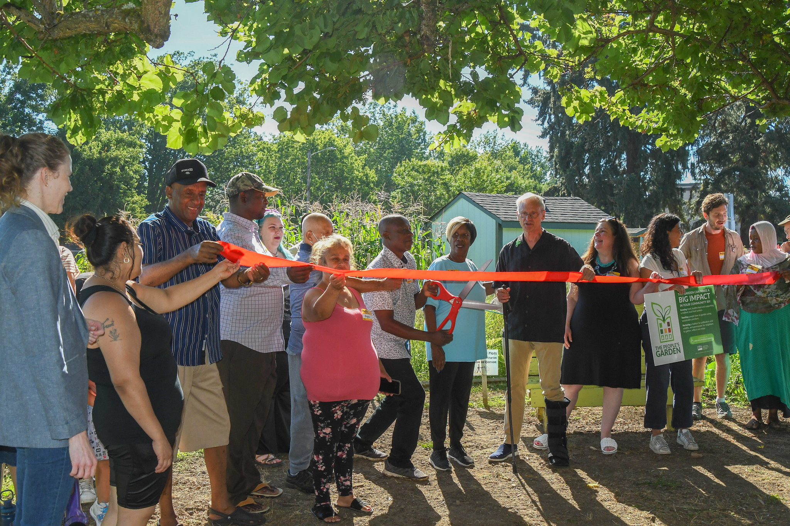
FY22 Urban Highlights
Oregon NRCS, FSA and U.S. Congressman Blumenauer commemorated Portland’s USDA People’s Garden in August
  Our Village Gardens in North Portland
  1 of 17 USDA People’s Gardens across the country in the first roll-out phase
Notes:
Portland is a designated USDA Urban Hub
In August 2022, NRCS Oregon commemorated Portland's People's Garden with a ribbon cutting event at Our Village Gardens alongside U.S. Congressman Earl Blumenauer and Oregon FSA’s State Executive Director. Portland’s People’s Garden is one of 17 USDA People’s Gardens across the country established in this first roll-out phase

