Slide 1
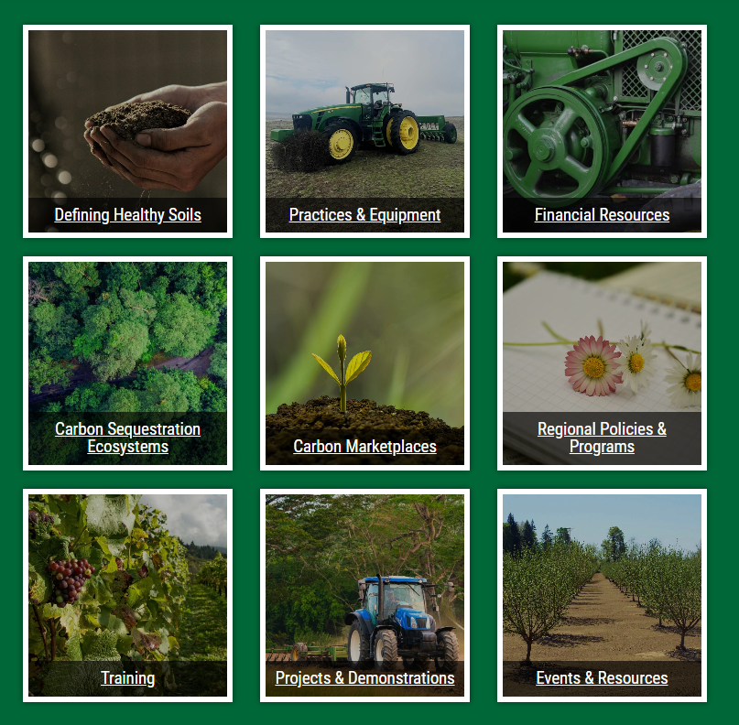
CARBON
SEQUESTRATION
AND SOIL HEALTH
https://OACDCarbon.org

Slide 2
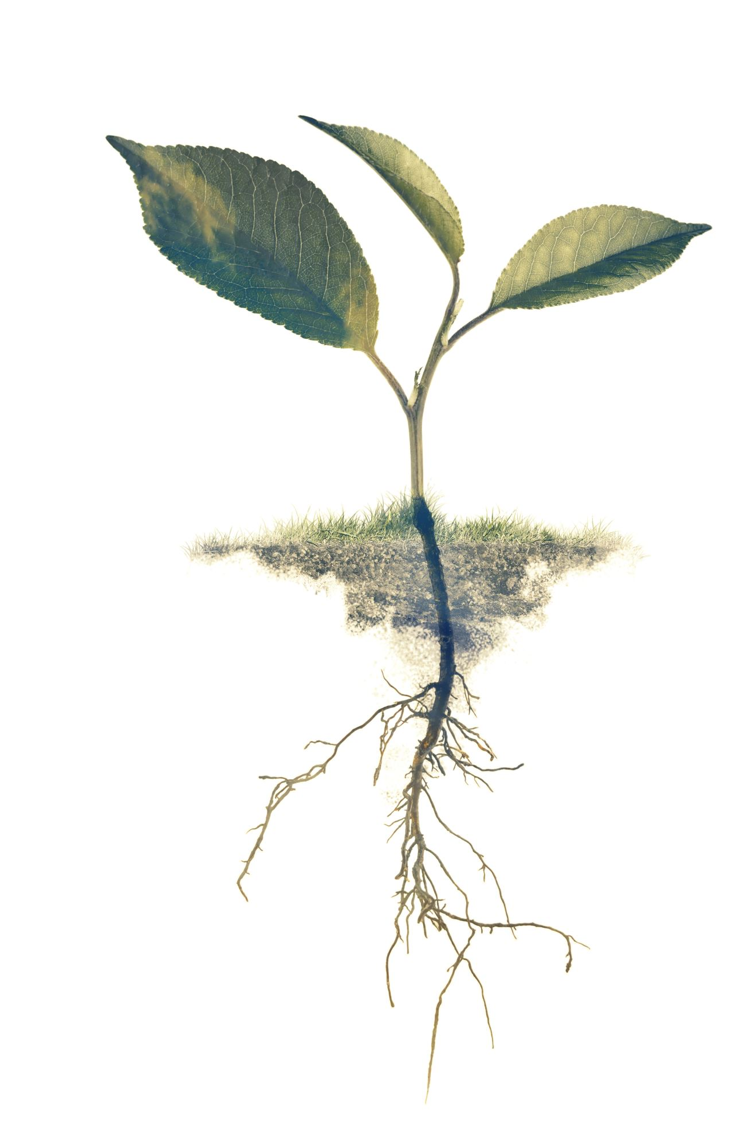
CARBON SEQUESTRATION AND SOIL HEALTH
Website
GUIDEBOOK

Slide 3
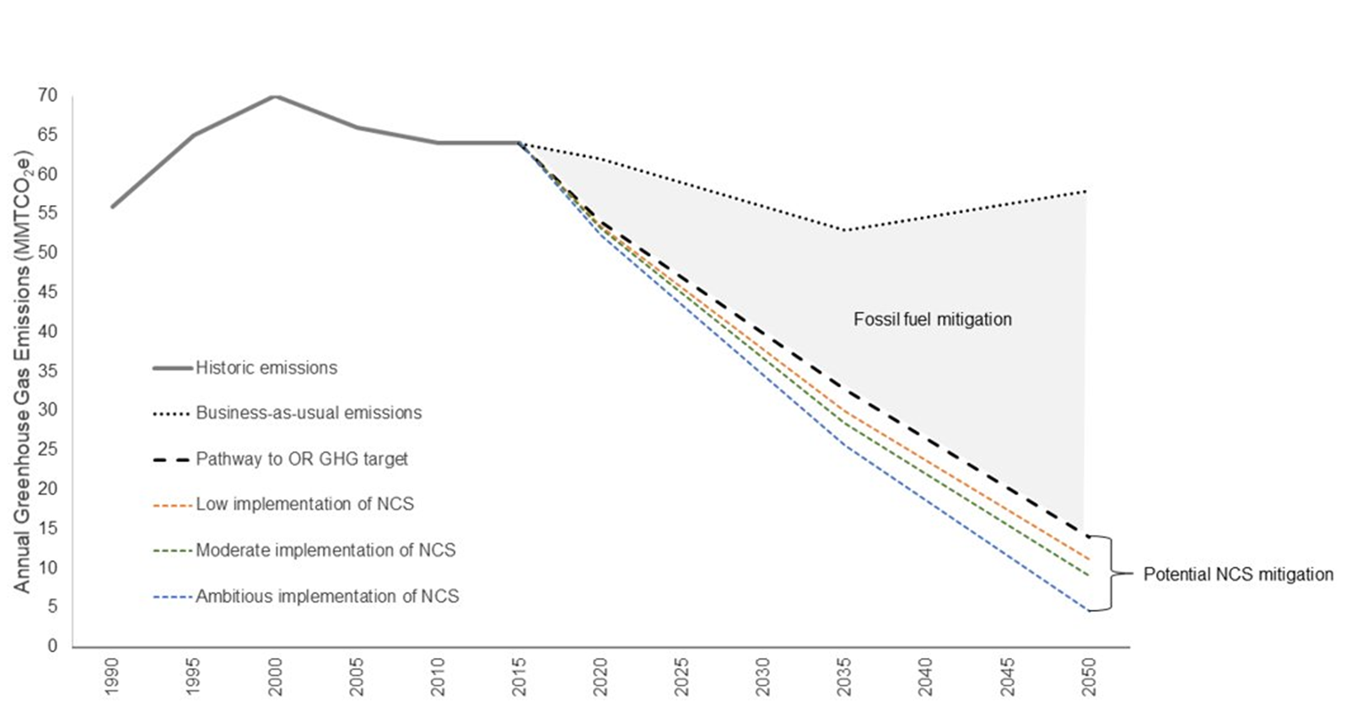
Nature can make a meaningful contribution to greenhouse gas goals in Oregon
Source: Graves et al 2020

Slide 4
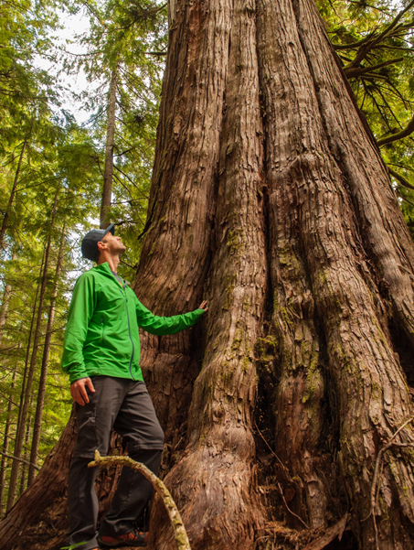
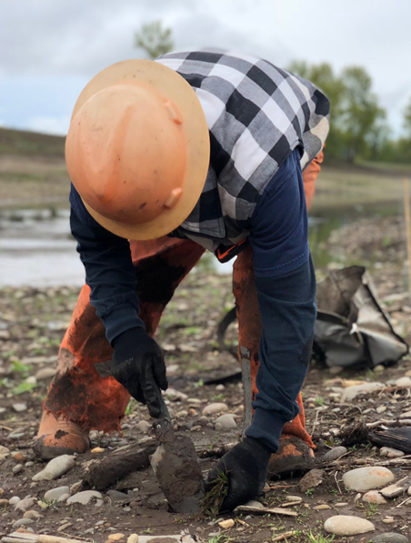
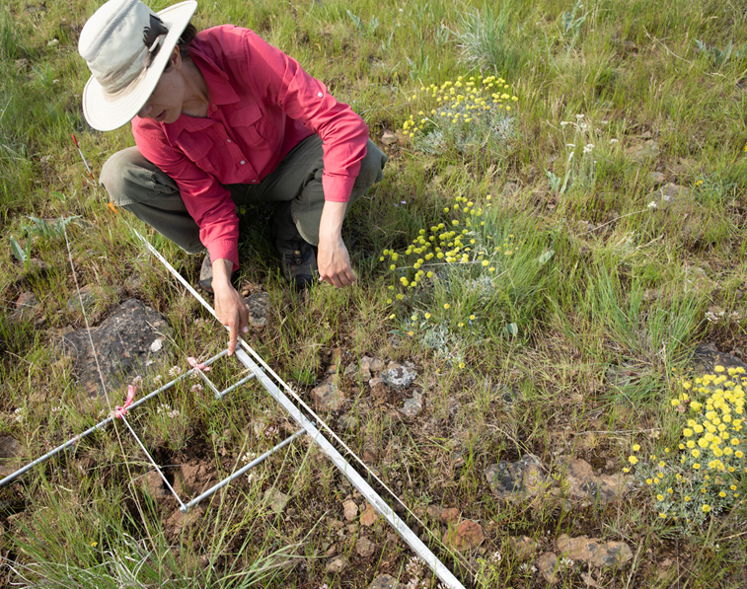
What are natural climate solutions?
PROTECT
intact ecosystems and processes
CHANGE
practices on working lands
cesses
RESTORE
native ecosystems
To increase carbon sequestration and storage while maintaining or improving and biodiversity

Slide 5
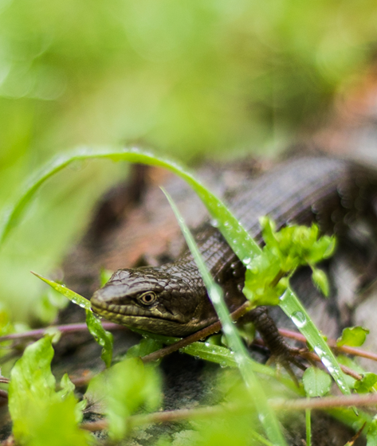
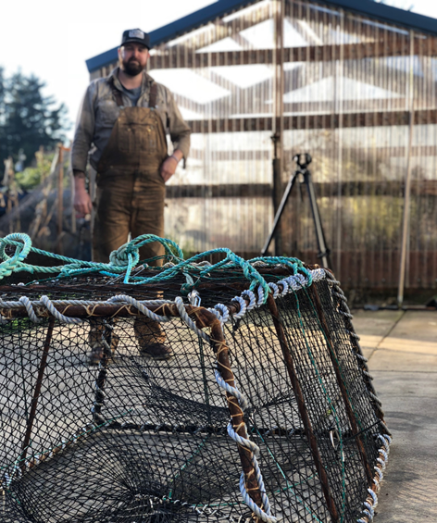
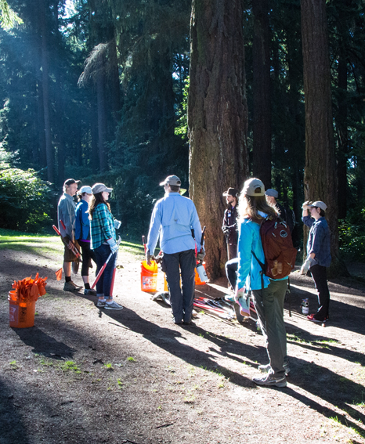
Natural climate solutions have multiple benefits
CLIMATE MITIGATION
ECOLOGICAL
ECONOMIC
SOCIETAL

Slide 6
NbS co-benefits
Co-Benefits Identified with Natural Climate Solutions
SOCIO-ECONOMICS
Improved/maintained:
Climate adaptation & mitigation
Livelihood opportunities
Human health
Agriculture/agricultural output
Religious/spiritual settings
Microclimate regulation
Food security
Recreation/tourism opportunities
Property/land value
Opportunities for education/ scientific study
BIODIVERSITY & ENVIRONMENT
Improved/maintained:
Aquatic habitat availability & quality
Terrestrial & aquatic habitat connectivity
Support for local pollinators
Natural pest control
Abundance and diversity of native plant & animal species
Improved/increased terrestrial habitat availability & quality (including soil health)
WATER QUALITY & QUANTITY
Reduced/avoided surface runoff & associated erosion
Improved/maintained:
Surface water storage
Groundwater recharge & storage
Flow regime
Flood protection and mitigation (inland & coastal)
Surface water & ground water quality
CARBON
Improved/maintained carbon sequestration
Reduced carbon emissions
Brill, Gregg, et al. (2021). Benefit Accounting of Nature-Based Solutions for Watersheds: Guide United Nations CEO Water Mandate and Pacific Institute. Oakland, California. www.ceowatermandate.org/nbs/guide (from Table 4)

Slide 7
NCS
Natural Climate Solutions (NCS)
increase carbon storage by conserving, restoring, or improving the use or management of ecosystems.
While maximizing the climate mitigation potential of nature, they also provide co-benefits including:
Improved soil
Improved air and water quality
Increased biodiversity habitat
Forests & Woodlands | Reforestation Avoided Forest & Woodland Conversion Natural Forest Management Improved Forest Plantations Deferred Timber Harvest Avoided Wood Fuel Harvest Fire Management
Agriculture | Biochar Nutrient Management Compost Amendments Cover Crops Trees in Croplands aka Agroforestry Conservation & Regenerative Agriculture Grazing: Animal Management / Legumes / Improved Feed / Optimal Intensity Improved Manure Management Improved Rice Cultivation
Grasslands & Shrublands | Grassland Restoration Avoided Grassland Conversion Sagebrush Restoration Avoided Sagebrush and Brushland Conversion
Riparian Reforestation | Interior and Coastal
Urban | Reforestation Grassland/Pollinator Restoration
Wetlands & Intertidal Zone | Avoided Coastal Wetlands Impacts/Loss Tidal Wetland Restoration & Reconnecting/Re-wetting Seagreass Restoration Avoided Seagross Loss

Slide 8
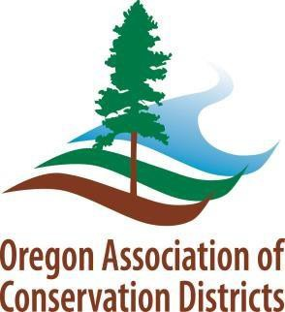
THANK YOU!
For more information, please contact:
Andrea Kreiner andrea.kreiner@oacd.org
Jan Lee janleewater@gmail.com

