Slide 1
OACD Annual Conference Jason Jeans ASTC-M&S
October 2022

Slide 2
FARM BILL TECH/ADMIN GRANTS
OWEB administered grant program to assist with delivering Farm Bill programs in Oregon
Grant provides funding for both administrative and technical staff
Period of Performance 2018 – 2023
19 Districts/2 watershed councils have been awarded
Current funding accounted for through Dec. 2023
*recipients please bill
NRCS/OWEB discussing next steps as this is a highly successful agreement
Do we extend current agreement?
What does the next iteration look like?
Notes:
These additional funds will help farmers and ranchers implement expanded conservation practices that reduce greenhouse gas emissions and increase storage of carbon in their soil and trees. The conservation funding is on top of otherwise available program funds, and the voluntary, incentive-based approach is targeted to support climate-smart agriculture mitigation and help producers build resilience in their operations.

Slide 3
NACD TECHNICAL ASSISTANCE GRANTS
2022 awarded 15M in new Tech Assistance grants
Nearly 500 conservation districts have been recipients
490 positions supported (technicians/planners/admin support)
Renewal funding period opens first each FY (typically March)
6 districts/1 tribe were awarded for renewals in FY22 here in Oregon
No new grant funding opportunity in FY22
New grant application period is posted after renewals (typically summer)
Sure to be additional funding for new applications FY23 – FY25

Slide 4
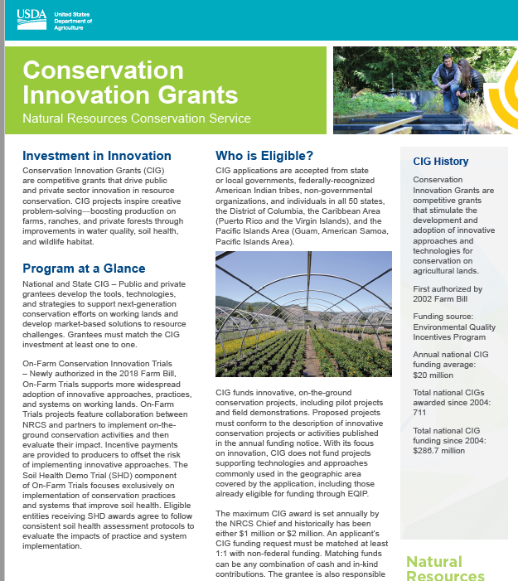
NRCS Conservation Innovation Grants
Conservation Innovation Grants (CIG) - competitive program that supports the development of new tools, approaches, practices, and technologies to further natural resource conservation on private lands. CIG partners work to address our nation's water quality, air quality, soil health and wildlife habitat challenges, all while improving agricultural operations.
Three annual CIG funding opportunities:
National CIG Classic (sign up ended Oct. 11)
State CIG Classic (typically announced March/April)
CIG On-Farm Conservation Innovation Trails (On-Farm)
Funds are awarded for single- or multi-year projects, not to exceed three years, are awarded through a nationwide competitive grants process.
https://cig.sc.egov.usda.gov/
4

Slide 5
REGIONAL CONSERVATION PARTNERSHIP PROGRAM
Partner driven – implements FB programs (planning – contracts/practices – solutions to resource concerns)
Districts are eligible lead partners
Oregon: 2015 – 2022
200 partner organizations
NRCS invested over 60M/partners 100M
200,000 acres
600 contracts
4,000 acres of restored oak woodland habitat
5,000 acres of restored wetland habitat
300,000 acres of reduced wildfire risk
23,000 acres enrolled in easements
**Want to learn more? Contact Tom Miewald, RCPP coordinator NRCS OR.

Slide 6
FY23 OR FB Program Application Batching Dates
OR FB Application Timelines
Environmental Quality Incentives Program (EQIP) - Applications due November 18th, 2022
Conservation Stewardship Program (CSP) – TBA (March 2023?)
State Conservation Innovation Grant (CIG) proposals – TBA (March/April 2023?)
National CIGs were due Oct.11, 2022
Regional Conservation Partnership Program (RCPP) – TBA (January 2023?)
Agricultural Conservation Easement Program (ACEP) – February 2023
Wetland Reserve Easements
Agricultural Land Easements
Healthy Forests Reserve Program
National and State Initiatives
TBA
Notes:
CIG is a competitive program that supports the development of new tools, approaches, practices, and technologies to further natural resource conservation on private lands. Through creative problem solving and innovation, CIG partners work to address our nation's water quality, air quality, soil health and wildlife habitat challenges, all while improving agricultural operations. More on CIG.
RCPP is a partner-driven approach to conservation that funds solutions to natural resource challenges on agricultural land. By leveraging collective resources and collaborating on common goals, RCPP demonstrates the power of public-private partnerships in delivering results for agriculture and conservation. More on RCPP.

Slide 7
In accordance with Federal civil rights law and U.S. Department of Agriculture (USDA) civil rights regulations and policies, the USDA, its Agencies, offices, and employees, and institutions participating in or administering USDA programs are prohibited from discriminating based on race, color, national origin, religion, sex, gender identity (including gender expression), sexual orientation, disability, age, marital status, family/parental status, income derived from a public assistance program, political beliefs, or reprisal or retaliation for prior civil rights activity, in any program or activity conducted or funded by USDA (not all bases apply to all programs). Remedies and complaint filing deadlines vary by program or incident. Persons with disabilities who require alternative means of communication for program information (e.g., Braille, large print, audiotape, American Sign Language, etc.) should contact the responsible Agency or USDA’s TARGET Center at (202) 720-2600 (voice and TTY) or contact USDA through the Federal Relay Service at (800) 877-8339. Additionally, program information may be made available in languages other than English. To file a program discrimination complaint, complete the USDA Program Discrimination Complaint Form, AD-3027, found online at http://www.ascr.usda.gov/complaint_filing_cust.html and at any USDA office or write a letter addressed to USDA and provide in the letter all of the information requested in the form. To request a copy of the complaint form, call (866) 632-9992. Submit your completed form or letter to USDA by: (1) mail: U.S. Department of Agriculture Office of the Assistant Secretary for Civil Rights 1400 Independence Avenue, SW Washington, D.C. 20250-9410; (2) fax: (202) 690-7442; or (3) email: program.intake@usda.gov. USDA is an equal opportunity provider, employer, and lender

