Slide 1
OACD Annual Report
October 16, 2023

Slide 2
Accomplishments 2022-2023
Advocacy – successful 2023 legislative session
Wildlife Habitat Tax Credit
Juniper removal
$10 million for natural climate solution
Served on Oregon Global Warming Commission’s advisory committee on agricultural conservation and sequestration
Carbon Sequestration and Soil Health Website and Guidebook
Building Partnerships
Hired new Executive Director

Slide 3
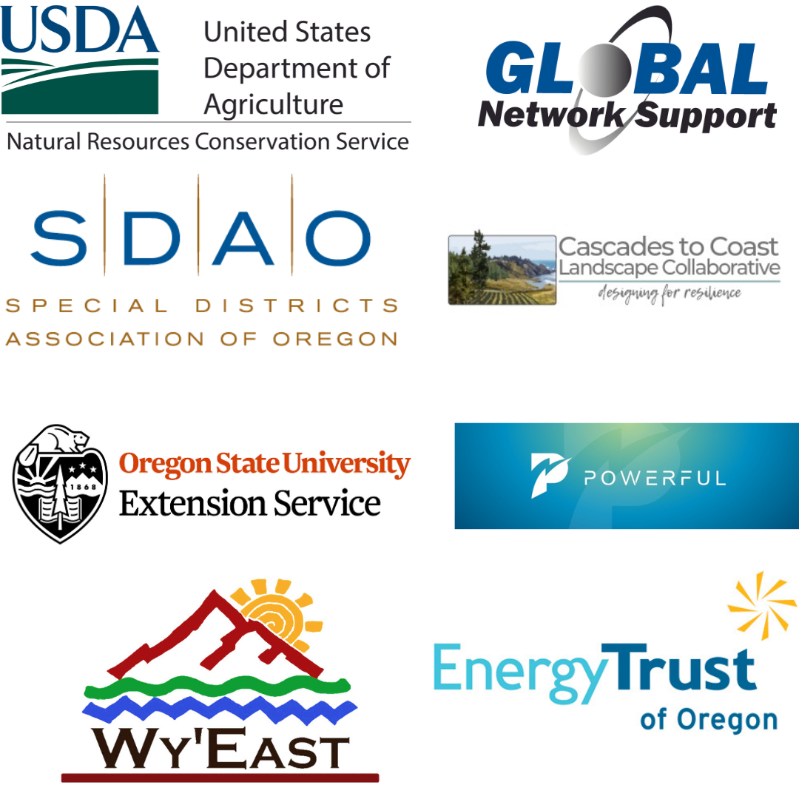
Annual Conference Sponsors

Slide 4
Looking Ahead
Member Engagement
Implementing Natural Climate Solutions Legislation
Providing Information
Managing the Oregon Conservation Partnership Grant

Slide 5
Oregon Conservation Partnership OACD, COLT, NOWC, OCEAN
Webinars
Legislative Tours
Communicating Successes
Agency Engagement
2024-2025 Biennium
Grant Hub
“Plug and Play” Guide

