Slide 1
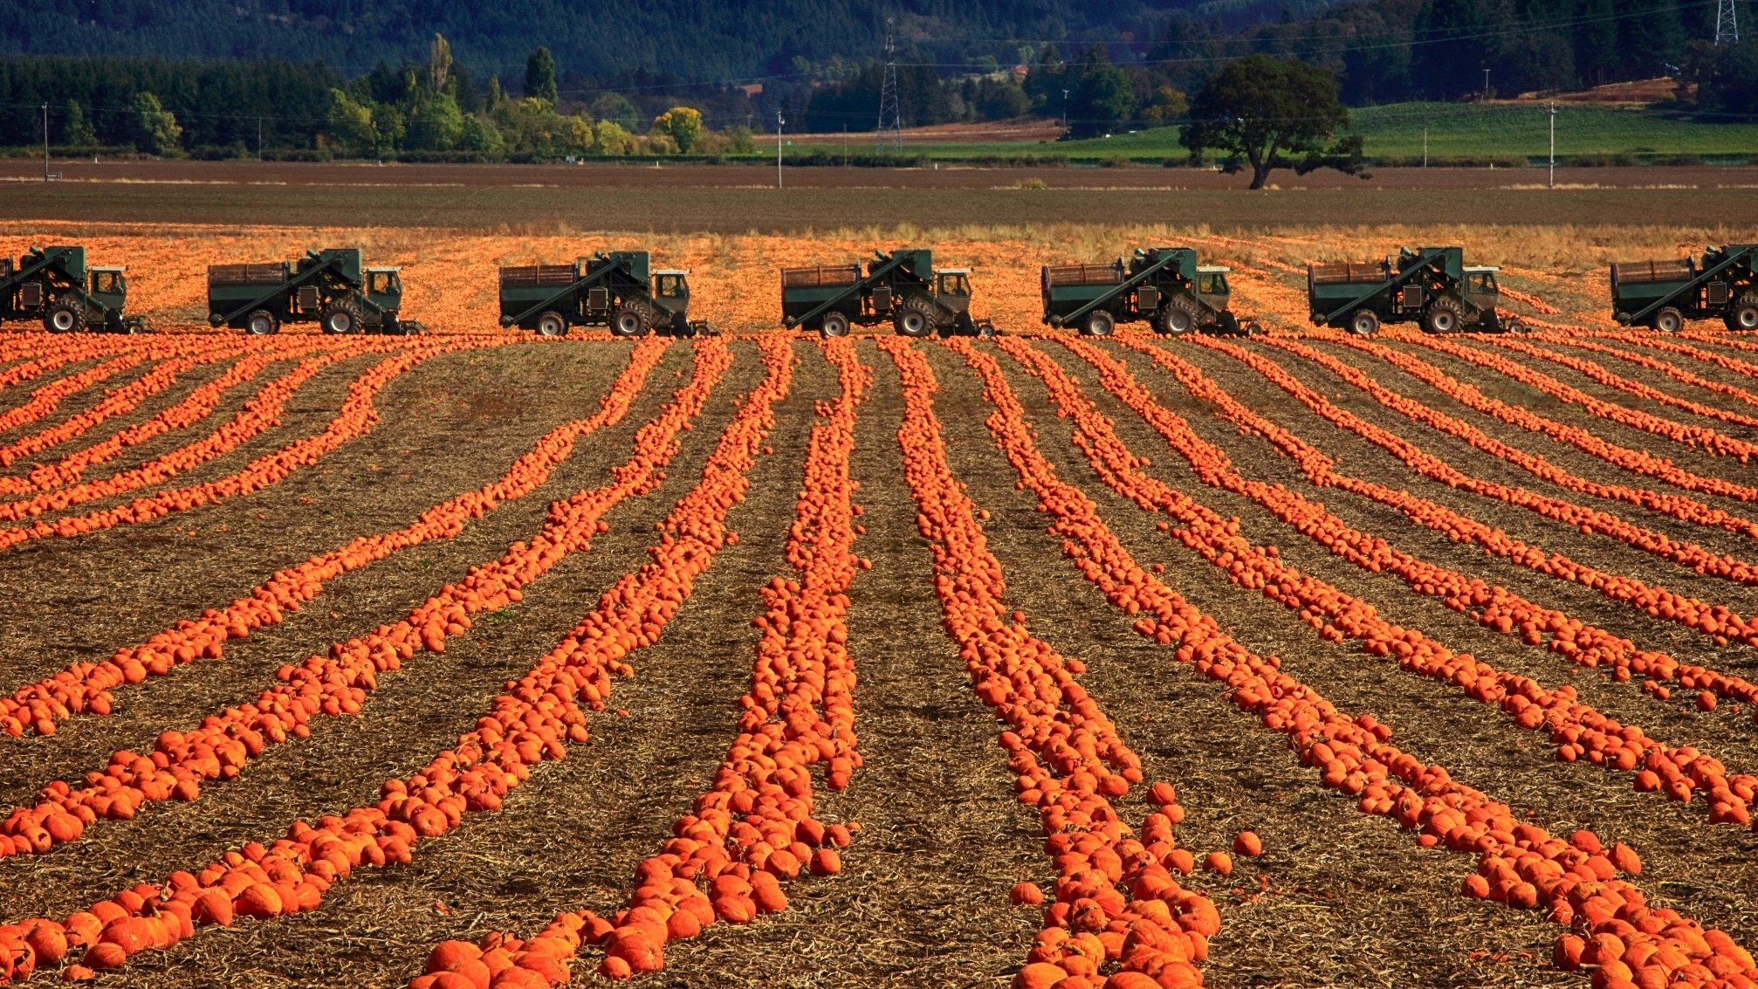
Oregon Agricultural Trust
Nellie McAdams
Oregon Agricultural Trust Manager
Columbia Land Trust

Slide 2
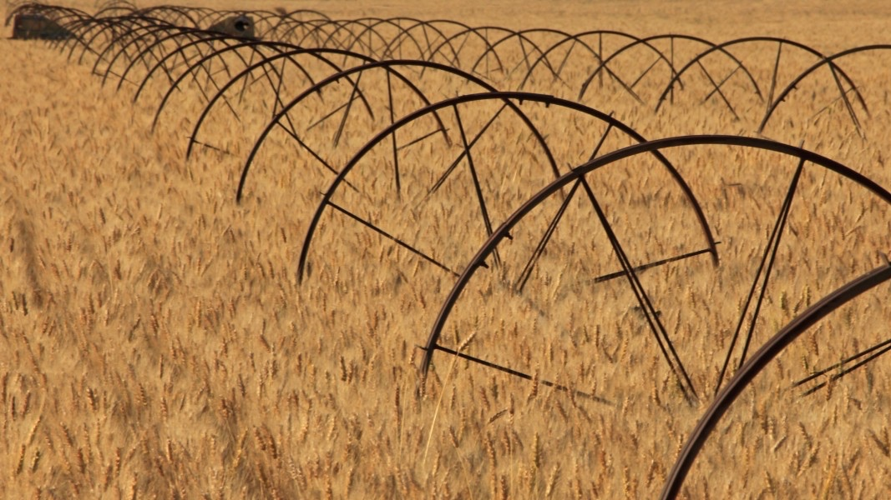
58
81
340,000
Average Age
% Without Succession Plan
Acres Lost

Slide 3
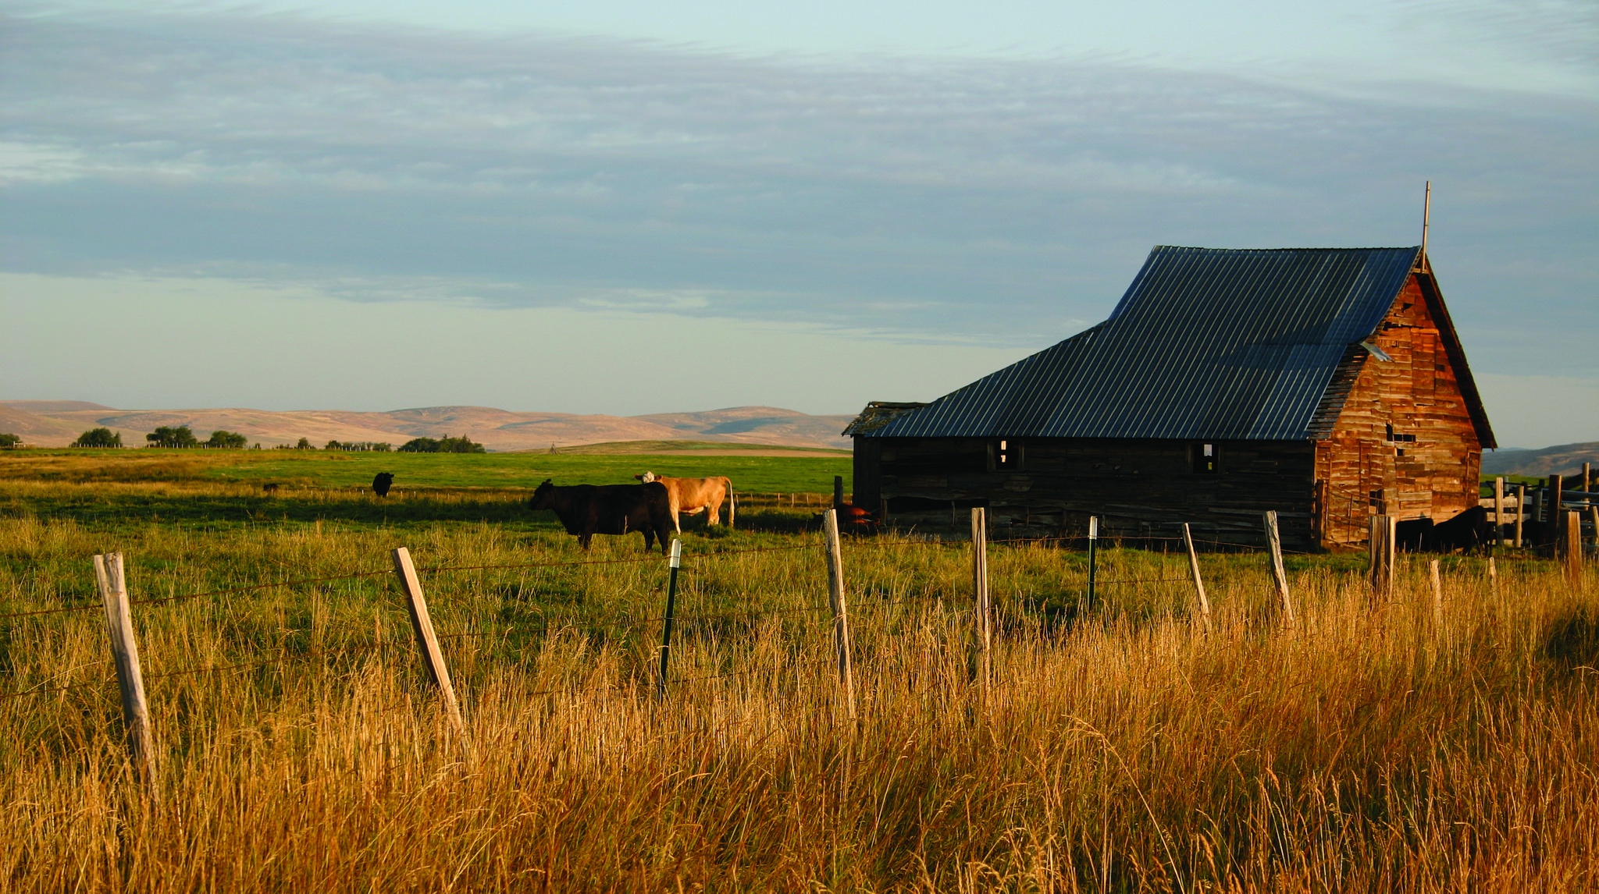
More Fragmented
Into Parcels
Not planning
leads to Fragmentation & Consolidation
Converted to
Non-Farm Uses
Harder for Beginning Farmers
Notes:
Farmers and their family will often sell land to split up the assets and pay taxes
We have a great land use system in Oregon, but it’s not bullet-proof
Half a million acres taken out of production since 1974,
64,000 taken out of EFU zoning.
Death by 1,000 cuts due to parcelization and non-farm uses
Shadow development - land becomes less viable from planners’ perspective, and more likely to be zoned for development in the future.
Fragmentation different in different parts of state – 160 or 320 acres in E OR
BFR - Parcels are harder to make a living on, and it’s hard to buy into consolidated land

Slide 4
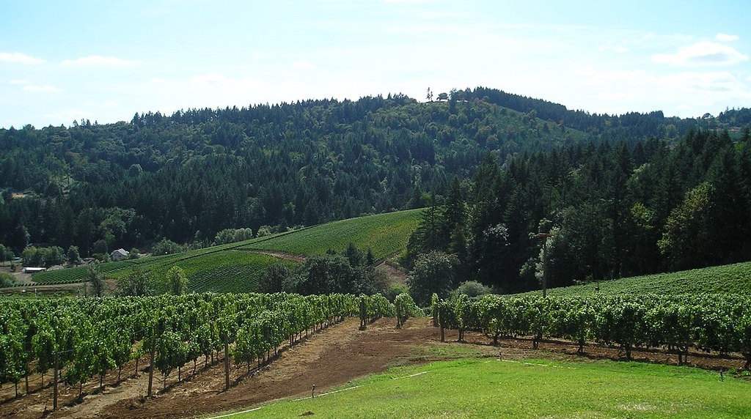
A conservation easement is a
voluntary legal agreement
between a landowner and land trust or government agency that
permanently limits use of the land (covenants are temporary)
to protect specific conservation values, including agriculture
Easements & Covenants
Notes:
Voluntary is key
Easement holders strongly encourage landowners to work witht an attorney
Public access is entirely up to the landowner
Easements and covenants do not grant public ownership of private lands. Funds are used to purchase only certain development rights, not the whole property
Dylan

Slide 5
How does a Conservation Easement Work?
Land ownership has certain rights associated with it.
Property Rights
In an conservation easement, a landowner voluntarily sells or donates some of the sticks or rights
Post-easement Property Rights (including ownership and right to sell)
Conservation Easement
Notes:
For example, a landowner may restrict or limit the rights to develop a property for commercial, industrial, or multi-residential purposes while retaining rights to use the land for grazing, farming, harvesting of timber, recreation, or for residences for the owner’s family. These rights you relinquish can be either sold or donated. The landowner still owns the property and retains the right to sell or lease the land and to pass it on to your heirs.
Once sticks are removed, they cannot be put back.
.

Slide 6
Appraisals
Valuation “before and after” analysis
$1,000,000 value of property as is
- $600,000 value of property encumbered by easement
$400,000 value of conservation easement
$1,000,000
$400,000
Easement value
$600,000
$600,000
Remaining property
value
Value “as-is”
Value after easement
Total assets with easement
Both for purchases and donations
Notes:
Value is determined by calculating the difference between the value of the property today without (or “before”) the imposition of the easement and the value of the property today subject to (or after) the imposition of the easement. This latter value is determined by the nature of the restrictions and their impact on potential uses. The resulting amount is the value of the easement.

Slide 7
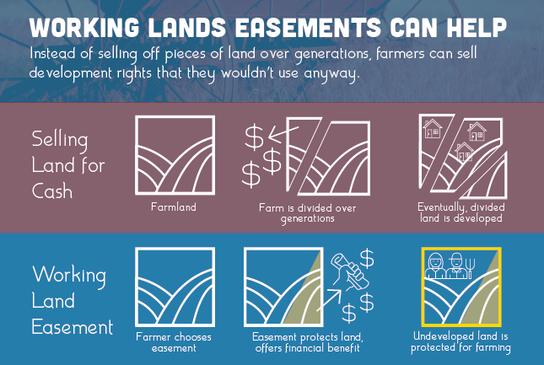

Slide 8
Why Convey an Easement?
Philosophical Reasons
Keep land permanently available for agriculture
Protect from subdivision and development
Conservation objectives
Notes:
Protect the resources on the property by controlling future uses. SLIDE For some families, one of the major advantage of CE is that it helps pass land on to the next generation, by reducing estate taxes. Estate taxes can lead to the land being broken up or sold off. Changes to the tax code that were made permanent in 2014, raised the threshold for estate taxes to $5 million (indexed to inflation). As of 2016, estates of $5.45 million or more are subject to estate taxes of 40%. Oregon also imposes an inheritance tax on estates that are greater than $1 million.

Slide 9
Why Convey an Easement?
Estate Planning
Liquify some assets to help divide the estate
Cash for attorney fees and estate taxes
Affordability for future generations
Notes:
Protect the resources on the property by controlling future uses. SLIDE For some families, one of the major advantage of CE is that it helps pass land on to the next generation, by reducing estate taxes. Estate taxes can lead to the land being broken up or sold off. Changes to the tax code that were made permanent in 2014, raised the threshold for estate taxes to $5 million (indexed to inflation). As of 2016, estates of $5.45 million or more are subject to estate taxes of 40%. Oregon also imposes an inheritance tax on estates that are greater than $1 million.

Slide 10
Why Convey an Easement?
Financial Considerations
Convert real estate to cash without losing ownership
Income and estate tax deduction (for donation)
Reduces size of estate for tax purposes
Notes:
Protect the resources on the property by controlling future uses. SLIDE For some families, one of the major advantage of CE is that it helps pass land on to the next generation, by reducing estate taxes. Estate taxes can lead to the land being broken up or sold off. Changes to the tax code that were made permanent in 2014, raised the threshold for estate taxes to $5 million (indexed to inflation). As of 2016, estates of $5.45 million or more are subject to estate taxes of 40%. Oregon also imposes an inheritance tax on estates that are greater than $1 million.

Slide 11
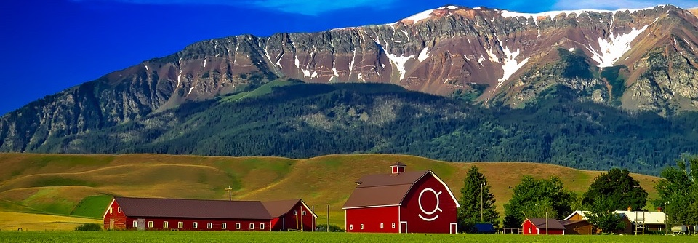
Funding Sources
ACEP-ALE
Agricultural Conservation Easement Program – Agricultural Land Easements
Natural Resources Conservation Service
Up to 50% of easement value in most cases
75% in ”Grasslands of Special Environmental Significance”
$450 million / year in 2018 Farm Bill

Slide 12
Funding Sources
ACEP-ALE
Up to 25%
Landowner Donation
Up to 50%
Federal $
(ACEP-ALE)
At least 25%
Non-federal $

Slide 13
Funding Sources
Oregon Agricultural Heritage Program (OAHP)
Up to 75% match
Designed to integrate with ACEP-ALE
UNFUNDED
28 states with funded match programs have leveraged 3.7 times more federal dollars than those without

Slide 14
Delaware has received more than 10x as much funding as Oregon
Notes:
As of 2016, DE had received $58,071,501 in ACEP-ALE Funds. Oregon had received $5,305,724

Slide 15
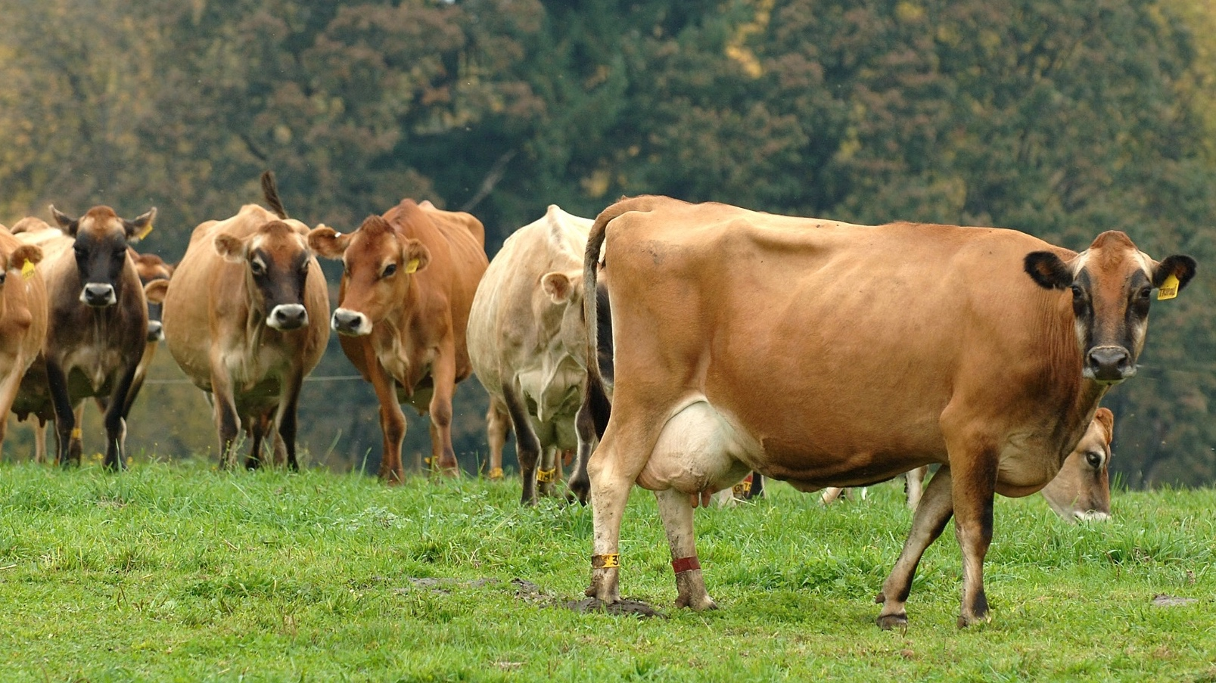
Oregon Agricultural Trust
(OAT)
New, statewide land trust that only preserves ag land
Launching in January, 2020
Salem office with Marion SWCD & OACD

Slide 16
Oregon Agricultural Trust
(OAT)
Hold ag easements where there are gaps
TA for orgs that want to preserve ag land
Educate farmers and public about easements & land loss
Advocacy, e.g. for OAHP

Slide 17
Oregon Agricultural Trust
Nellie McAdams
Oregon Agricultural Trust Manager
Columbia Land Trust

