Slide 1
2023
Legislative Session
Update
October 2023| OACD Conference
Item D
Notes:
Intros.
Here with OWEB Grant Program Manager Eric Williams to discuss proposed revisions to OWEB Grant Program ‘Division 5’ Administrative Rules

Slide 2
Budget Overview
No cuts to Current Service Level
Organization structure improvements
Fire and Drought GF re-allocation – grants and staff
Several federally funded positions
Continues OAHP and Water Acquisition positions
No new grant funding for OAHP
Sunrise Mount Hood -flickr ilirjan rrumbullaku, cc

Slide 3
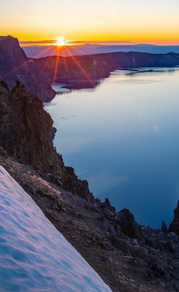
Water Package (HB 2010/5030)
OWEB to administer Community Drinking Water Enhancement and Protection Fund
$5 million grant program
$1 million General Fund
$4 million Lottery Bond
Requires OWEB rulemaking to develop grant program
Legislation includes a position for OWEB to administer the grant program
Oregon Integrated Water Resource Strategy
Adding OWEB to agencies that OWRD will work with in developing strategy
Legislation includes funding for additional capacity for OWEB to fully engage
Sunrise Crater Lake CEB Imagery, cc
Notes:
Purpose of the program is to provide grants to water suppliers to protect, restore, or enhance sources of drinking water
OWRD work in ‘close cooperation’ with OWEB to develop IWRS

Slide 4
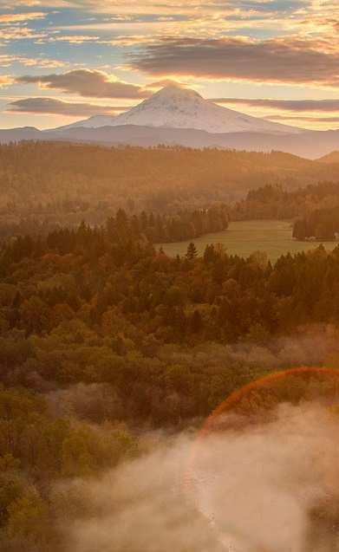
Climate Package (HB 3409)
Changes name of Oregon Global Warming Commission to Oregon Climate Action Commission
Adds Director of OWEB as nonvoting member
Natural and Working Lands Fund
Supports natural climate solutions
Initial $10 million General Fund appropriation, OWEB as fiscal agent
OWEB one of four agencies to work with Commission to develop programs related to natural climate solutions
Funding transferred to support those programs
Legislation includes position for OWEB to support fund administration
Sunrise Mount Hood -flickr ilirjan rrumbullaku, cc

