Slide 1
Working with OACD and the Legislature November 10, 2021
Oregon Association of Conservation Districts

Slide 2
Topics for Today
Working with OACD on Advancing Legislation
Getting to Know your Legislators
Preparing Your District
(Focus is on Oregon Legislation, but much is applicable to state rule making and Federal actions)

Slide 3
Bringing the Issues to OACD
Legislative or Rulemaking Issues Submittal Form (posted on OACD web site)
Sent out to all Districts about 6 months before long legislative session
Can be used at any time
Can always just talk with OACD

Slide 4
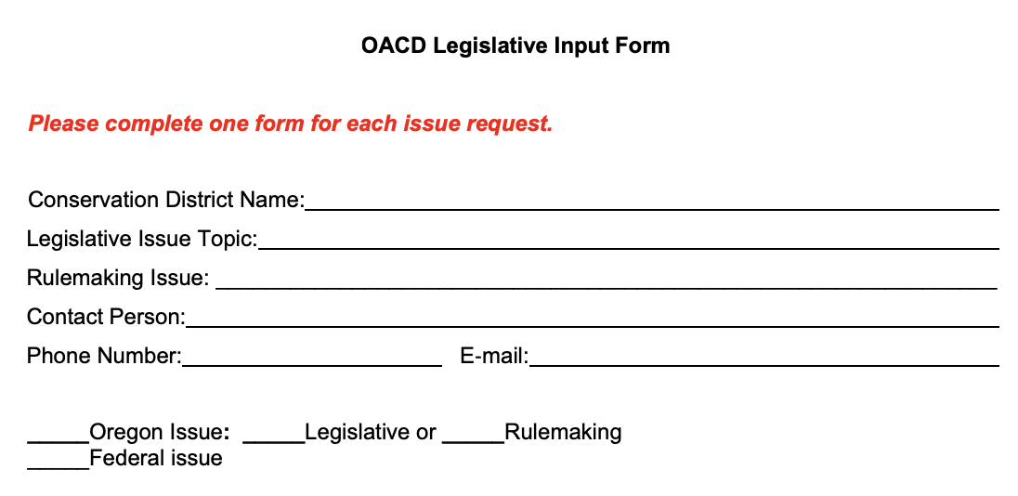
Issues Submittal form

Slide 5
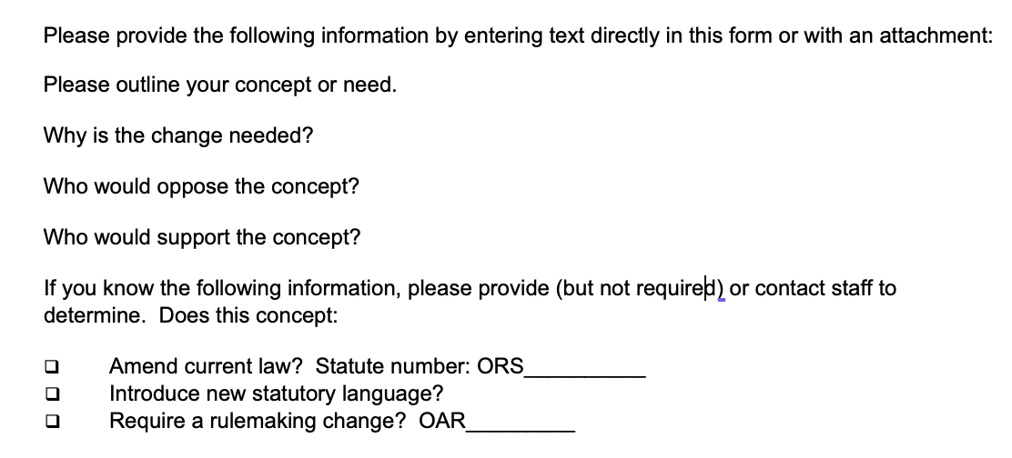
Issues Submittal Form

Slide 6
Working with OACD
Write up available on the OACD web site
OACD is here to work with you, and can bring:
Expertise
Resources
Connections
Strength in Numbers

Slide 7
Define the “Ask”
Consider:
Urgency
Effort
Likelihood of Success
Unintended Consequences
Allies and Opponents
Relevance to OACD
What’s the problem?
What are the alternatives?
Do nothing
Rulemaking
Legislation

Slide 8
Make a Plan
Who’s on the team? (OACD, SWCDs, key partners)
Who’s doing what? (roles and responsibilities)
Securing legislative sponsors
Creating broad support
Pathways through the legislature
Schedule and timing

Slide 9
Prepare Communication Materials
Flyers
Issue Papers
Case Studies
Must communicate what
needs to be changed and why

Slide 10
Engage!
Securing the sponsors
Meetings with legislators, partners and stakeholders
Preparation of the legislative concept / draft legislation
Testimony
Communications

Slide 11
Get to Know Your Legislators
Write up available on the OACD web site
Do it if you want to be effective!

Slide 12
Who Are Your Legislators?
Check district boundaries (Oregon Secretary of State)
Who is in each district? (Oregon Legislative Information System – OLIS)
OACD has a list for each District, but it may become outdated

Slide 13
What are They About?
Each legislator has a web page on OLIS and usually links to other online forums
Check out their biographies, priorities and interests, committees they serve upon, and legislation they have sponsored
Sign up for newsletters and e-mail updates

Slide 14
Engage!
Hold a “meet and greet”
Attend town halls
Invite to District events
Attend committee meetings
Support the legislation you like

Slide 15
Preparing your District
Model Advocacy policy available
on the OACD web site
Make sure you district is aligned,
nimble, and quick!
Alignment on Positions
Advocacy Policies
Delegated Authority

Slide 16
Position Statements
Reflect the positions of Soil & Water Conservation Districts on conservation of natural resources
OACD Position Statements
Develop your Own
Voluntary Conservation:
OACD supports the use of voluntary conservation as an approach to conserving natural resources.

Slide 17
OACD Model Advocacy Policy
Intended to be adopted by SWCDs to streamline advocacy efforts
Divides advocacy into three categories
Political campaigning
Lobbying
Other
Do’s and Don’ts
Streamlined Version Now Available

Slide 18
Delegation of Authority
Who can speak on behalf of the District
What positions can they take
How should they communicate back to the District
Actions in legislative proceedings can happen quickly.
Often can’t wait for next SWCD Board meeting.

Slide 19
Thank you – Questions?
Contact us!
Jan Lee, Executive Director for OACD
503.545.9420 (cell) jan.lee@oacd.org
Stan Dean, Advocacy Committee Chair
530.902.7415 (cell) stan.dean@jswcd.org

