Slide 1
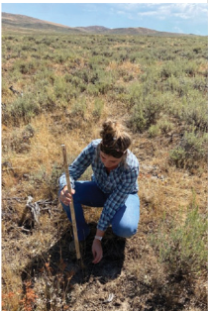
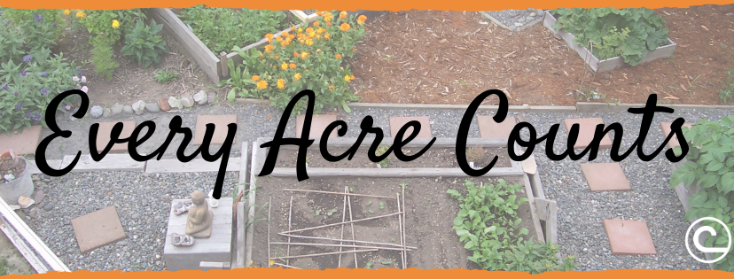
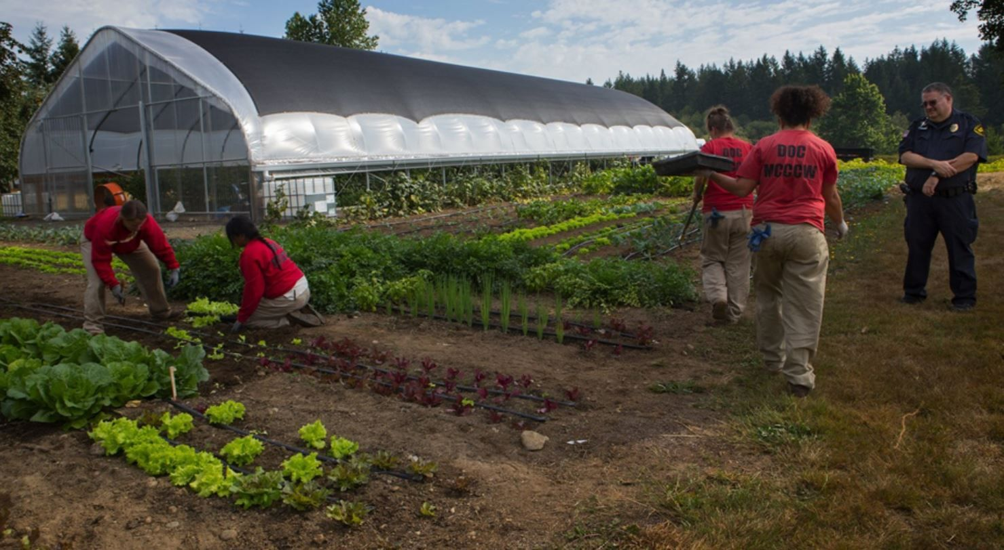
Funding Services & Resources
Technical Assistance Grants – Provide “Boots on the Ground” funding for districts to hire staff to deliver customer technical and conservation programs assistance in partnership w/ local NRCS teams. >$9M to Pacific Region since 2020
Urban & Community Agriculture Conservation Grants – Provide technical assistance on urban and small-scale conservation projects to address community needs in both rural and urban contexts. >$1.25M to Pacific Region since 2020
Notes:
https://www.nacdnet.org/technical-assistance-grants/
https://www.nacdnet.org/about-nacd/what-we-do/urban-and-community/

Slide 2
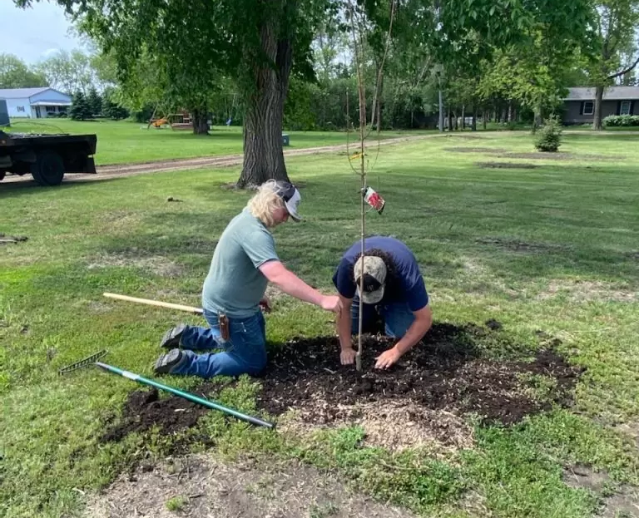
Funding Services & Resources, continued
Friends of NACD Grants – Provide up to $2500 for conservation districts to conduct new activated or test novel approaches to their operations. Program entirely funded through donations to Friends of NACD. >$20,000 awarded to districts nationwide since 2020
On the Horizon:
Climate Smart Commodities Program – Funding initiative to support climate resilience in commodity production systems, with a focus on carbon emissions reduction and storage. Anticipated RFP in Spring of 2024; call for concept papers closed October 13th.
Feral Swine Perimeter Fencing Program – Sponsors perimeter fencing projects to protect resources from feral swine impacts, based on population density thresholds. First funding cycle in progress; applications closed October 13th.
Notes:
https://www.nacdnet.org/get-involved/friends-of-nacd/friends-of-nacd-district-grants-program/
https://www.nacdnet.org/about-nacd/what-we-do/climate-smart-commodities-project/

Slide 3
UPCOMING NACD EVENTS:
NACD 2024 Annual Meeting – San Diego, CA on February 10th-14th, 2024 Registration is Open Now and Room Reservations are available at the discounted rate through January 19, 2024
NACD 2024 DC Fly-In Event – Washington, D.C. in ~mid-March, 2024
NACD 2024 Summer Meeting – Boston, MA in July, 2024
NACD 2024 Joint Region Meeting – Anchorage, AK in August/September, 2024

Slide 4
NACD and Oregon’s Conservation Districts: Investing in Each Other
3 YR Return On Investment: 22.99 $/$
Over the last three years, for each dollar OR conservation districts have invested in NACD, NACD has invested ~$23 in grant funds back into OR’s districts.
Notes:
These amazing contributions have supported our ability to serve districts throughout OR and the region, and we thank you for your investment in NACD!
Your awareness of and access to NACD’s district resources and opportunities is Caleb’s priority. He is excited and eager to support your district’s efforts in locally led conservation.
Please don’t hesitate to reach out to him for assistance!

