Slide 1
OACD 2022:
Water Quality Panel
Marganne Allen, ODA Ag WQ/SWCD Program Manager
Ken Baily, Wasco SWCD, SWCC, Ag WQ AC
Karin Stutzman, ODA SWCD Program Lead

Slide 2
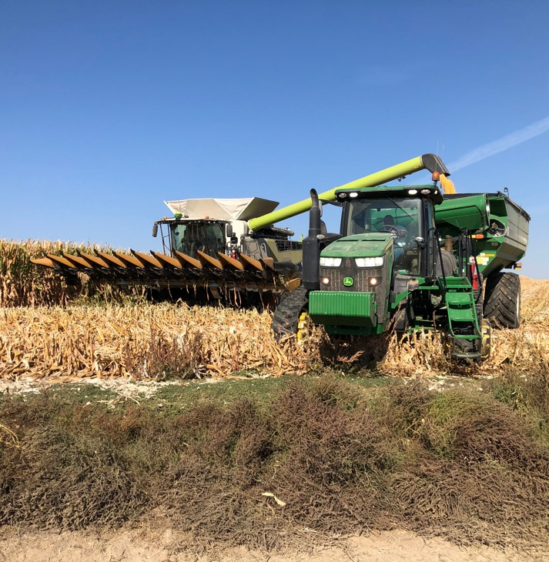
Outline
ODA Ag WQ Program Influences (Marganne)
ODA Ag WQ Grant (Karin)
SWCD Perspective (Ken)
Group discussion

Slide 3
ODA Ag WQ Program Influences
ODA-DEQ Memorandum of Agreement Update
Emerging/sleeper issue: Groundwater quality

Slide 4
ODA-DEQ Memorandum: Background
Original MOA – 2012
  Focus: Biennial reviews, program effectiveness
2018 renewal without changes
2022 Draft
  Update, reflect current programs
  @ November Board of Ag, EQC
  Goal: Signature in December 2022

Slide 5
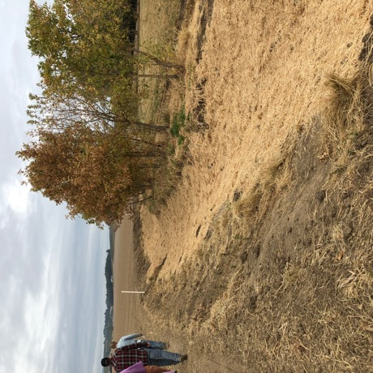
Draft MOA content
TMDL roles, responsibilities
Updated
  Compliance and enforcement
  SIAs
Also
  Progress and adaptive management
  TMDL Implementation plans and Ag WQ Management plans

Slide 6
Draft MOA content, con’t
Commitment
  Seek methods, capacity for monitoring
  Evaluating implementation, effectiveness
Accountability and transparency
  Reporting to EQC and the Board of Agriculture

Slide 7
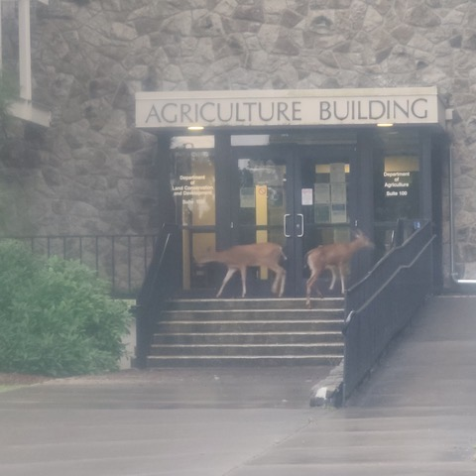
MOA does not…
Add new authority
Change Ag WQ program out of the gate

Slide 8
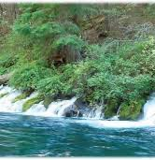
Groundwater
Emerging/sleeper issue

Slide 9
Lower Umatilla Basin GWMA
Groundwater Management Area
Issue: Nitrate contamination
Long term (~30 years)
Complex
New
  EPA Petition (drinking water, CAFOs)
  County drinking water emergency declaration
  Recent DEQ enforcement
  Highlight on irrigated agriculture

Slide 10
Potential Affect on SWCDs?
No change: SWCDs = ODA Ag WQ voluntary program
Indirect - Increased transparency
  Monitoring
  Assessment and reporting
  Success of implementation, effectiveness
Expanding expectations
  From surface to groundwater

Slide 11
ODA Ag WQ Grant
(Karin Stutzman)

