Slide 1
ODFW Update: Habitat Division Activities of Interest Davia Palmeri, Acting Land Program Manager Sarah Reif, Habitat Division Administrator

Slide 2
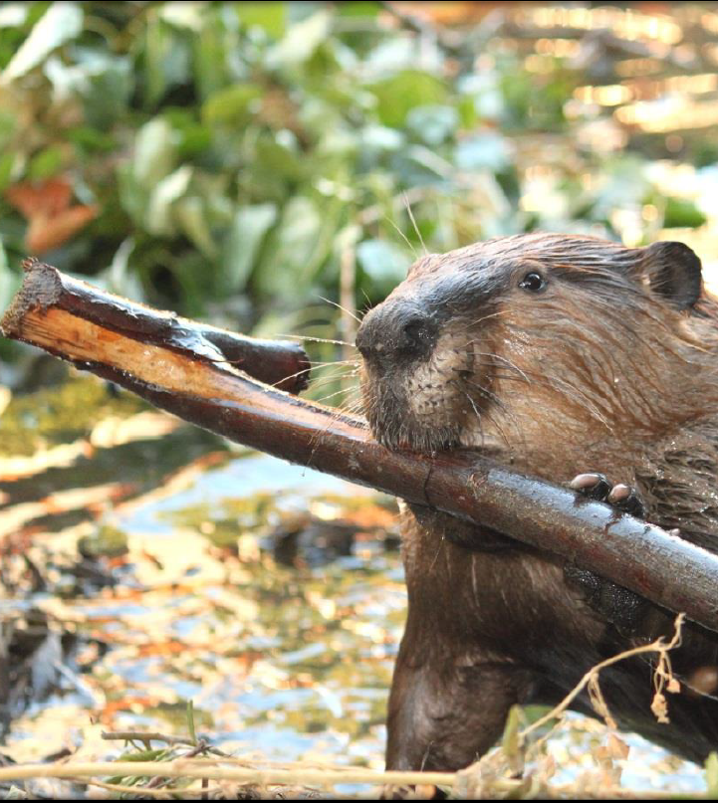
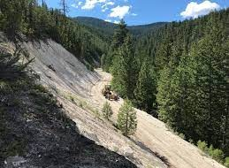
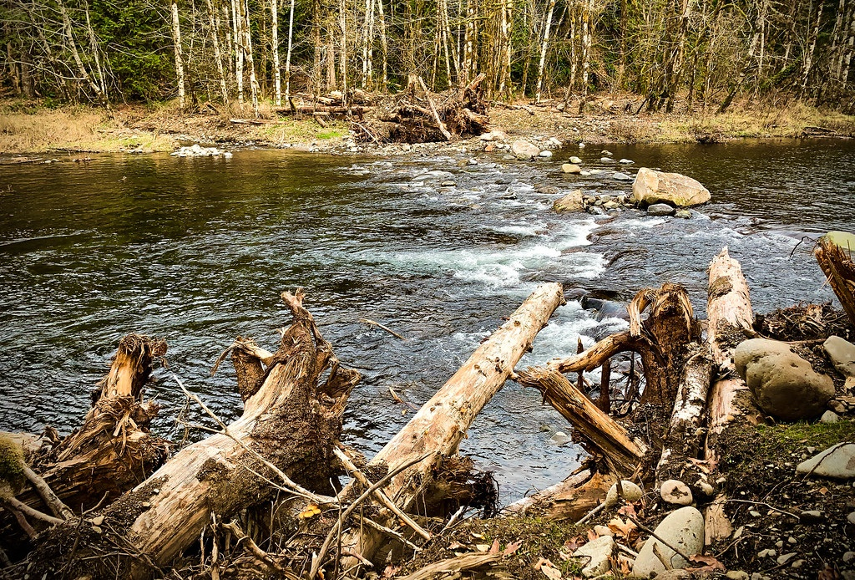
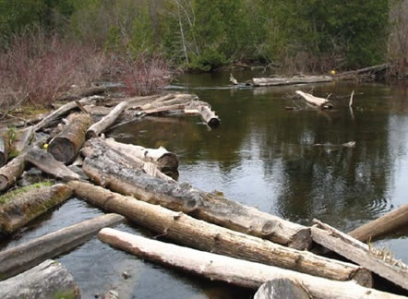
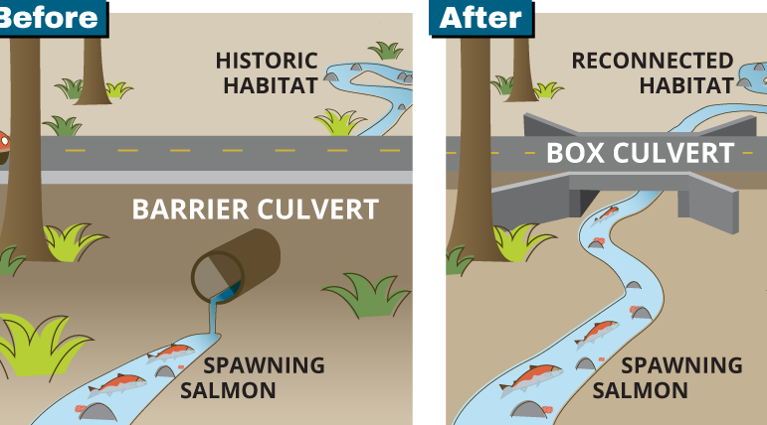
Private Forest Accord Grant Program opens in November
$10 million in funding available for projects affecting covered species
OACD Webinar in November
Contact Andy Spyrka to RSVP andrew.j.spyrka@odfw.oregon.gov

Slide 3
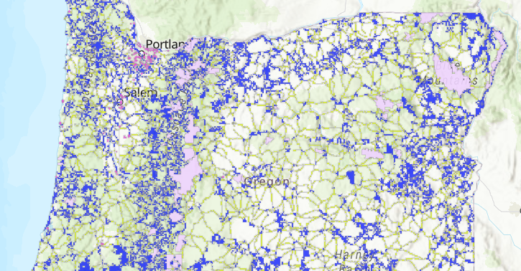
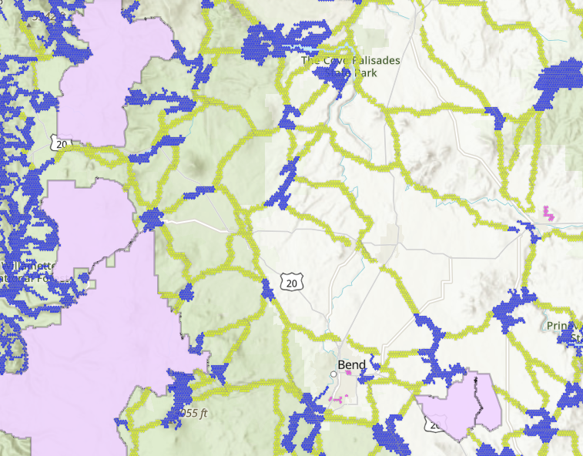
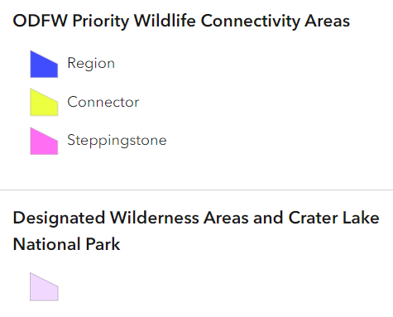
ODFW Wildlife Connectivity Coordinator Rachel.E.WHEAT@odfw.oregon.gov
https://oregonconservationstrategy.org/success-story/priority-wildlife-connectivity-areas-pwcas/

Slide 4
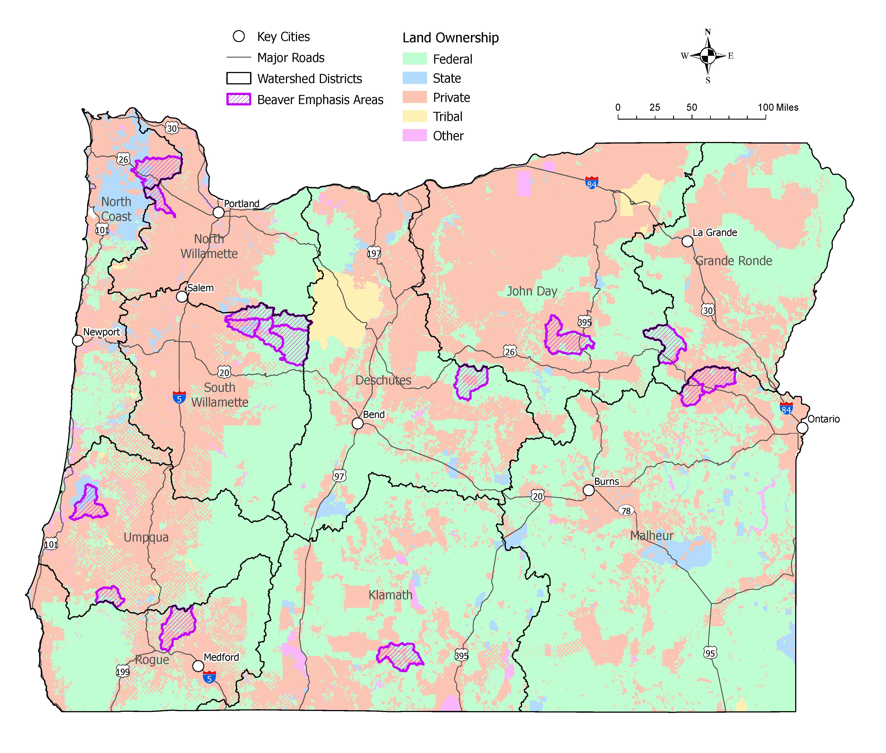
ODFW 3-Year Action Plan for Beaver-Modified Landscapes
Nehalem River Headwaters BEA
Gales Creek BEA
Goal: Accelerate the restoration of beaver habitat and beaver-modified habitat at the landscape-scale in Oregon.
Breitenbush & North Santiam River BEA
Cottonwood -Fox Creek BEA
North Fork Burnt River BEA
Upper North Fork Crooked River BEA
Middle & Upper Willow Creek BEA
Millicoma River & West Fork Cow Creek BEA
Evans
Creek BEA
Beaver Action Plan Coordinator
adrienne.w.averett@odfw.oregon.gov
South Fork Sprague River BEA

Slide 5
Revise the WHCMP OARs, program materials, and program process by June 30 Pilot two properties through the new process by end of 2024
Revise OARs by June 30
Revise materials and forms by June 30
Revise website and other comms by June 30
Recruit cooperating agency and pilot the new program with two properties by end of 2024
Re-assess and fully document existing properties in the program by mid-2025
Go fully live with new enrollments by mid-2025

Slide 6
Revising OARs to Add Priorities, Refine Monitoring
October
Final scoping of priorities and monitoring
November
Draft rules completed and initial draft circulated
December & January
Request for public feedback
February
Notice of proposed rulemaking
March
Public comment period
April 2024
Commission rulemaking

Slide 7
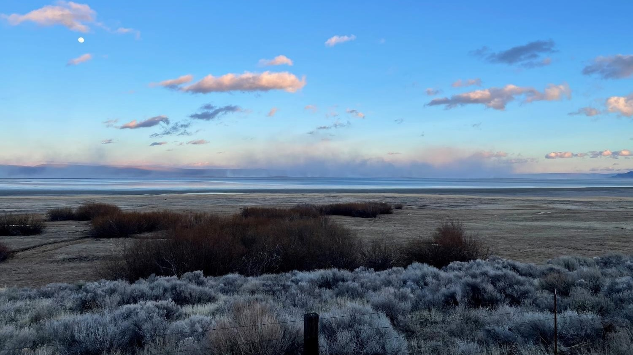
Thanks for your time! Davia Palmeri, Acting Land Program Manager davia.m.palmeri@odfw.Oregon.gov Sarah Reif, Habitat Division Administrator sarah.j.reif@odfw.Oregon.gov

