Slide 1
Klamath SWCD
Distinguished District of the Year Award
Oregon Department of Agriculture

Slide 8
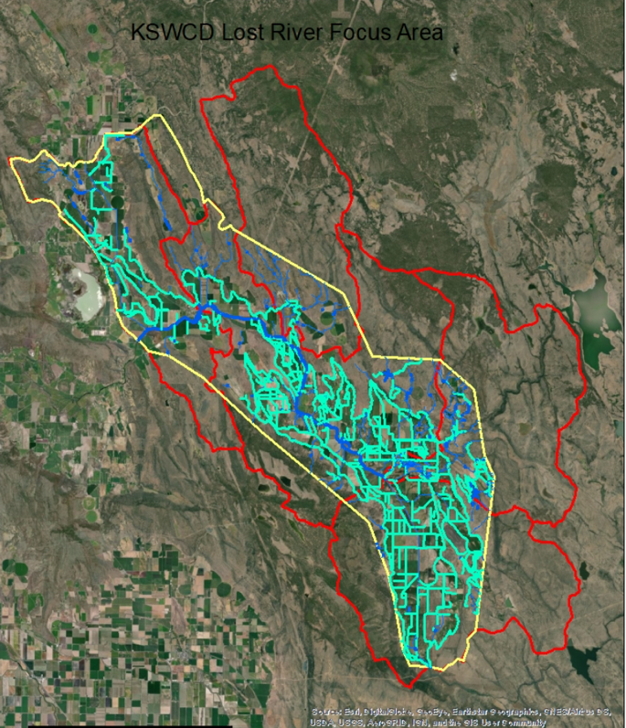
Lost River Focus Area South Fork Sprague Strategic Implementation Area

Slide 9
2018-2019 Accomplishments
Over 500 landowners provided with technical assistance.
10 grants submitted and approved for funding.
633 acres of invasive juniper removed.
Over 2400 feet of open ditches piped.
Over 3 miles of riparian fencing.
One off-stream livestock watering facility.
Over 1200 acres of fields planted with No-Till drills.

Slide 10
Klamath Basin Partners
Klamath Soil and Water Conservation District
Klamath Watershed Partnership
Trout Unlimited
NRCS
USFWS
ODFW
The Klamath Tribes
USGS
ODA
Ore-Cal R C and D
OSU Extension Service and Research Station

Slide 11
Congratulations Klamath Soil and Water Conservation District!

