Slide 1
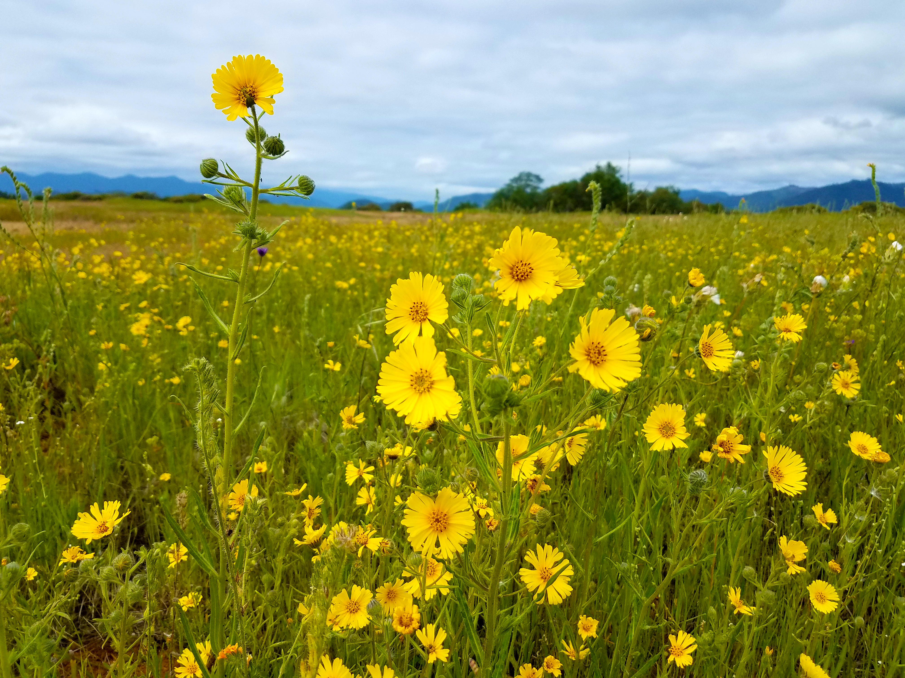

Oregon
Agricultural Heritage
Program
Photo: BLM
Notes:
Intros etc.
Introduce myself and my role w/ OAHP
Recovering Farmer
Decade experience transitioning into farm management with support State, federal and local conservation programs.
Learned Alphabet Soup (NRCS: CIG, SARE, EQIP, CSP, RCPP, ETC. FSA: CREP, ECP and Various other “Disaster Relief” and Loan Programs. OWEB: Open Solicitation, FIP, CREP TA, Small Grants. BPA: WWMP, WAH. MMT: WRI
Leveraged over $1 million in agroecological infrastructure investments. (fencing, water development, pasture, prairie, cover crop and riparian forest establishment, hoop houses
Former Watershed Council employee, (Professional Peace Corps Volunteer)
Experience pairing federal, state and other conservation programs in →to integrate agricultural and ecological objectives.
How I’ll answer questions. Logistics

Slide 2


Oregon Context
13% of Oregon’s GDP
Ag = 2nd Largest Land Use
~40,000 Farms/Farm Owners
97% “Family Owned”
2/3 of Ag land will change hands over the coming 2 decades
Notes:
13% of GDP
Ag = 2nd biggest economic sector
Communities throughout the state rely on farms to remain viable far into the future
Extremely diverse cropping systems
Ag = 2nd biggest land use
25% (16 million acres)
If we’re serious about ecosystem function and repair, we need an integrated working lands strategy
>40,000 Farms/Farm Owners
97% “Family Owned”
These are folks with a unique, valuable, hard earned skill set. Professional Ecosystem Managers
Discuss Oregon’s Agricultural Heritage
Complicated and nuanced history
Mention our 320 acre farm
2/3 of Ag land will change hands over the coming 20 years
40,000*.66=(26,400)→26,400/20= 1,320/year Roughly 1,000/year
Every transition carries a risk of the land being lost to development.
Talk about history of program since 2017

Slide 3
Purpose
Increase economic viability of Oregon’s agricultural operations and economic sector
Reduce conversion and fragmentation of Oregon’s “working land”
Enhance fish or wildlife habitat, water quality, and other natural resources on Oregon’s working land
Notes:
Soils a big part of all three purposes…
Working Land = land that is actively used by an agricultural owner or operator for an agricultural operation that includes , but not be limited to, active engagement in “farm use”
It’s a program focused on habitat conservation and restoration. Includes human habitat as well as wildlife. Humans need Abundant Healthy Food, Clean Water, Happy Homes – just like everyone one else (salmon, sage grouse, etc)

Slide 4
Approach
Be at the “Table” (~1,000 farms/year)
Engage with Change (Economic, Ecological)
Focus on “Big Picture Basics” (Food, Water, Habitat)
Come with Complementary “Tools”
  Stabilize and enhance resource base for future generations
  Facilitate transitions in land management
Notes:
Taylor
Be at the “Table”
~1,000 farms change hand every year in Oregon. This is a unique opportunity to facilitate positive change
It’s in all of our best interest that our farmlands continue to be able to thrive economically and perform ecologically
Pass on wisdom/knowledge, facilitate positive change.
“Where does this farm need to be a generation from now in order to be “successful”?
Food, Water, Habitat (including human and non-human)
Help Folks “Zoom Out
Help folks focus on what is Importatnt
Come with Tools
Eric: Providing grants for tools needed to enable long term viability of working lands. This means long-term sustainability of ag and habitat resources.
.

Slide 5
Grant Programs “Tools”
Working Land Conservation Covenants and Easements (*stabilize resource base)
Succession Planning (*facilitate transitions)
Technical Assistance (*human capacity)
Conservation Management Planning (*enhance resource base)
  Development (Action Planning)
  Implementation (Adaptive Management)
Notes:
Insert discussion of how the pieces fit together.

Slide 6
Conservation Management Plans
Develop and Implement conservation measures for maintaining or enhancing habitat, water quality, or other natural resource values in a manner consistent with the interests and abilities of agricultural landowner/operator
A commitment to stay in dialog around how to integrate the agricultural and ecological health of a farm. (20-50 Years)
Facilitate (including funding) the implementation of this shared vision
Notes:
Emphasize that we are offering these grants to entities that are willing to work regularly (long term relationship) with the landowner
We are only funding the Development of CMP’s this year. Implementation in following years.
Implementation funding likely in 3-5 year “bites”
Backbone of program
Talk about Synthesizing all available conservation programs
Limited match funding required (not 25% like CE/CC grants)

Slide 7
Conservation Management Plans
Things to Note
CMP funding to compliment (not duplicate) existing conservation programs → Synthesize strategies and fill gaps.
Will look different in different regions with different resource concerns
Could look different depending on implementation funding source
Developing Methodology to pay for plan implementation (this will likely have a focus on “Soil Health”)
Notes:
TAYLOR
Emphasize that we are offering these grants to entities that are willing to work regularly (long term relationship) with the landowner
We are only funding the Development of CMP’s this year. Implementation in following years.
Implementation funding likely in 3-5 year “bites”
Backbone of program
Need one of these in place (approved by OWEB) before closing on CE or CC
Talk about Synthesizing all available conservation programs
Limited match funding required (not 25% like CE/CC grants)

Slide 8
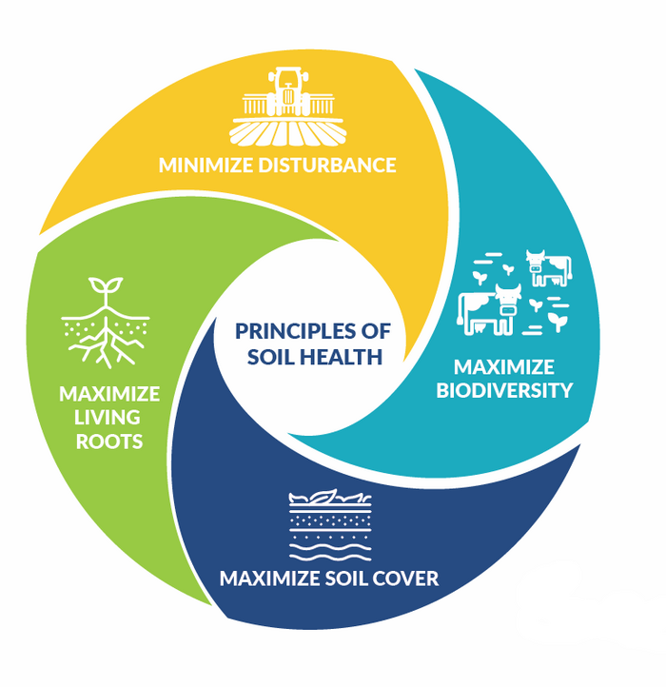

Slide 9
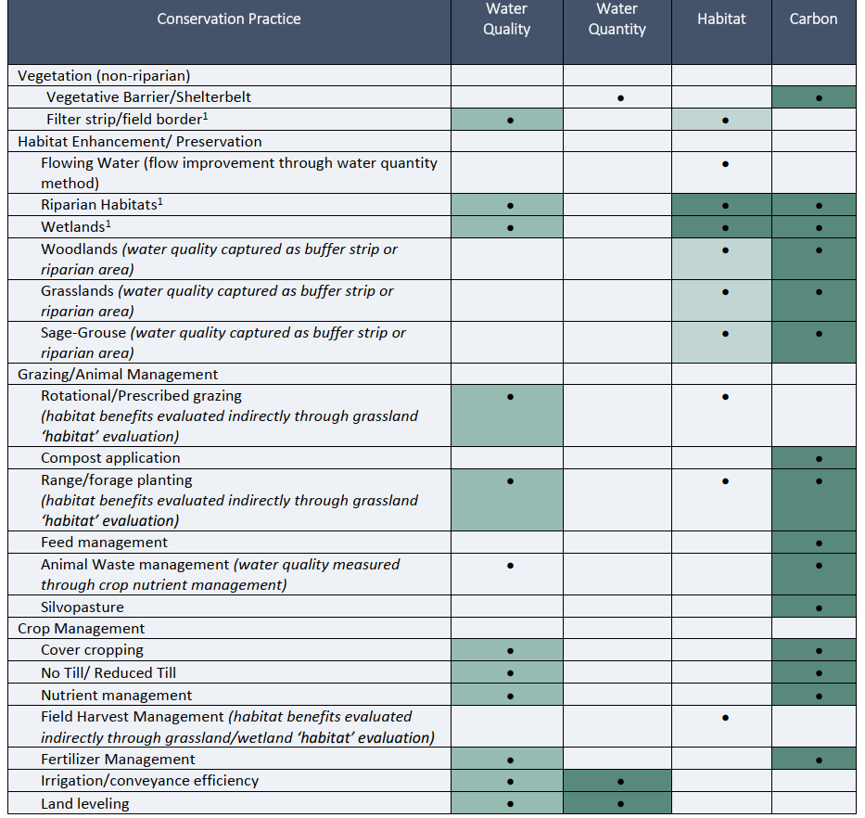
Notes:
TAYLOR
Feasible = Darker green
Dot = Potential for significant impact on “benefit type”

Slide 10
Venn Diagram of Success Likelihood
Plans for communicating with neighbors
Conservation Management Plan Evaluation Criteria
Impacts of plan implementation on neighboring lands
Significance of the agricultural, natural resource, and social values of the working land subject to CMP
Level of threat of conversion or fragmentation of the working land
Maintenance plans for infrastructure that may impact neighboring lands
Benefits to the state may be maximized
Plan implementation protects, maintains, or enhances farming or ranching on working lands
Improve or maintain economic viability of the operation
Leverages other funding sources
Sweet Spot: Likelihood
For Success
Duration & extent of CMP
Reduce potential for conversion or fragmentation from agricultural uses
Potential for setting an example that will encourage more projects
Plan implementation protects , maintains, or enhances agricultural outcomes, benefits, or investment gains,
Plan implementation connection to significant fish or wildlife habitat, water quality, or other natural resources
Protects, maintains, or improves priority natural resource values
Capacity and competence of organization
Supports implementation of priorities or plans
Relevant commitment, expertise, & track record
Measurably protects, maintains, or improves water quality/quantity
Financial capability to manage the plan(s)
Effective governance
Sustains ecological values
Protects, maintains, or improves wildlife habitat quality & connectivity
Notes:
TAYLOR
Talk through each Circle: ask for discussion/questions following this slide?
Start with “Significance of the agricultural, natural resource, and social values of the working land subject to the CMP
Pause for questions/comments?

Slide 11
Stay in Touch
Taylor Larson: OAHP Coordinator
Taylor.Larson@OWEB.Oregon.gov
971-701-3248
Notes:
Open it up for questions and discussion.

Slide 12
Conservation Management Plans
(1) A summary describing how the conservation management plan meets OAHP’s purpose;
(2) The contact and location information for the agricultural landowner or operator and conservation management plan holder;
(3) Relevant background and context of the working land and operation;
(4) Inventory, including site characteristics and current management;
(5) Short- and long-term social, economic, and conservation goals of the agricultural landowner or operator;
(6) Resource analysis and identification of resource and management concerns;
(7) Identification of potential plan activities and a justification for the activities that were selected for implementation;
Notes:
TAYLOR
Emphasize that CMP’s will be co-developed with partners over time.

Slide 13
Conservation Management Plans
(8) The implementation plan, including a budget;
9) If applicable, a maintenance plan for infrastructure associated with the plan that may affect neighboring lands if not maintained over time;
(10) The expected agricultural, fish or wildlife, water quality or other natural resource outcomes, and related social outcomes of the plan once implemented;
(11) How the conservation management plan will be evaluated and managed;
(12) A conflict resolution protocol for the agricultural landowner or operator and the conservation management plan holder if the grant program would fund the implementation of the plan; and
(13) The term of the plan.
Notes:
TAYLOR
8) Where the rubber meets the road. This is the true value of the plan!
11) Plan Holder and Landowner need to meet and update the plan every year

