Slide 1
Sakari Farms by Jamie Thrower
OACD Conference 2023
Carly Boyer, Program Manager

Slide 2
Climate Resilience Training for Agriculture Professionals
QR code here for registration:
Session 1: Wednesday, November 1
Farmer Perceptions of, and Barriers to, Climate Adaptation
Session 2: Wednesday, November 8th
Drought and Heat Mitigation Practices, Obstacles & Needs
Session 3: Wednesday, November 15th
Climate Resilience and Adaptive Management on Rangelands

Slide 3
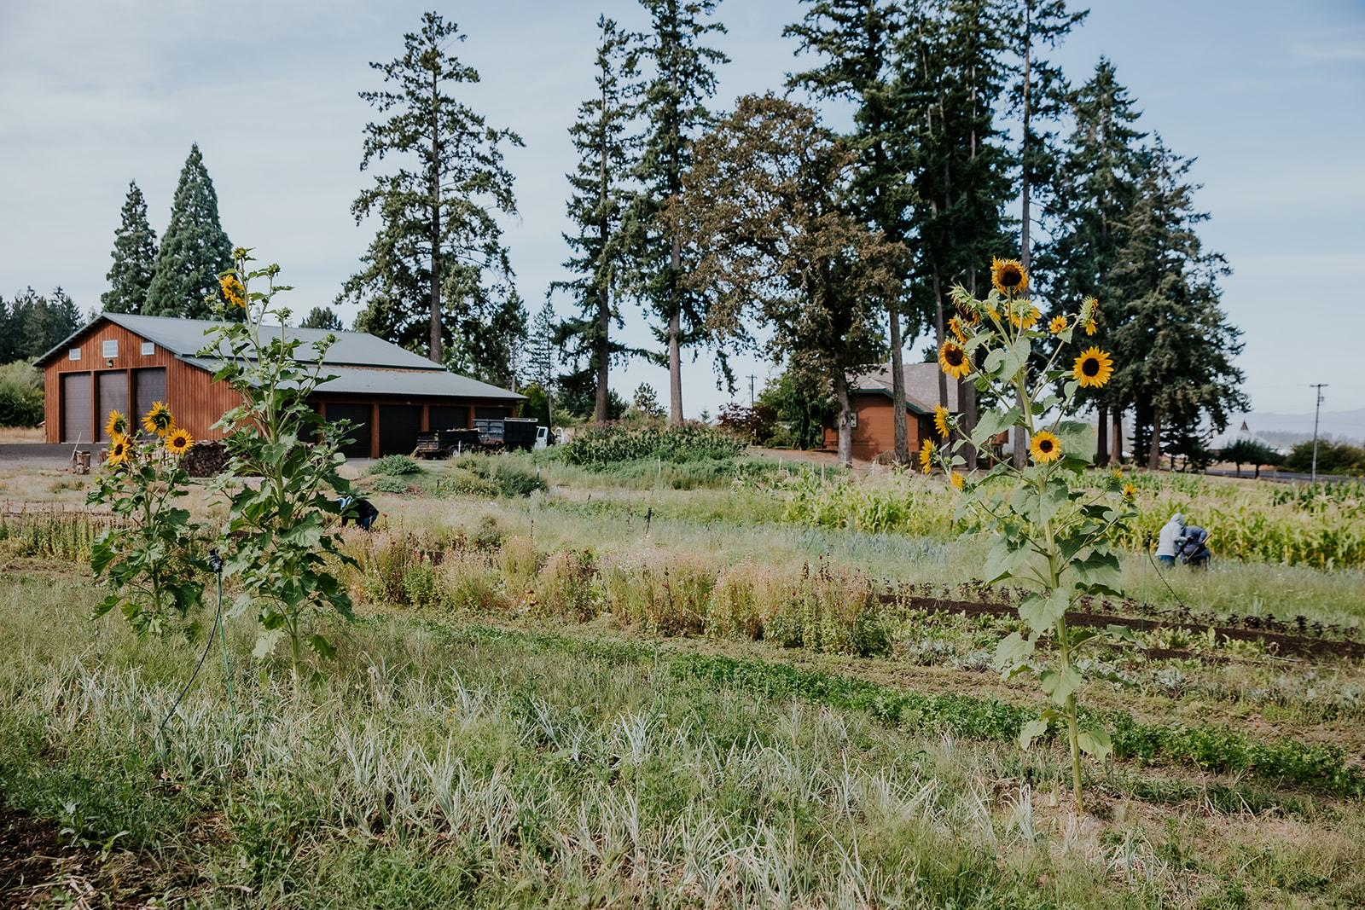
Natural Climate Solutions Bill
We’re working closely with OACD on implementation as part of the Natural Climate Solutions Coalition to:
Ensure that the grants and technical assistance provided by the state are equitable and work for farmers and ranchers on the ground.
That soil health practices are recognized as natural climate solutions.
CAMPO Collective by Jamie Thrower
Notes:
We are thrilled that the state will be providing this support for climate mitigation and resilience, including soil health, on Oregon's farms and ranches!
What’s next? Implementation!

Slide 4
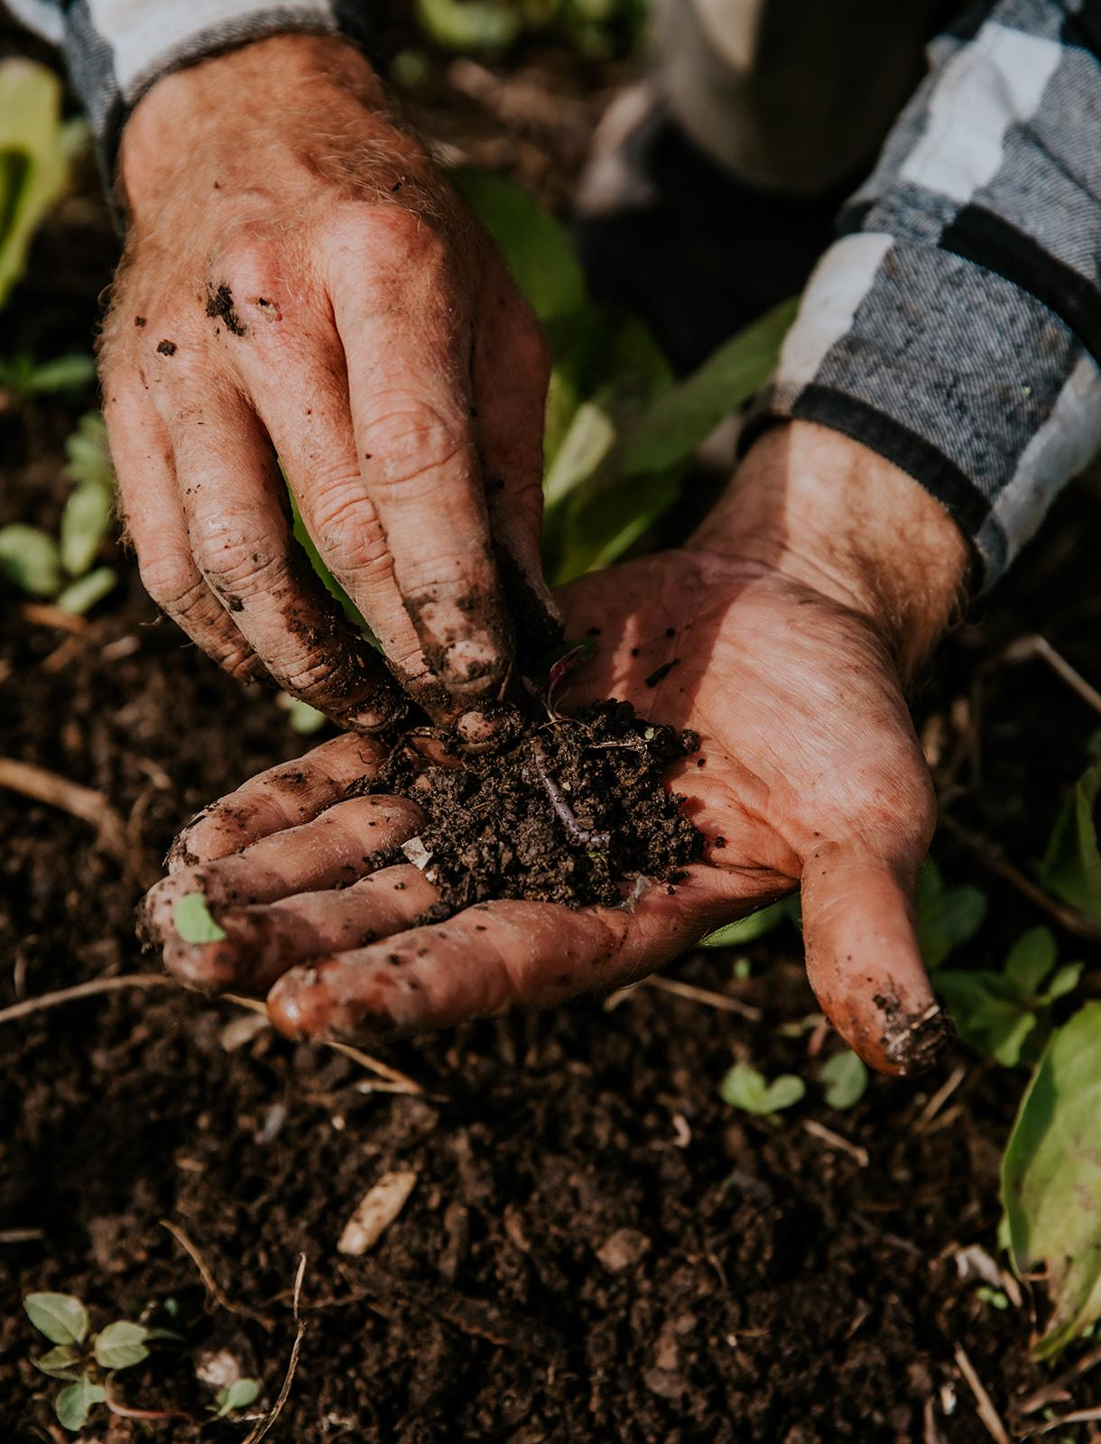
Network Development
With over 37,000 farms and ranches in Oregon, OrCAN’s strategy to effectively support them is to work with influential producers and the existing ecosystem of trusted agricultural service providers including SWCDs and also OSU Extension, NRCS and non-profits.
We’re about to dive into an intentional network planning process to clarify the structure of our collaborative state-wide soil health network,
We’ll also be exploring establishing regional hubs and/or hubs based on practices or farm type (pasture, orchards, row crops, etc)
And hope to have an in-person conference in the next year.
CAMPO Collective by Jamie Thrower

Slide 5
Questions?
Photo credits: Jamie Thrower, Sakari Farms

