Slide 1
Voluntary Conservation Assistance with NRCS
Natural Resources Conservation Service
Presented By: Loren Unruh, Assistant State Conservationist for Programs, NRCS Oregon
Notes:
GO TO VIEW > MASTER > SLIDE MASTER TO EDIT THE IMAGES ON THE TITLE AND DIVIDER SLIDES

Slide 2
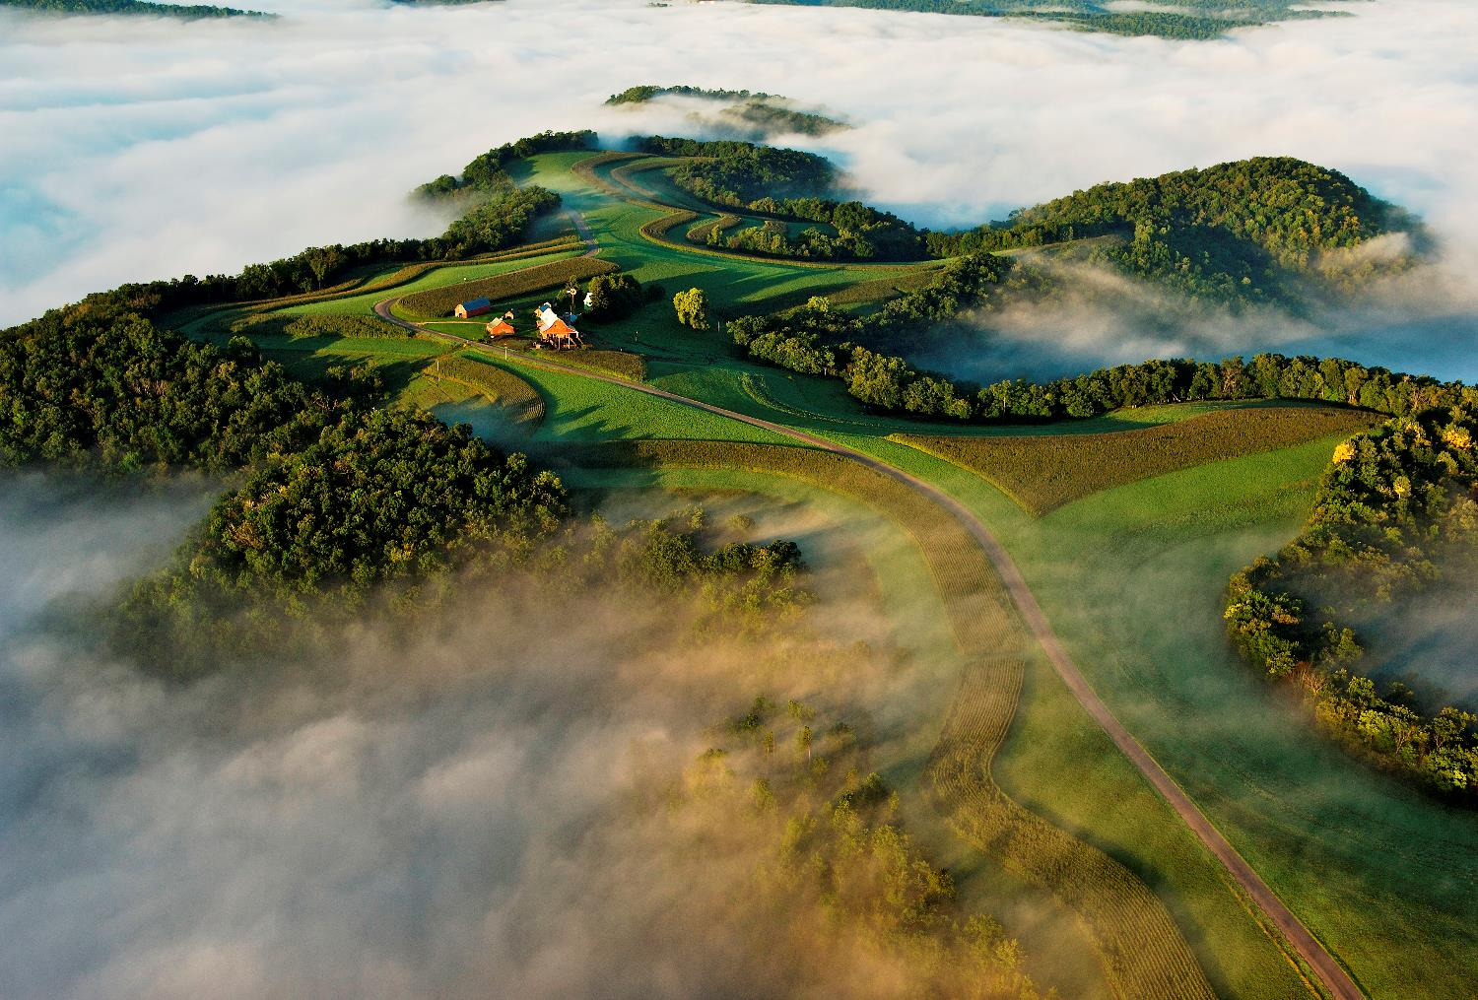
2018 Farm Bill
Ensure strong support for America’s farmers and ranchers.
Streamline, target and simplify programs.
Fulfill the Secretary’s goal of improving customer service.
Continue to offer the types of assistance producers have come to expect, and even improve upon them.

Slide 3
Programs
NRCS invests an average of $8 million every day into conservation systems that help producers stay profitable and productive.
Notes:
The Farm Bill makes our work possible through a host of programs like Conservation Technical Assistance, the Environmental Quality Incentives Program (EQIP) and the Conservation Stewardship Program (CSP), just to name a few.
NRCS invests an average of $8 million every day of the year into conservation systems that help producers stay profitable and productive.
We stand ready, at field offices in nearly every county in the country, to serve the needs of agricultural producers.

Slide 4
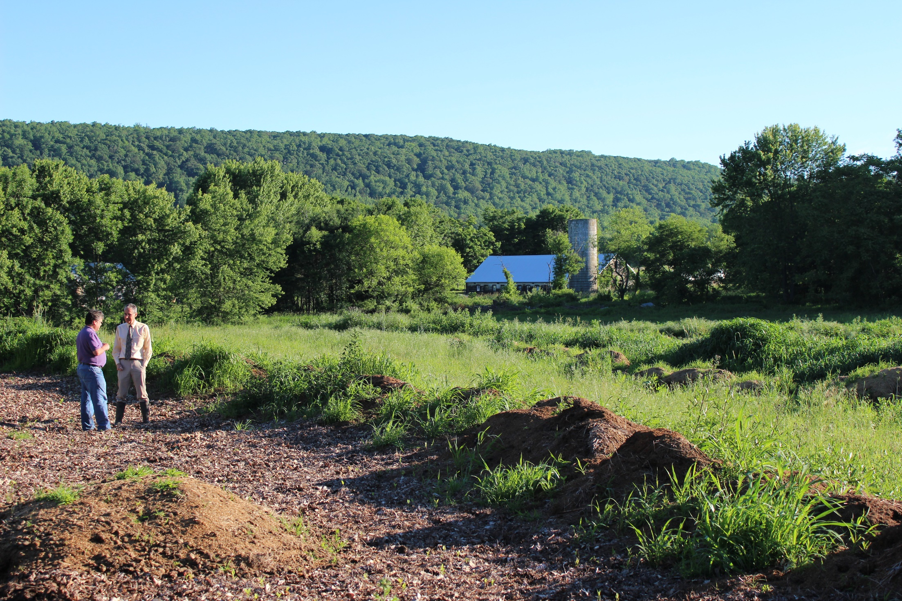
Environmental Quality Incentives Program - EQIP
Provides financial and technical assistance to address natural resource concerns and delivers environmental benefits such as improved water and air quality, conserved ground and surface water, reduced soil erosion and sedimentation, and improved or created wildlife habitat.
Notes:
The Environmental Quality Incentives Program provides financial and technical assistance to agricultural producers to address natural resource concerns and deliver environmental benefits such as improved water and air quality, conserved ground and surface water, reduced soil erosion and sedimentation, and improved or created wildlife habitat.

Slide 5
Changes to EQIP
• Adds resource concerns
• Raises cap for organic producers
• New enrollment option to address resource concerns
• Advance payments for historically underserved producers
• Authorizes direct program assistance to irrigation districts for purposes of improving water use efficiencies
Notes:
Changes
• Adds potential resource concerns related to beneficial cost-effective operation changes.
• Raises cap for organic producers to $140,000 over six years.
• New enrollment option through incentive contracts to address priority resource concerns.
• Requires advance payment option for historically underserved producers.
• Authorizes direct program assistance to irrigation districts, including acequias and other entities, for purposes of improving water use efficiencies.

Slide 6
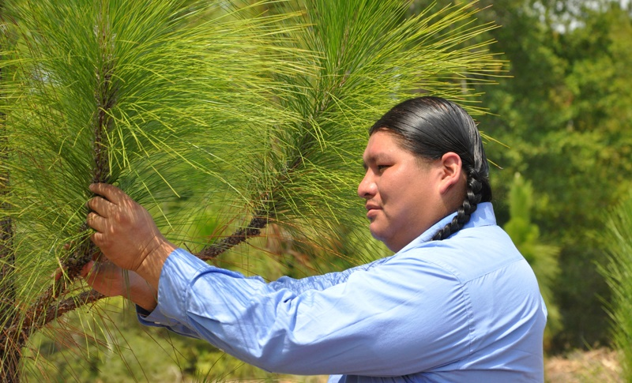
Regional Conservation Partnership Program - RCPP
Promotes coordination between NRCS and its partners to deliver conservation assistance to producers and landowners. Under partnership agreements, NRCS and its partners leverage and target their respective resources to deliver conservation assistance to producers and landowners to address priority natural resource concerns.
Notes:
The Regional Conservation Partnership Program Promotes coordination between NRCS and its partners to deliver conservation assistance to producers and landowners. Under partnership agreements, NRCS and its partners leverage and target their respective resources to deliver conservation assistance to producers and landowners to address priority natural resource concerns.

Slide 7
Changes to RCPP
• Simplifies funding authorities
• Authorizes RCPP contracts
• Expands flexibility for funding
• Expands availability of watershed program authorities
Notes:
Changes
• Simplifies funding authorities for program implementation.
• Authorizes RCPP contracts rather than requiring enrollment through other programs.
• Expands flexibility for alternative funding arrangements.
• Expands availability of watershed program authorities to projects outside critical conservation areas.

Slide 8
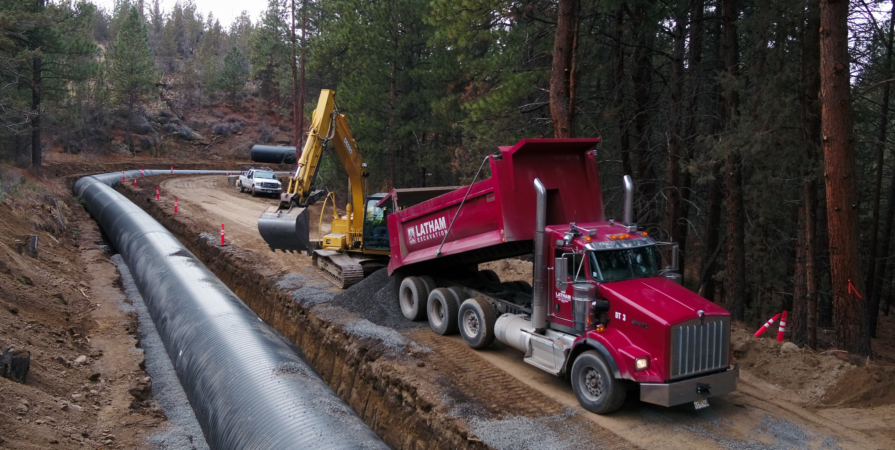
Watershed Protection and Flood Prevention Program (PL83-566)
Provides local sponsors with financial and technical assistance for:
Erosion and sediment control
Watershed protection
Flood prevention
Water quality improvements
Rural, municipal and industrial water supply
Water management
Fish and wildlife habitat enhancement
Notes:
Pictured: construction for irrigation modernization with Tumalo Irrigation District in Deschutes County, Oregon
Project sponsors can use land treatment solutions or structural solutions, which require construction. An approved watershed plan must be in place prior to initiation of any corrective land treatment or structural solutions.
Once the watershed plan is approved, the project sponsor helps landowners install planned land treatment measures if that is the appropriate solution. For structural solutions, project sponsors ensure surveys and investigations are completed. They also acquire detailed designs, specifications and engineering cost estimates for construction projects. If needed, project sponsors will outline areas where land rights, easements, and right-of-ways are needed.
Accessing the Watershed Protection and Flood Prevention Program
Project sponsors can access help through this program in the following ways:
Project sponsors can request funding to carry out an existing NRCS authorized plan. Assistance can include design and construction.
Project sponsors can request the Chief of NRCS to authorize a plan developed with USDA Watershed Operations funding;
Watershed plans that require $5 million or more in federal funding for construction require Congressional approval.
Once the watershed plan is authorized, project sponsors can access NRCS’s financial and technical help to implement their plan.

Slide 9
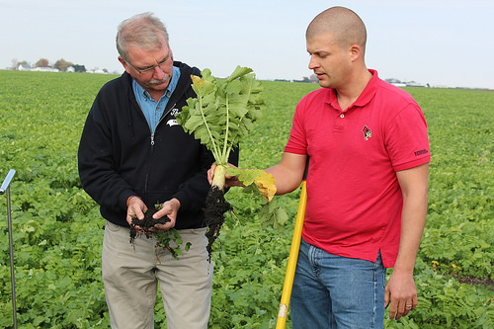
Conservation Stewardship Program - CSP
Helps agricultural producers maintain and improve their existing conservation systems and adopt additional conservation activities to address priority natural resource concerns. Participants earn CSP payments for conservation performance—the higher the performance, the higher the payment.
Notes:
Conservation Stewardship Program helps agricultural producers maintain and improve their existing conservation systems and adopt additional conservation activities to address priority natural resource concerns. Participants earn CSP payments for conservation performance—the higher the performance, the higher the payment.

Slide 10
Changes to CSP
• Increases payment rates for certain activities
• Authorizes contract extensions
• Provides specific support for organic
• Includes special grassland conservation initiative
Notes:
Changes
• Increases payment rates for adoption of cover crop rotations and advanced grazing management activities.
• Authorizes contract extensions to facilitate renewal under new program authority.
• Transforms funding mechanism for program contracts, authorizing specified annual funding levels.
• Provides specific support for organic and transitioning to organic production activities.
• Includes special grassland conservation initiative for certain producers who have maintained cropland base acres.

Slide 11
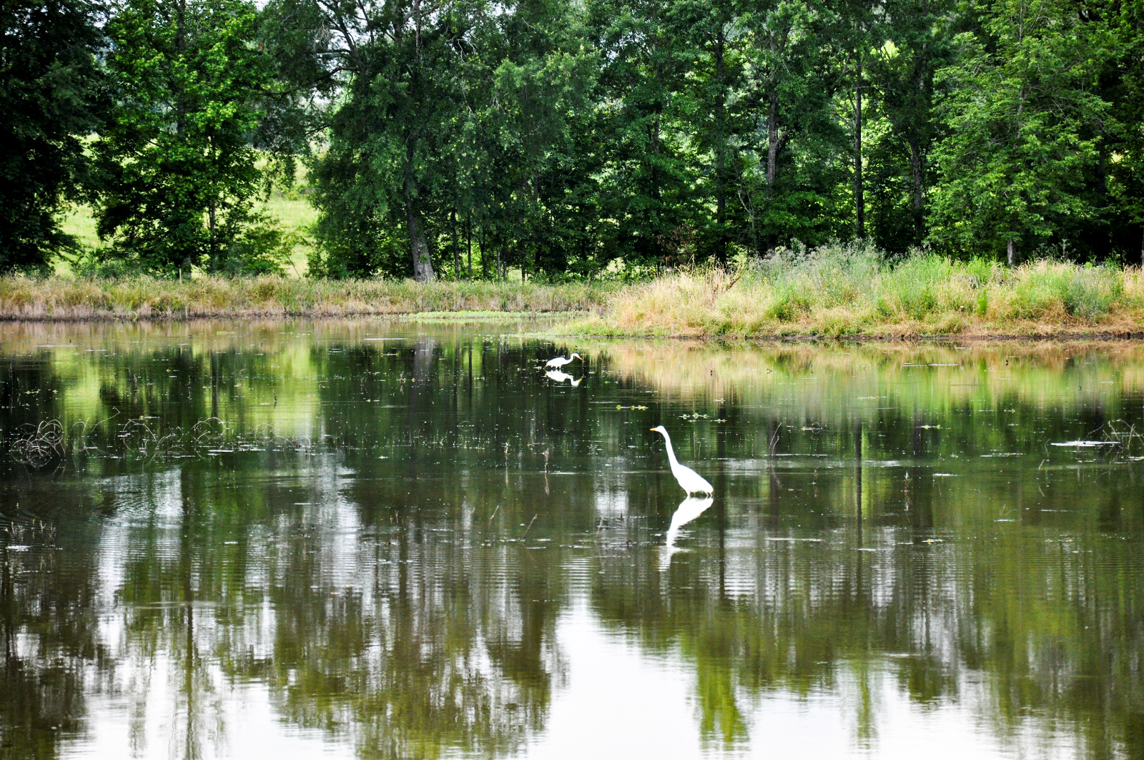
Agricultural Conservation Easement Program - ACEP
Helps landowners, land trusts, and other entities protect, restore, and enhance wetlands, grasslands, and working farms and ranches through conservation easements.
Notes:
The Agricultural Conservation Easement Program Helps landowners, land trusts, and other entities protect, restore, and enhance wetlands, grasslands, and working farms and ranches through conservation easements.

Slide 12
Changes to ACEP
• Assistance for ‘Buy-Protect-Sell’ transactions
• New requirements for highly erodible land
• Increases flexibility for partners
• Adds water quality as resource concern
• Expands wetland eligibility
Notes:
Changes
• Authorizes assistance to partners who pursue ‘Buy-Protect-Sell’ transactions.
• Requires a conservation plan for highly erodible land that will be protected by an agricultural land easement.
• Increases flexibility for partners to meet cost-share matching requirements.
• Identifies water quality as a program purpose for enrollment of wetland reserve easements.
• Expands wetland types eligible for restoration and management under wetland reserve easements.

Slide 13
Other NRCS Farm Bill Changes
Conservation Innovation Grants
-Adds the option for on-farm-trials
Healthy Forests Reserve Program (HFRP_
-Expands enrollment options for Indian tribes
Notes:
The Farm bill strengthens conservation assistance through continued support for—
• Agriculture Conservation Experienced Services Program
• Conservation Innovation Grants
• Technical Service Providers
• Veteran Farmers
• Voluntary Public Access and Habitat Incentive Program
• Conservation Compliance for Highly Erodible Lands and Wetlands
• Small Watershed Rehabilitation Program
• Emergency Watershed Protection Program

Slide 14
The Farm Bill is an important tool. But it doesn’t work without the dedication of the folks in the field, most importantly, the farmers and ranchers that use it to make the best decisions for their land and operations.

