Slide 1
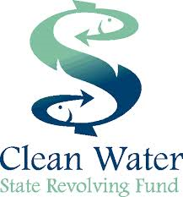
Oregon Association of Conservation Districts Annual Conference
Oregon Department of Environmental Quality
Clean Water State Revolving Fund Overview
Nov. 1, 2022
CWSRF | Oregon Department of Environmental Quality

Slide 2
The Basics
Water Quality
Finance
Infrastructure
CWSRF
Oregon Department of Environmental Quality

Slide 3
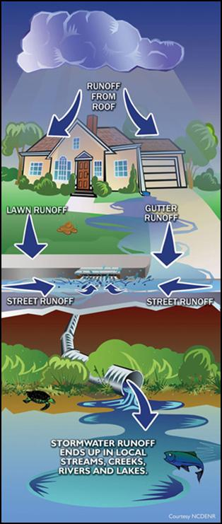
Oregon CWSRF Overview
Funding authorized under the Clean Water Act in 1987
to finance water pollution control activities
Below-market rate loans for a wide range of
water quality and infrastructure projects
More than $1.4 billion to 200 borrowers throughout
the state of Oregon over 30 years
$750 million loan portfolio value at any given time –
the fund “revolves” …
Notes:
…
…for water pollution control projects over 30 years

Slide 4
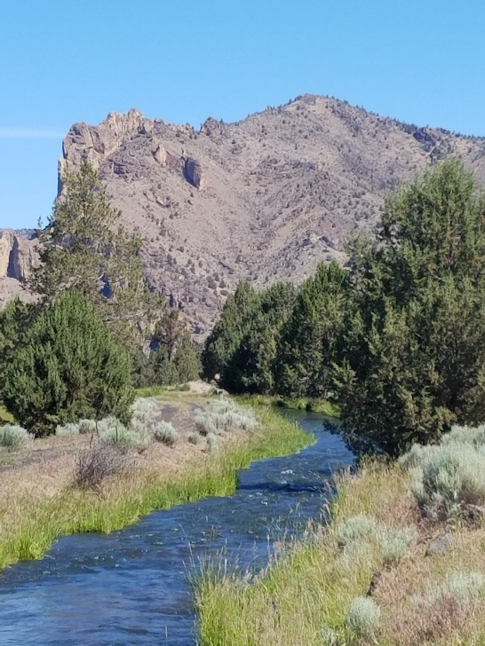
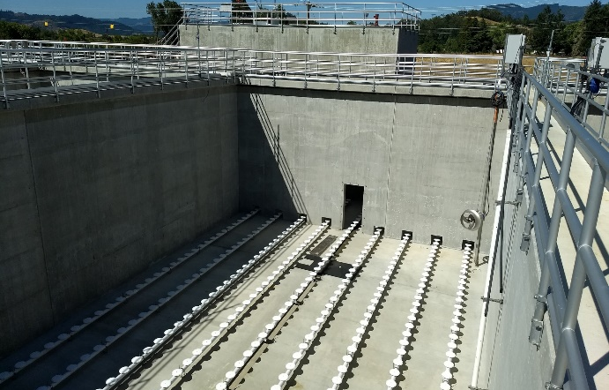
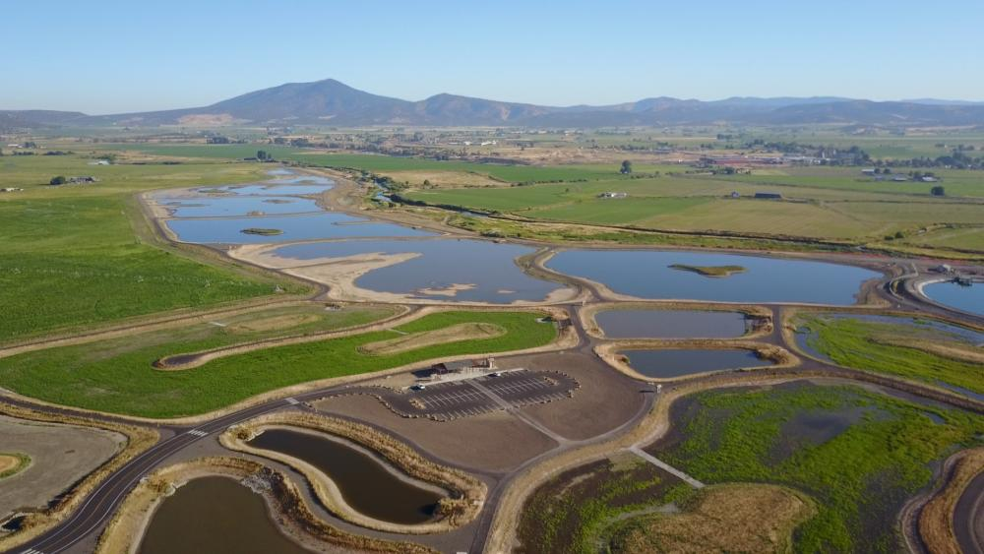
If it improves water quality, we can likely finance it!
Point source and nonpoint source projects!
Wastewater, stormwater, irrigation modernization, watershed protection and restoration, energy and water efficiency, green infrastructure and more!
Planning, design and construction projects!
Land acquisition
Central Oregon Irrigation District open canal flows by Smith Rock
Wastewater aeration basin
Prineville’s treatment wetlands

Slide 5
Eligible Borrowers (ORS 468.423)
An Oregon Public Agency:
Cities
Counties
State Agencies
Federally recognized Tribes
Irrigation Districts
Sanitation Districts
Soil & Water Conservation Districts
Intergovernmental entities under ORS 190
Community Development Financial Institutions for septic tank repair, replacement, or connection to sewer
Oregon Department of Environmental Quality

Slide 6
Four primary loan types: Many possible projects

Slide 7
Point Source vs. Nonpoint Source Investments Over Time
Oregon Department of Environmental Quality

Slide 8
Nonpoint Source Pollution Control Eligibilities
Clean Water Act Section 603(c)(2) Eligibility: Section 319
Projects must support the implementation of a current EPA approved state NPS management program plan
DEQ staff determine if a project is consistent with the Oregon Nonpoint Source Management Program Plan
Oregon Department of Environmental Quality

Slide 9
Nonpoint Source Project Categories
Stormwater (nonregulated systems as nonpoint source)
Decentralized wastewater treatment (septic tanks systems)
Surface water protection and restoration
Groundwater protection and restoration
Habitat protection and restoration
Agriculture best management practices
Silviculture
Contaminated sites
Landfills
Oregon Department of Environmental Quality

Slide 10
Green Project Categories
Water efficiency
Energy efficiency
Green infrastructure
Environmentally innovative
Oregon Department of Environmental Quality

Slide 11
Local Community Loans
Finances an eligible public agency’s local financial program
Public agency must have authority to lend
Septic system repair and replacement for private land owners
Pass through lending
Nonpoint source projects
Oregon Department of Environmental Quality

Slide 12
Sponsorship Option Loans
Combine a nonpoint source project with point source project (i.e. centralized wastewater system project)
Two applications submitted (point source and nonpoint source)
Combined debt service
Interest rate as low as one percent
Oregon Department of Environmental Quality

Slide 13
CWSRF: financial benefits
Below-market rate loans – fixed rates up to 30 years
Interest accrues only as funds are utilized on a cost-reimbursement basis
Repayment begins six months to one year after project completion
Principal forgiveness up to $500,000 or 50% project cost, whichever is less for eligible recipients (currently)

Slide 14
Oregon Department of Environmental Quality

Slide 15
Application and Intended Use Plan
Applications reviewed and scored three times per year
Deadlines:
December 9th, 2022
April 14th, 2023
August 11, 2023
Applications are included in the Intended Use Plan and need to meet requirements before signing a loan
An application can be on the IUP for up to 36 months
Oregon Department of Environmental Quality

Slide 16
Oregon CWSRF Program Resources
Oregon CWSRF Webpage
Loan Information Request Form
Loan Application Request Form
Program Contacts
Oregon Department of Environmental Quality

Slide 17
Chris Marko, Oregon DEQ CWSRF Program Coordinator chris.marko@deq.oregon.gov 503-229-6412
Oregon Department of Environmental Quality

