Slide 1
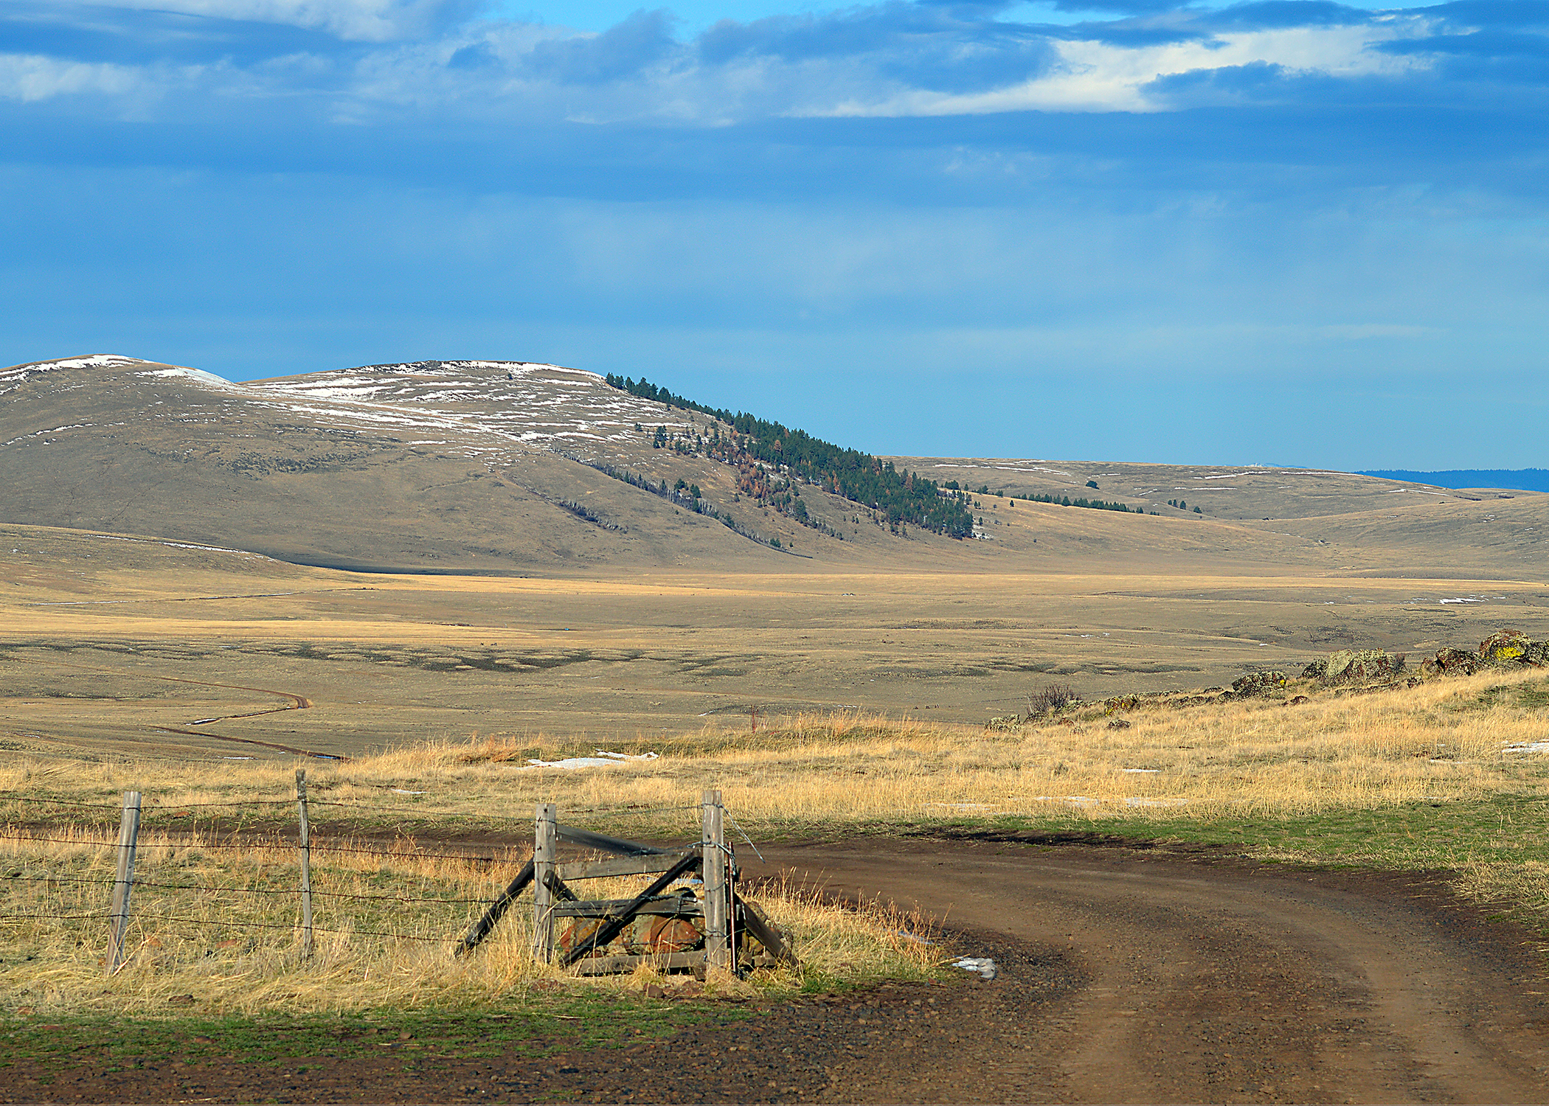
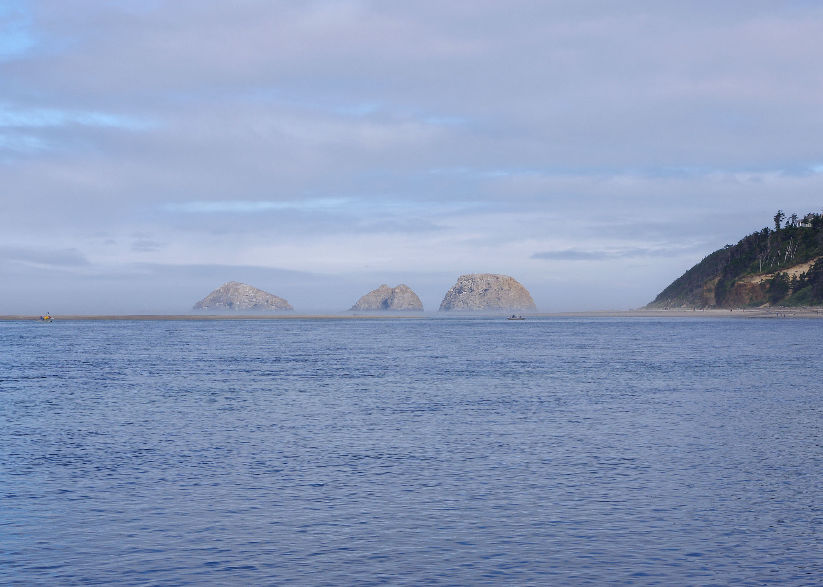
Natural & Working
Lands Fund
Created in 2023 session (HB 3409)
$10M to support natural climate solutions
Four eligible agencies (OWEB, ODFW, ODA, ODF)
Allocations made by Oregon Climate Action Commission
Oregon Association of Conservation Districts
Annual Conference
October 15, 2024
Notes:
Thank you for opportunity
Talk about NWL funds designations across 4 state agencies and opportunities for Tribal engagement, specifically with ODA and OWEB

Slide 2
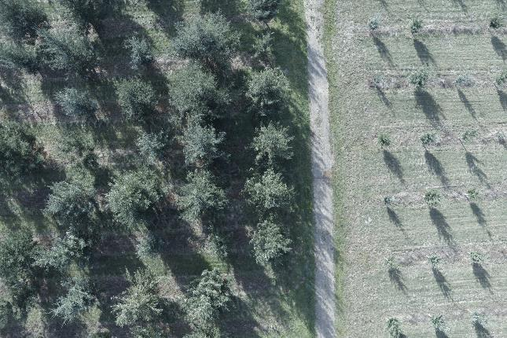
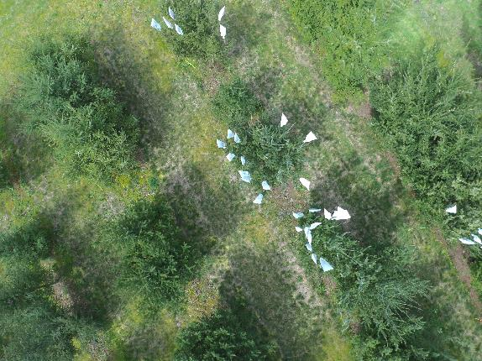
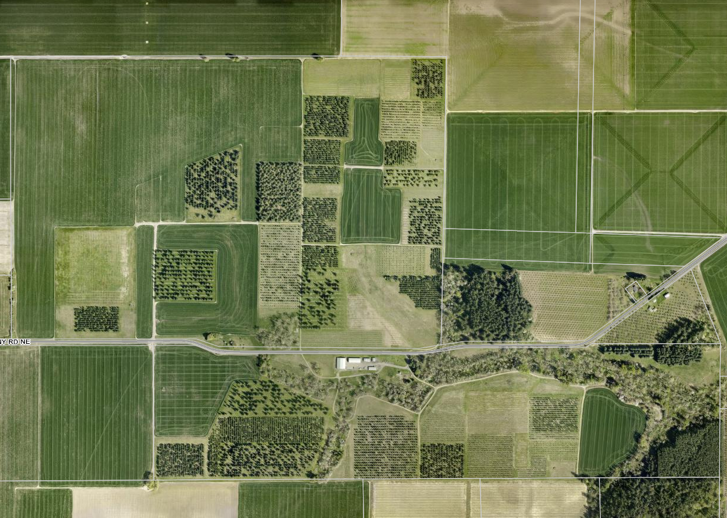
Purpose of the Funds
Advance natural climate solutions to sequester and store carbon
Provide incentives, technical assistance, and financial assistance
Leverage federal investments
Prioritize the use of existing programs
Remove barriers for tribes, environmental justice communities, landowners and land managers
Notes:
Advance natural climate solutions
(a) Securing and leveraging federal and private investments in natural climate solutions
on natural and working lands;
(b) Prioritizing the use of existing programs;
(c) Ensuring equitable benefits of climate mitigation for environmental justice communities, landowners and land managers;
Removing barriers for Indian tribes, environmental justice communities, landowners and land managers to engage in natural climate solutions or access funding to support natural climate solutions;
Identifying resources to provide incentives to land managers interested in voluntarily adopting practices that optimize natural climate solutions;
Strengthening education, engagement and technical assistance efforts for land managers, Indian tribes and environmental justice communities;
Providing financial assistance for Indian tribes, local governments or nongovernmental organizations for the purpose of entering into voluntary transactions with willing landowners to acquire natural and working lands to enhance the local benefits of natural climate solutions;
Increasing and deploying natural climate solutions in and around our urban and built environment

Slide 3
13 Investment Areas
Agency | Area of Investment | Total
ODA | Invasive Annual Grasses | $396,000
 | OR Native Seed Strategy Implementation | $582,928
ODF | Advance implementation of Climate-Smart Forestry as outlined in ODF’s Climate Change and Carbon Plan | $1,500,000
 | Incentivize Climate-Smart Forestry Implementation in partnership with Tribal and Environmental Justice Communities | $1,000,000
 | Establishment of climate-ready seed orchards to support small, disadvantaged, and tribal forestry (at existing facility) | $750,000
OWEB | Restoration and technical assistance grants – Open Solicitation Programs | $1,625,000
 | Conservation management planning, technical assistance, and payment-for-practices | $875,000
ODFW | Floodplain Reforestation on North Santiam River | $412,500
 | Carbon Capture & Restoration in North-Central Oregon Rangelands | $750,000
 | Carbon Capture in Oregon Coastal Estuaries | $1,100,000
 | Carbon Sequestration & Habitat Restoration Service Provider | $285,000
 | Red Hills Conservation Area Wildfire Risk Reduction | $170,770
 | Natural Climate Solutions Lead | $320,000
Notes:
The proposal focused on investments that are ready to be made quickly to demonstrate the value and feasibility of these natural climate solutions.
The proposal provides for natural climate solutions across a range of Oregon’s natural and working land sectors including blue carbon ecosystems, natural lands, rangelands, forestlands, and agricultural lands.
Designed to leverage millions of dollars in federal funding, the package of investments advances natural climate solutions through incentives, technical assistance, and on-the-ground projects with a focus on accessibility and funding for tribes and environmental justice communities.
The technical and direct financial assistance will help remove barriers for Indian tribes, environmental justice communities, landowners, and land managers to engage in natural climate solutions or access funding to support natural climate solutions.
13 investment areas:
11 linked to/anticipated Federal Funds (BPA, NRCS Farm Bill, NOAA, USFWS, BLM, USFS)
Background notes:
“Environmental justice community” has the meaning given that term in ORS 182.535.
(4) “Natural and working lands” means:
(a) Lands:
(A) Actively used by an agricultural owner or operator for an agricultural operation, including
but not limited to active engagement in farming or ranching;
(B) Producing forest products;
(C) Consisting of forests, woodlands, grasslands, sagebrush steppes, deserts, freshwater
and riparian systems, wetlands, coastal and estuarine areas or the submerged and
submersible lands within Oregon’s territorial sea and marine habitats associated with those
lands;
(D) That are privately owned and that are eligible for special assessment under ORS
chapter 308A;
(E) Used for recreational purposes, including, but not limited to, parks, trails, greenbelts
and other similar open space lands; or
(F) Consisting of trees, other vegetation and soils in urban and near-urban areas, including,
but not limited to, urban watersheds, street trees, park trees, residential trees and
riparian habitats; and
(b) Lands described in paragraph (a) of this subsection that are:
(A) Held in trust by the United States for the benefit of any of the nine federally recognized
Indian tribes in this state;
(B) Held in trust by the United States for the benefit of individual members of any of the
nine federally recognized Indian tribes in this state;
(C) Within the boundaries of the reservation of any of the nine federally recognized Indian
tribes in this state; or
(D) Otherwise owned or controlled by any of the nine federally recognized Indian tribes
in this state.

Slide 4
ODF Summary
Implementation of Climate Change and Carbon Plan with focus on Climate-Smart Forestry
$1.5M - Small landowners and forest managers
$1M - Tribal forests and traditionally marginalized landowners
$750k - Build capacity for climate ready seed and seedlings at existing ODF facility
Increase adaptation of forests to ensure continual sequestration and maintain forests even with shifts in forest types.
Notes:
DANNY TO CONFIRM COMBINED SLIDE, ADD TALKING POINTS

Slide 5
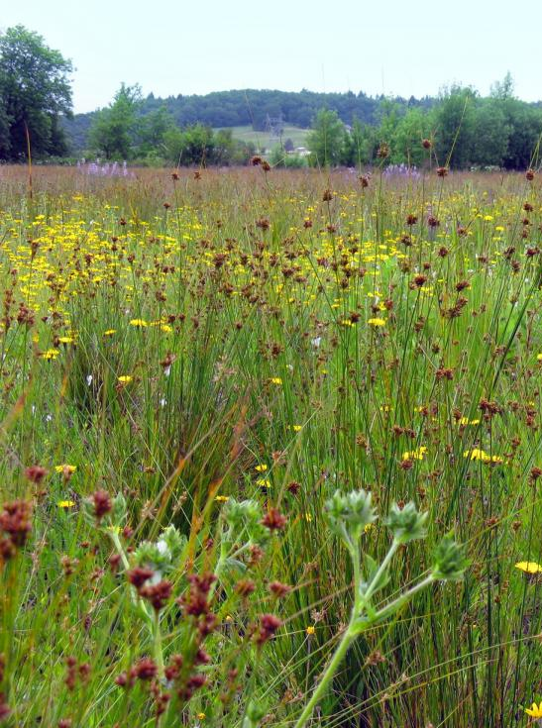
ODFW Summary
Co-benefits: working lands, carbon, fish & wildlife habitat
$3.04 million to diverse projects
  Floodplain restoration - CTGR
  Estuary restoration – Tillamook, Umpqua
  Fire resilience in oak woodland - CTWS
  Grassland Restoration – Wasco County
  Natural Climate Solutions Biologists
Implementation underway
Notes:
ODFW received a little over $3 million in Natural & Working Lands Funds to implement a diverse set of projects that will generate co-benefits for fish and wildlife habitat, working lands resiliency, and carbon sequestration.
The projects range geographically from coastal estuaries to Willamette Valley to Wasco County grasslands.
Two of ODFW’s projects involve pass-through funds to tribes, including the Confederated Tribes of the Grand Ronde for riparian floodplain restoration on their lands and to the Confederated Tribes of the Warm Springs for fire resiliency in oak woodlands on some of their lands.
Other projects involve climate resiliency and carbon sequestration activities on private working lands, with co-benefits for livestock operations and fish and wildlife habitat.
All of the habitat projects are in early stages of implementation right now.
ODFW also requested and received funding for some staff capacity to help with implementation of these projects and to pursue federal funding to further leverage projects on natural and working lands. Those positions are in the recruitment process.

Slide 6
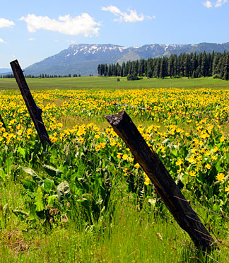
ODA Projects Summary
Two Projects Funded by N&WL
Rangeland Resilience/Invasive Annual Grass
  $360,000
  5 Year Project
  Partnership with NRCS
Oregon Native Seed Strategy
  $530,000
  Existing effort
  Builds on National Seed Strategy
Notes:
Funds proposed here will support Tribal participation in the ODA-led Oregon Native Seed Coalition (ONSC) working group, financial assistance for Tribal nurseries and/or native plant programs, and ODA staff for native seed scouting and collection of target species identified by the ONSC. Further funding will be sub-awarded for additional seed collection, seed cleaning, seed grower technical assistance, and farmer co-op development.
Supports numerous HB3409 priorities. (see agency pre-proposal)

Slide 7
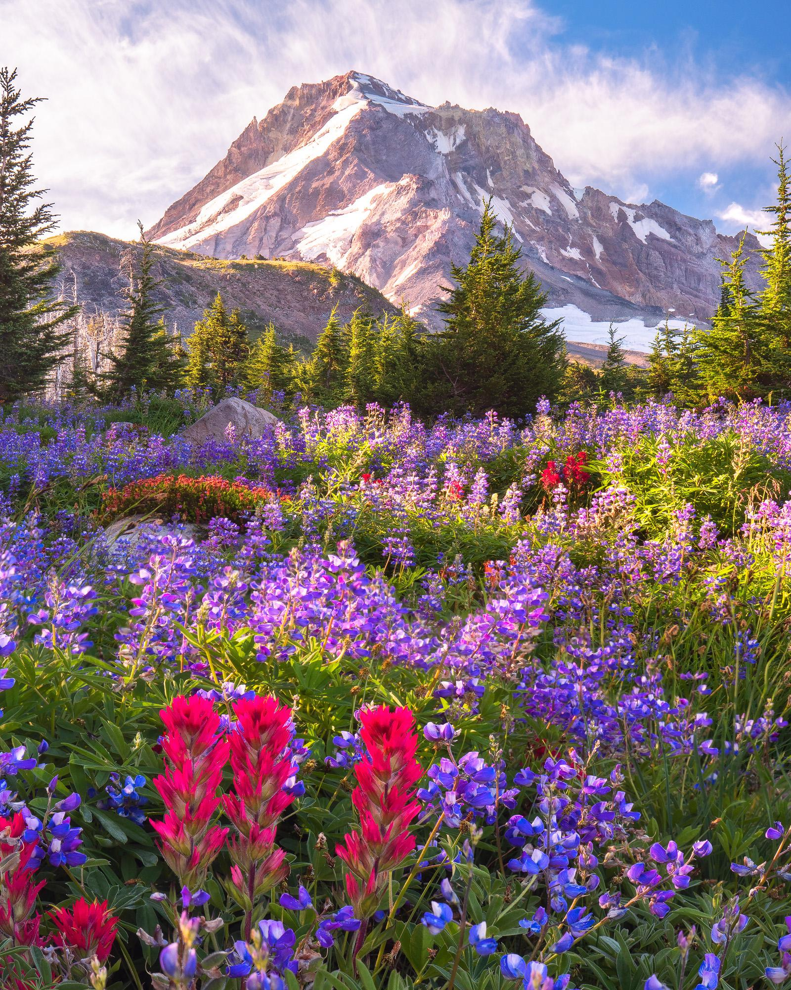
Oregon Native Seed Strategy
Ensures access to reliable supply of ecologically appropriate native seed collection, storage, and production
Native seedstock is critical to conservation and restoration of natural working lands and the ecosystem services they provide:
    Carbon sinks
    Resilience to climate change and wildfire
    Habitat
$530k
All natural and working land types
Includes $100k in Tribal assistance/incentives
Notes:
Funds proposed here will support Tribal participation in the ODA-led Oregon Native Seed Coalition (ONSC) working group, financial assistance for Tribal nurseries and/or native plant programs, and ODA staff for native seed scouting and collection of target species identified by the ONSC. Further funding will be sub-awarded for additional seed collection, seed cleaning, seed grower technical assistance, and farmer co-op development.
Supports numerous HB3409 priorities. (see agency pre-proposal)

Slide 8
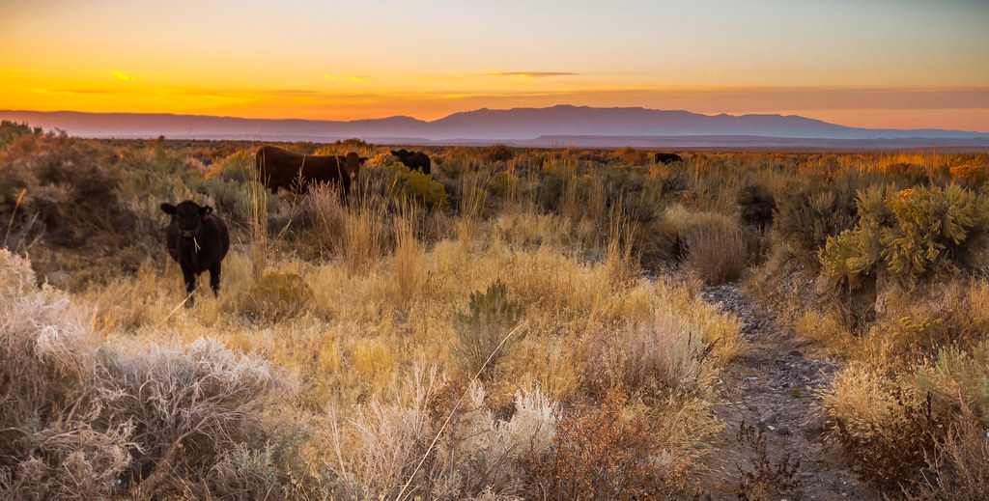
Invasive Annual Grasses
Technical assistance and regional coordination for range, ag, and forest resilience projects focused on invasive annual grasses
$360k, leverages minimum $1.7M+ FF
Healthy, functional rangelands are crucial to carbon sequestration, resilience to wildfires, and climate change
Notes:
TROY TO BRIEFLY TOUCH ON
Doesn’t come with any money, so will not spend much time presenting on this.
The effort will support coordination, collaboration, and outreach efforts to identify priority treatment areas and high value partnerships for invasive grass management and prioritize projects that align with the goals and objectives identified by the USDA Working Lands for Wildlife Initiative, USDA Grazing Lands Conservation Initiative, Western Weed Action Plan, Oregon Sagecon Partnership, and others aimed at protecting rangeland and forests from numerous threats like invasive annual grasses, fire and climate change.
Supports numerous HB3409 priorities.

Slide 9
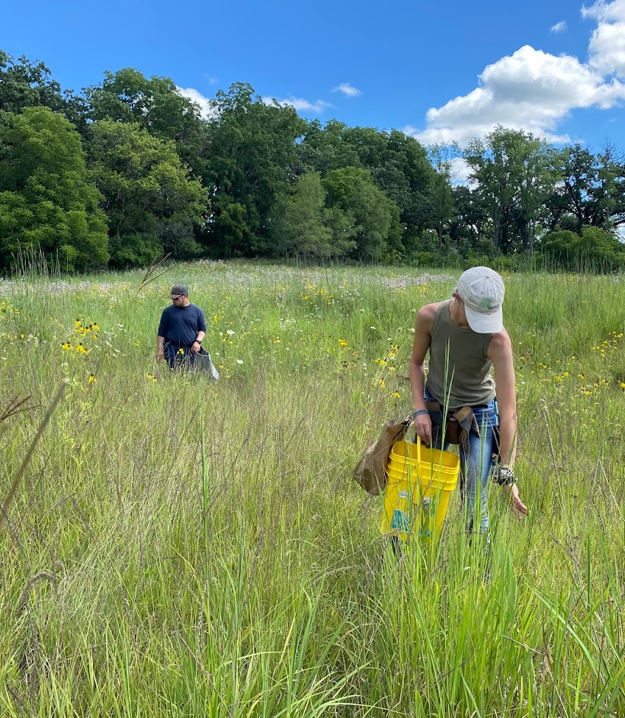
Seed Strategy Implementation
Collection and banking began in 2024
  Continues in 2025
  Workhorse and niche species
Awarded $230K through open RFP
  Collection, storage and amplification
  Development of Native Seed Co-Ops
Final review/publishing in early 2025

Slide 10
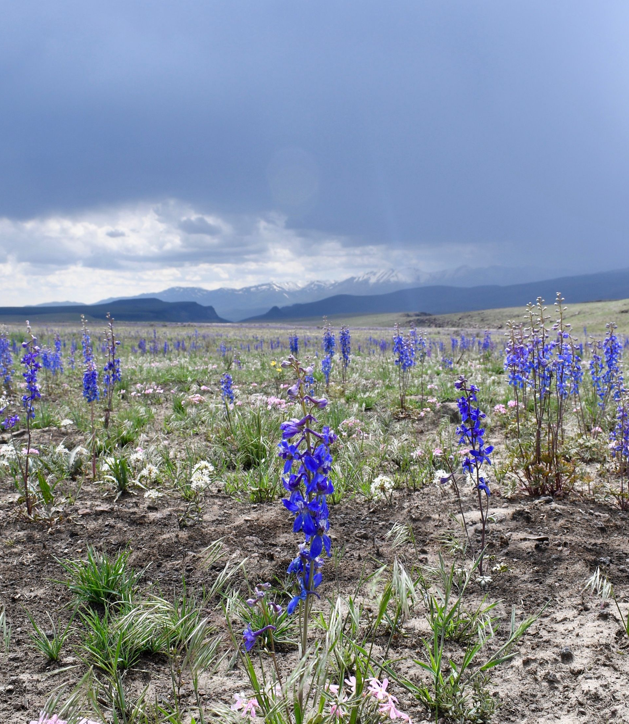
Opportunities for SWCD’s
Native Seed Co-Ops
  Producer outreach
  Shared resources
Connect producers to programs/funding
  Underserved sector
  Risk mitigation
  Market development
We want to hear your ideas

Slide 11
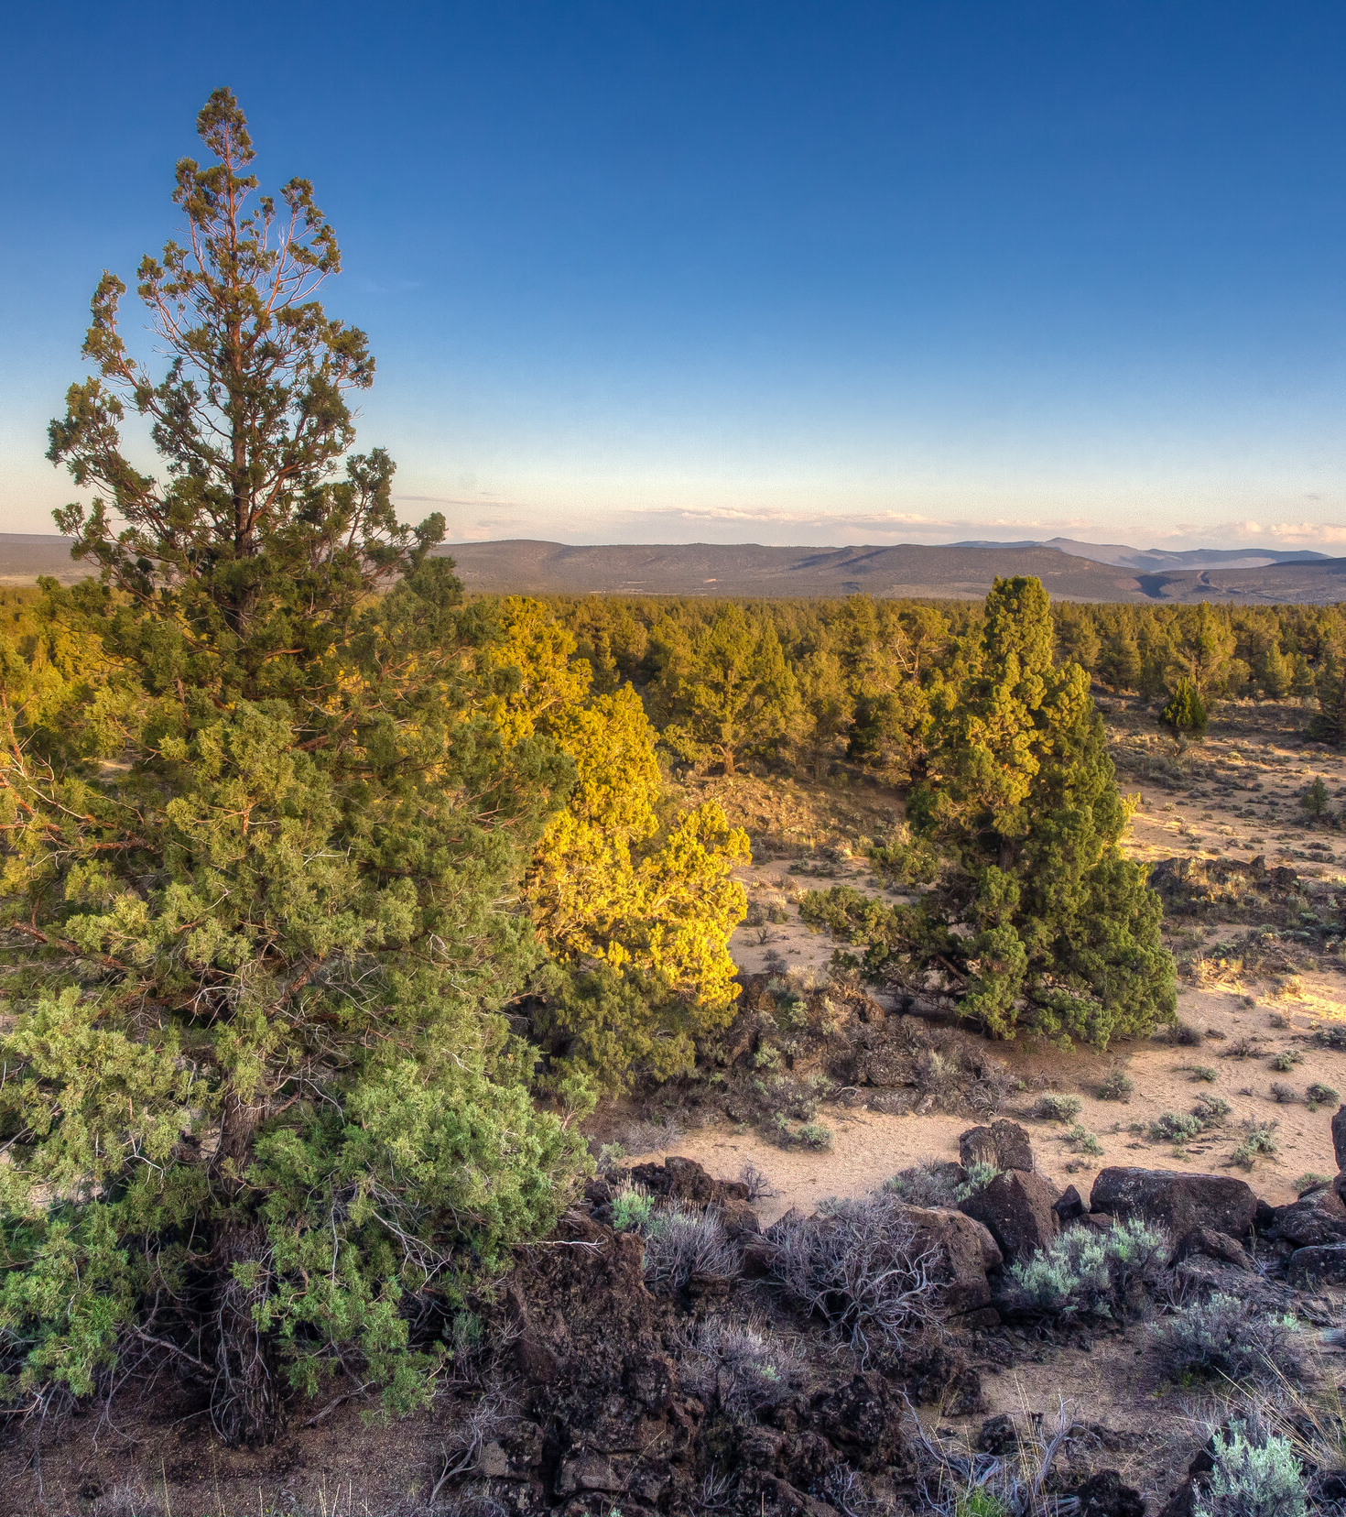
IAG Implementation
Recruitment for Rangeland Health Specialist
  Interviews are underway
  Hiring in November
  Second specialist recruitment in 2025
Broad scope of work over 5 years
  20-year goals
  10-year action plan
  Priority geographies
    For many reasons
Notes:
TROY TO BRIEFLY TOUCH ON
Doesn’t come with any money, so will not spend much time presenting on this.
The effort will support coordination, collaboration, and outreach efforts to identify priority treatment areas and high value partnerships for invasive grass management and prioritize projects that align with the goals and objectives identified by the USDA Working Lands for Wildlife Initiative, USDA Grazing Lands Conservation Initiative, Western Weed Action Plan, Oregon Sagecon Partnership, and others aimed at protecting rangeland and forests from numerous threats like invasive annual grasses, fire and climate change.
Supports numerous HB3409 priorities.

Slide 12
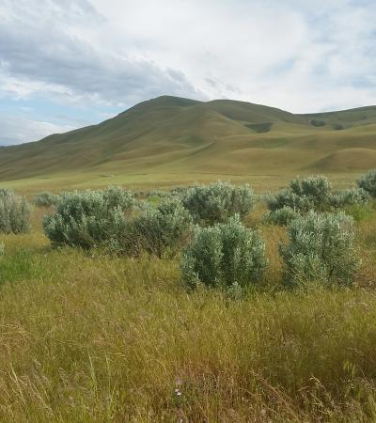
Rangeland Health Specialists
Liaison between landowners and agencies
  SWCD’s
  NRCS
  USFS, BLM, etc.
Agency lead, SME
Technical Assistance
Planning and Coordination
Notes:
TROY TO BRIEFLY TOUCH ON
Doesn’t come with any money, so will not spend much time presenting on this.
The effort will support coordination, collaboration, and outreach efforts to identify priority treatment areas and high value partnerships for invasive grass management and prioritize projects that align with the goals and objectives identified by the USDA Working Lands for Wildlife Initiative, USDA Grazing Lands Conservation Initiative, Western Weed Action Plan, Oregon Sagecon Partnership, and others aimed at protecting rangeland and forests from numerous threats like invasive annual grasses, fire and climate change.
Supports numerous HB3409 priorities.

Slide 13
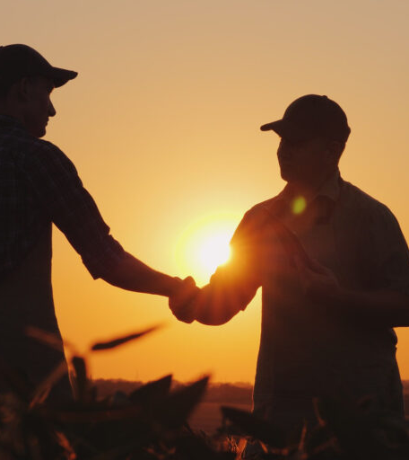
SWCD Opportunities
Capacity through the RHS
  Landowner/manager outreach
  Initiative implementation
  Consultation
  Project development/implementation
    Funding opportunities
    Pilot programs
  Let’s talk about it!
Notes:
TROY TO BRIEFLY TOUCH ON
Doesn’t come with any money, so will not spend much time presenting on this.
The effort will support coordination, collaboration, and outreach efforts to identify priority treatment areas and high value partnerships for invasive grass management and prioritize projects that align with the goals and objectives identified by the USDA Working Lands for Wildlife Initiative, USDA Grazing Lands Conservation Initiative, Western Weed Action Plan, Oregon Sagecon Partnership, and others aimed at protecting rangeland and forests from numerous threats like invasive annual grasses, fire and climate change.
Supports numerous HB3409 priorities.

Slide 14

Learning Experience....
Climate Change & Resilience
  BIG, BIG picture
  Long range outcomes
    Short term measurables are difficult
    How do we advocate continued investment?
This work is new for all of us
Learning as we go
Communication and collaboration is key
Notes:
TROY TO BRIEFLY TOUCH ON
Doesn’t come with any money, so will not spend much time presenting on this.
The effort will support coordination, collaboration, and outreach efforts to identify priority treatment areas and high value partnerships for invasive grass management and prioritize projects that align with the goals and objectives identified by the USDA Working Lands for Wildlife Initiative, USDA Grazing Lands Conservation Initiative, Western Weed Action Plan, Oregon Sagecon Partnership, and others aimed at protecting rangeland and forests from numerous threats like invasive annual grasses, fire and climate change.
Supports numerous HB3409 priorities.

Slide 15
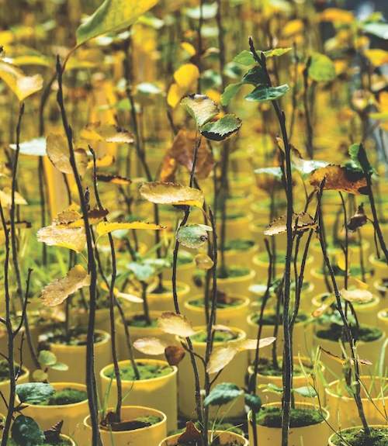
OWEB Implementation
Consultation process underway, with survey completed and listening sessions
Grant offerings open January-April, with awards made in June
Practices include climate-smart farming practices
Designed to complement NRCS funding opportunities

Slide 16
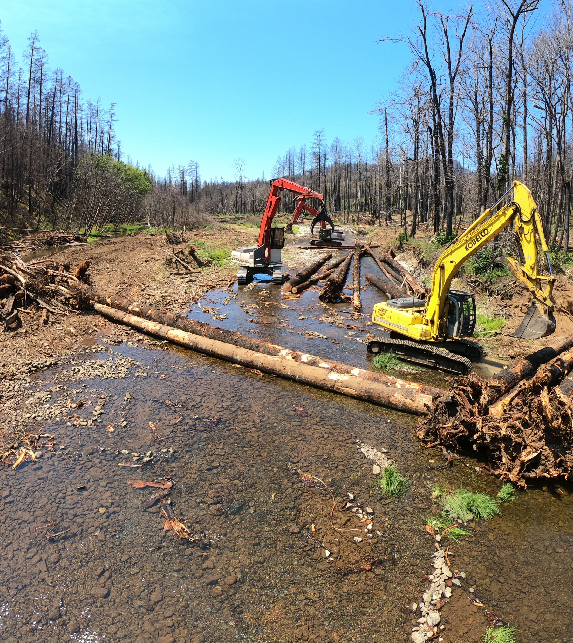
OWEB – Open Solicitation
$1.5M for restoration/technical assistance grants
Practices that support natural climate solutions (i.e. improved forest management, restore deep rooted perennial grasses, etc.)
Support social and economic co-benefits for Tribes and environmental justice communities
Will apply existing rules for both programs
Restoration Grant: Rock Creek in post-Archie Creek Fire area.
Credit: Partnership for the Umpqua Rivers, Jeff McEnroe.

Slide 17
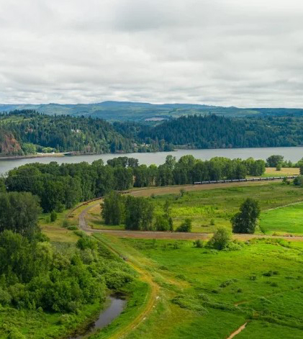
OWEB – OAHP
INSERT PHOTO HERE THAT IS RELEVANT TO PROJECT DESCRIPTION
Max of 2 slides per agency
$750,000 for technical assistance to develop conservation management plans and implement them through payment for practices
Practices include climate-smart farming practices like cover crops, nutrient management, and riparian buffer areas
Priority given to activities administered or proposed by an environmental justice community or Tribe
OAHP Grantee: Seely Farm, Clatskanie.
Credit: Oregon Agricultural Trust.

Slide 18
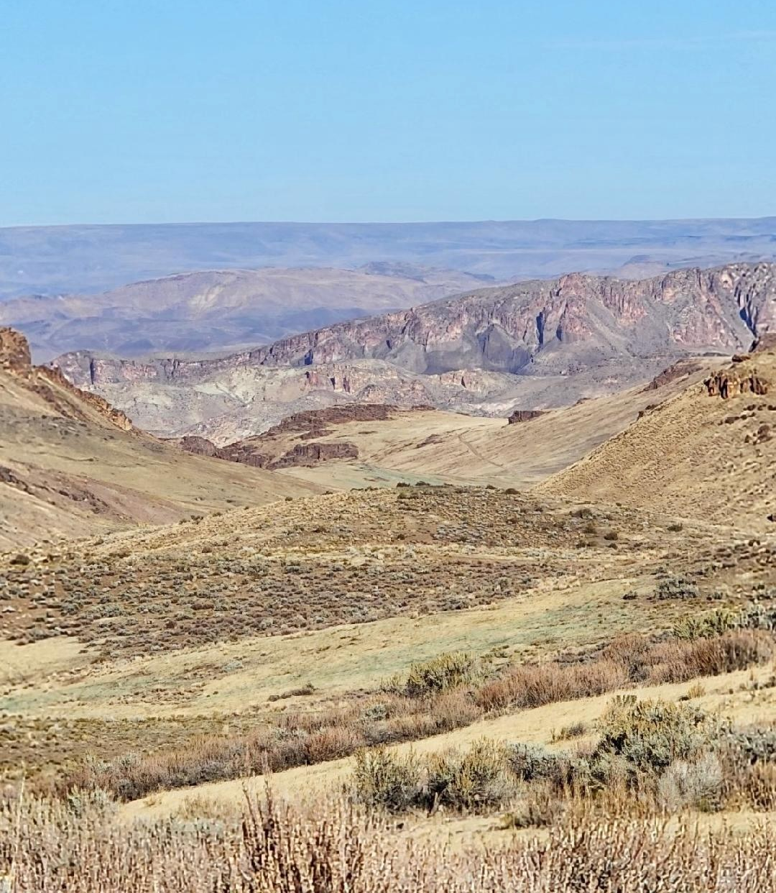
Contact Info
Troy Abercrombie
Oregon Dept. of Agriculture
Native Plant Conservation & Noxious Weed Control
  troy.abercrombie@oda.oregon.gov
  503-983-4065
  Alexa Schmidt
  Oregon Watershed Enhancement Board
  Water and Climate Coordinator
  alexa.m.schmidt@oweb.Oregon.gov
  971-718-4904

