Slide 1
DROUGHT RESILIENCE AND WATER SECURITY
HARMONY BURRIGHT
JOINT WATER CAUCUS
2023 LEGISLATIVE SESSION
BIPARTISAN INVESTMENTS, HIGHLIGHTS, AND FUTURE FOCUS

Slide 2
PRINCIPLES
BENEFIT
FAMILIES, FARMS,
AND FISH
BREAK
THE CYCLE OF
EMERGENCY
PREPARE FOR
LONG-TERM
WATER SCARCITY
COORDINATE
AND INVEST
STRATEGICALLY
LEVERAGE
FEDERAL
FUNDING
OUTLINE
1. Planning, Coordination, and Capacity
2. Data and Analysis
3. Water for Families: Drinking
Water Security
4. Water for Farms: Agricultural
Resilience and Food Security
5. Water for Fish: Instream Priorities
and Watershed Health
6. Water Project Investments
7. Outreach and Engagement

Slide 3
INITIAL PROPOSAL
PLANNING, COORDINATION, AND CAPACITY
$16M
DATA AND ANALYSIS
$7M
DRINKING WATER SECURITY
$20M
AGRICULTURAL RESILIENCE AND FOOD SECURITY
$55M
INSTREAM PRIORITIES AND WATERSHED HEALTH
$38M
WATER PROJECT INVESTMENTS
$111M
OUTREACH AND ENGAGEMENT
$4M
INITIAL PACKAGE PROPOSED: $250M

Slide 4
FINAL PACKAGE
PLANNING, COORDINATION, AND CAPACITY
$8.3M
DATA AND ANALYSIS
$8.8M
DRINKING WATER SECURITY
$7.5M
AGRICULTURAL RESILIENCE AND FOOD SECURITY
$9.7M
INSTREAM PRIORITIES AND WATERSHED HEALTH
$35.2M
WATER PROJECT INVESTMENTS
$68.9M
OUTREACH AND ENGAGEMENT
$4.4M
FINAL PACKAGE FUNDED: $143M, including $29M in carryover investments

Slide 5
RELATED INVESTMENTS
EMERGING CONTAMINANTS AND AREAS OF CONCERN
$1M
NATURAL AND WORKING LANDS FUND
$10M
COMMUNITY GREEN INFRASTRUCTURE PROGRAM
$6M
OREGON WORKER RELIEF CLIMATE FUND
$1M
LOCAL INFRASTRUCTURE PASSTHROUGH AND BONDS
$45M
WATER SUPPLY DEVELOPMENT ACCOUNT
$10M
LEVEE PROJECT GRANT FUND
$10M
SPECIAL PUBLIC WORKS FUND
$30M
E-BOARD APPROPRIATION FOR NATURAL DISASTERS
$35M
ADDITIONAL RELATED INVESTMENTS: $148M

Slide 6
PLANNING, COORDINATION,
AND CAPACITY
Supporting Planning: Created new Place-Based Water Planning Fund, including $2 million for communities to plan for and meet water needs.
Strengthening Our Strategy: Improved interagency coordination and implementation of Oregon's Integrated Water Resources Strategy.
Improving Core Functions: Funded essential agency capacity such as watermaster staff and resources to reduce administrative backlogs.
Enhancing Tools: Advanced voluntary instream leasing, coordination on water reuse and recycling, and voluntary groundwater agreements.

Slide 7
DATA AND
ANALYSIS
Understanding Water Resources: Funded monitoring equipment and staff for key metrics such as stream flow and temperature.
Updating Management Tools: Invested in updating Water Availability Reporting System used to understand water availability across the state.
Managing and Sharing Data: Contributed resources to create an integrated water data portal with value for state agencies as well as the public.
Integrating Existing Data: Ensured OWRD has authority to obtain data on water use in cases where measurement of water use is already required.

Slide 8
WATER FOR FAMILIES:
DRINKING WATER SECURITY
Protecting Water Sources: Created a Community Drinking Water Enhancement & Protection Fund with $5 million to assist communities.
Supporting Small Water Systems: Funded technical assistance resources and vulnerability study for small community water systems.
Aiding Domestic Well Users: Added eligibility to access Water Well Abandonment, Repair, and Replacement Fund due to contamination.
Exploring Ratepayer Safety Net: Directed research into program options to provide water utility rate assistance to low-income ratepayers.

Slide 9
WATER FOR FARMS: AGRICULTURAL RESILIENCE AND FOOD SECURITY
Promoting Resilience: Allocated $2.65 million for small-scale farms and ranches to promote drought relief, resilience, and adaptation.
Increasing Efficiency: Established a technical assistance program and demonstration network to promote efficient agricultural water use.
Strengthening Food Systems: Allocated $4 million to regional food hubs and farmers markets to increase access and drought resilience.
Supporting Workers: Supported reinvestment in the Oregon Workers Relief Climate Change Fund for workers impacted by climate disasters.

Slide 10
WATER FOR FISH: INSTREAM PRIORITIES AND WATERSHED HEALTH
Prioritizing Fish and Wildlife Passage: Increased ecological resilience through $13.75 million for critical fish and wildlife passage projects.
Drought Resilience Projects: Invested $1 million in drought resilience projects through the Oregon Conservation and Recreation Fund.
Western Juniper Removal: Funded watershed restoration to conserve water through removal of western juniper where overpopulated.
Protecting Investments: Retained key capacity and programs, and carried forward millions of dollars of drought response grants at risk of reversion.

Slide 11
WATER PROJECT
INVESTMENTS
Modernizing Systems: Funded $50 million in irrigation modernization, leveraging federal funds and improving efficiency and stream flows.
Developing Storage and Recharge: Dedicated substantial funds to evaluating and implementing aquifer recharge and storage projects.
Improving Grant Processes: Increased capacity and directed more frequent grants from the OWRD Water Supply Development Account.
Expanding Impact: Supported diverse water infrastructure projects and local partners across Oregon, with related project funding exceeding $100 million.

Slide 12
OUTREACH AND
ENGAGEMENT
Developing Technical Resources: Provided $1.6 million to Oregon Association of Water Utilities to build a Water System Training Center.
Engaging with Tribes: Dedicated resources to water right settlement facilitation with CTUIR as well as work of the Tribal Water Work Group.
Promoting Capacity: Funded capacity grants and research to understand and address water needs of environmental justice communities.
Convening Conversations: Allocated resources to OSU for a statewide water conference to facilitate learning and relationship-building.

Slide 13
SIEZING OPPORTUNITIES
FOR FEDERAL FUNDING
Existing programs that require state match can cover significant needs, such as PL566 covering up to
75% of irrigation modernization costs.
Steps should also be taken to leverage newer programs, with the IIJA's $50B representing the largest investment in water infrastructure in American history.
Maximizing Benefits
Investments like
pre-planning and technical assistance can help build a project pipeline to access funds such
as the Clean Water State Revolving Fund

Slide 14
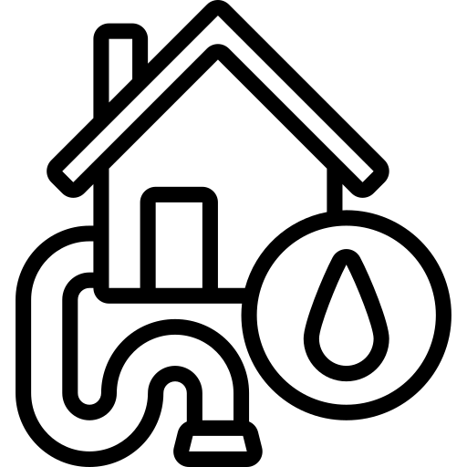
LOOKING TO THE FUTURE
Increase access to and understanding of water data and information, especially the status of surface and groundwater supply and demand at a basin-scale.
.
Address aging and failing water infrastructure that hinders Oregon’s ability to meet housing targets.
Address barriers to accessing federal funding and continue to focus on efforts to leverage federal funds and increase federal funding readiness.

Slide 15
LOOKING TO THE FUTURE: BIPARTISAN WATER LEADERSHIP

Slide 16
QUESTIONS AND CONVERSATION

