Slide 1
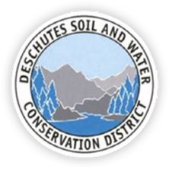
Deschutes Soil and Water Conservation District

Slide 2
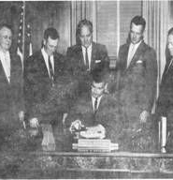
History
The Deschutes Soil and Water Conservation District was established on June 23, 1947 under the name “Midstate SCD”, which then was changed to the Deschutes SWCD on September 9, 1987.

Slide 3
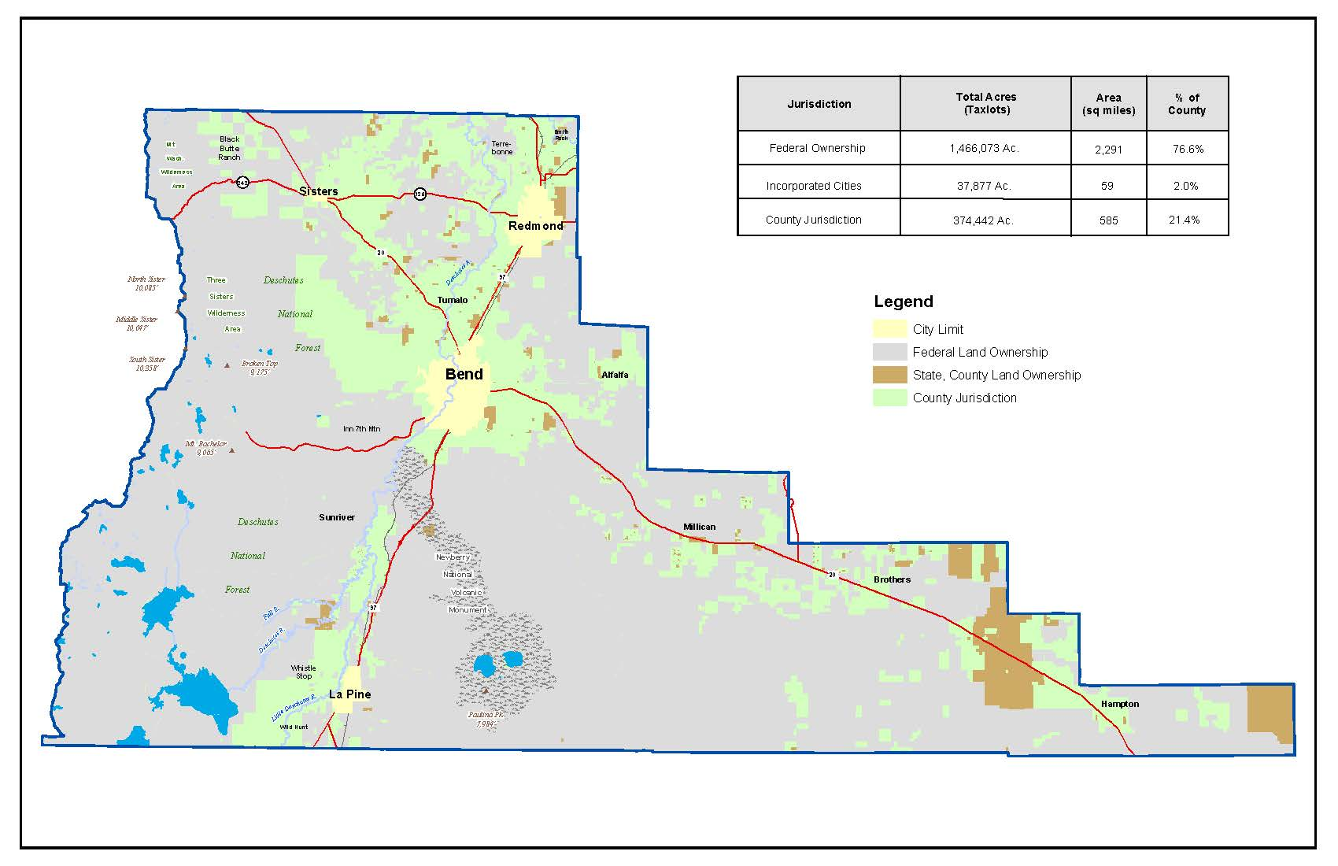
Demographics
2010 Census data:
Deschutes County: 3,018.19 Square Miles ( 1.9 million acres)
77% Federally Owned
21% Private lands
2% Incorporated Cities
21% Private lands:
Land use:
23% Cropland (Forage or small grains)
57% Pasture
10% woodlands
10% Other
5 irrigation district service 66,280 acres
978 New or Beginning Farmers or Ranchers

Slide 4
Resource Concerns
Water Quantity – On farm irrigation systems
Water Quality – Runoff or leaching of nutrients or sediment
Plant Condition - Plant Health and Vigor; low yields, forest stand density
Plant Condition – Invasive and noxious Weed; Disease or Pests
Wildlife Habitat – Inadequate feed, cover shelter or Fragmentation
Domestic Animals – Feed and forage and water

Slide 5
Deschutes SWCD Strategies:
Increase Partnerships and Capacity
Forest Health / Reduce High Fire Risk
Irrigation Conveyance Water Savings
Indian Ford Watershed Function and Health
Urban Agriculture and Sustainability

Slide 6
Increase Partnerships and Capacity

Slide 7
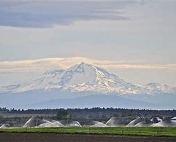
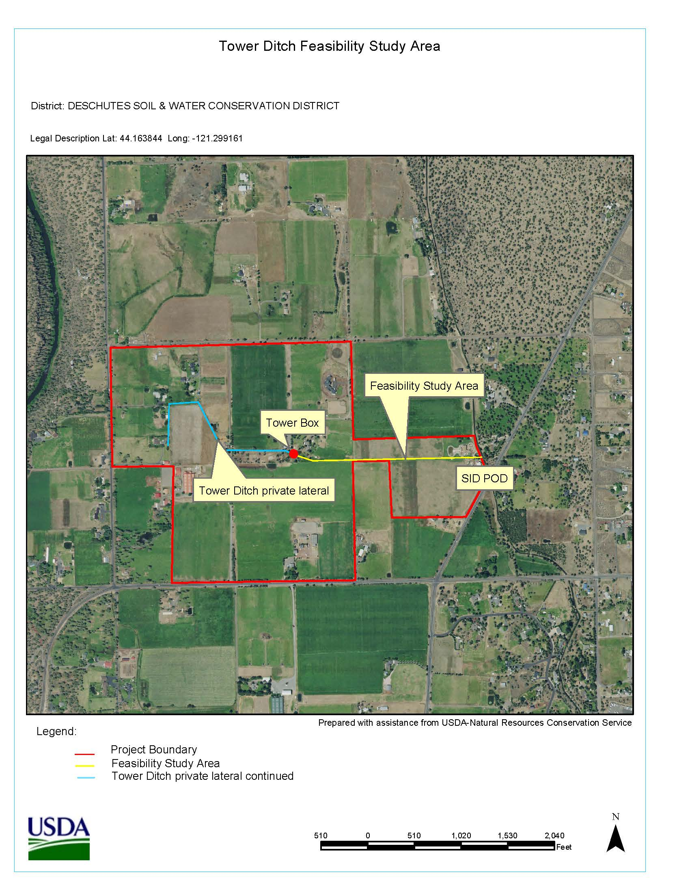
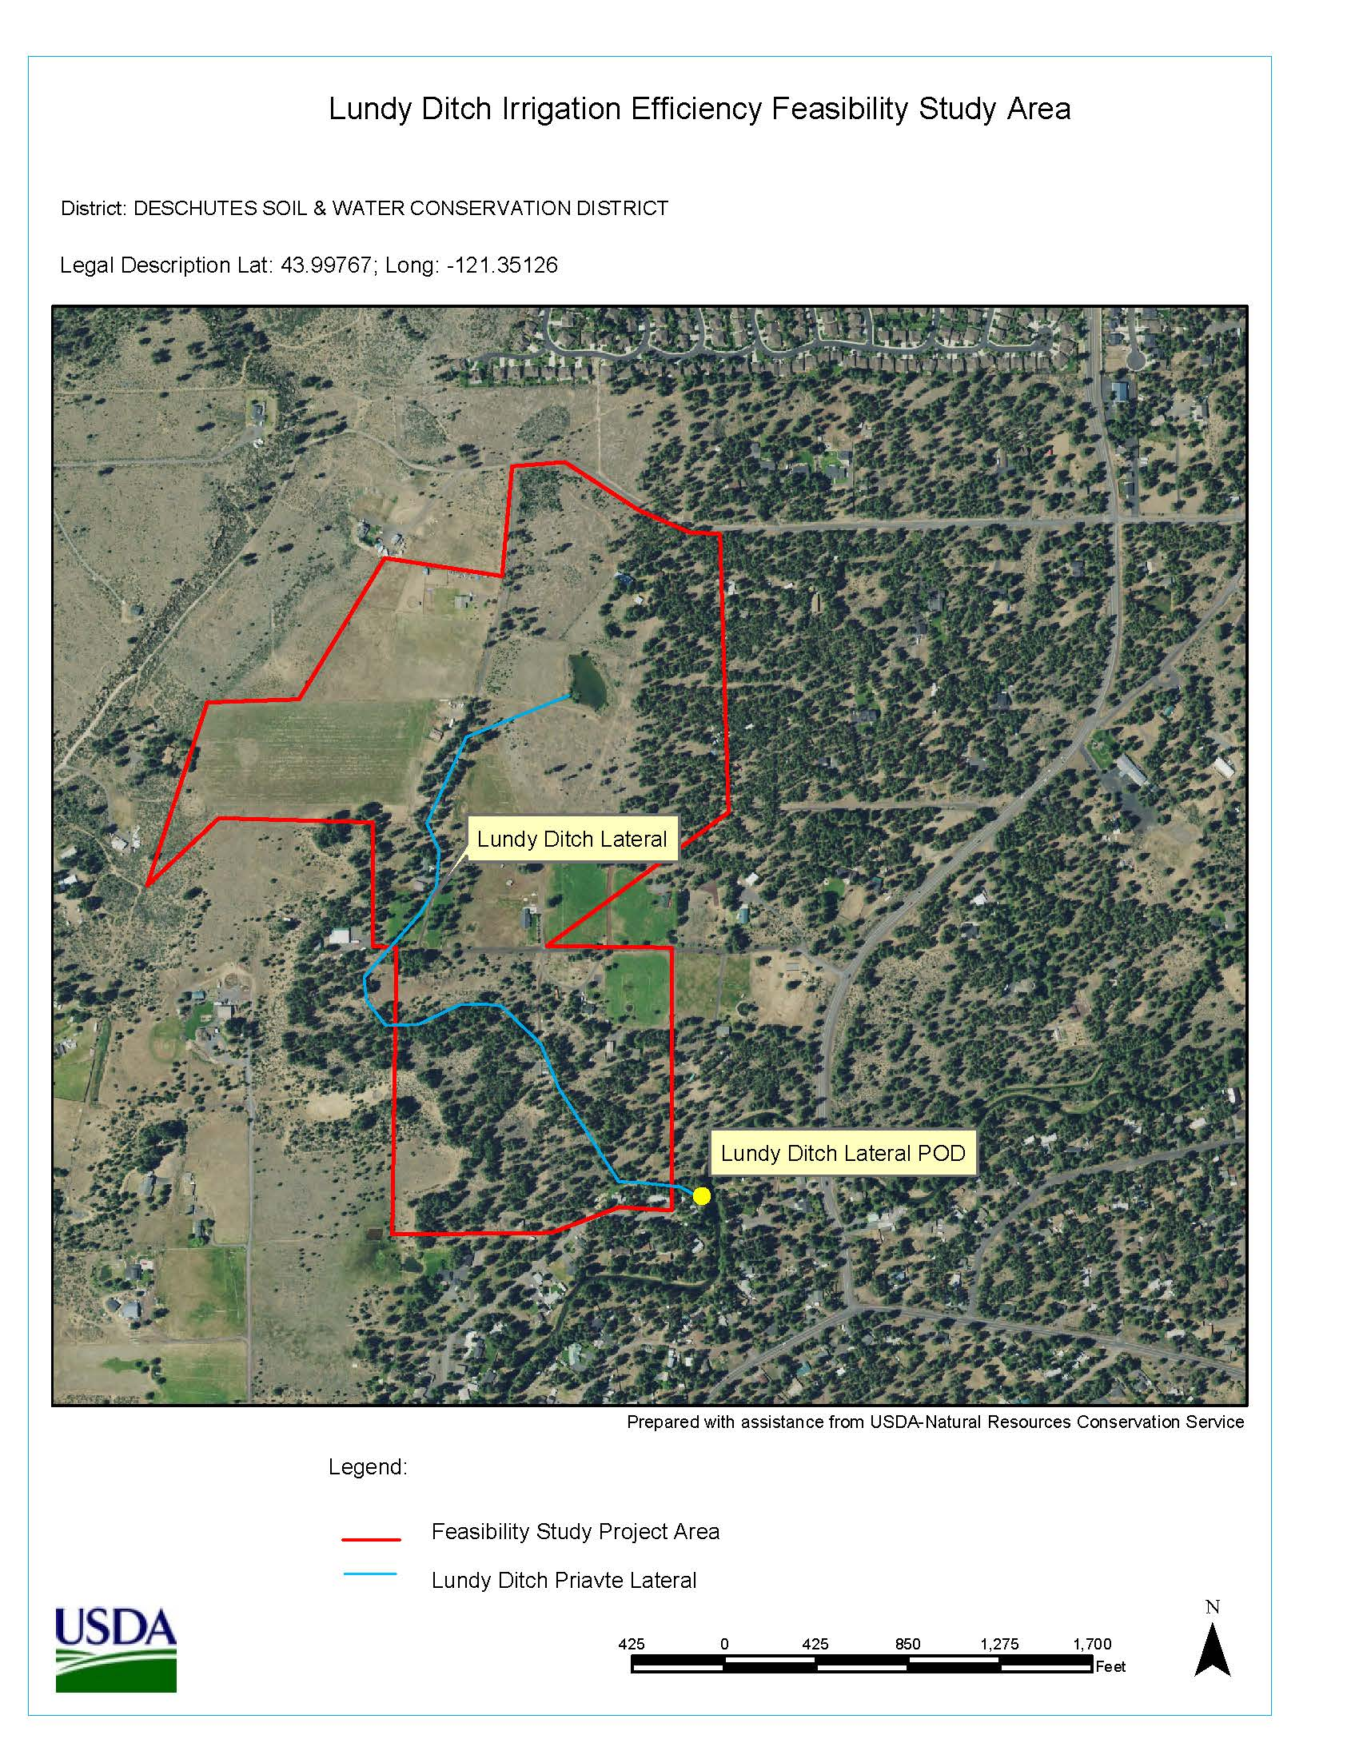
Irrigation Conveyance Water Savings

Slide 8
Upper Deschutes Forest Health Investment Project

Slide 9
Indian Ford Watershed Function and Health

Slide 10
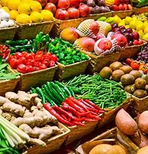
Urban Agriculture and Sustainability

Slide 11
Thank You!
Check out our Website!
https://www.deschutesswcd.org/
Deschutes SWCD

Slide 12
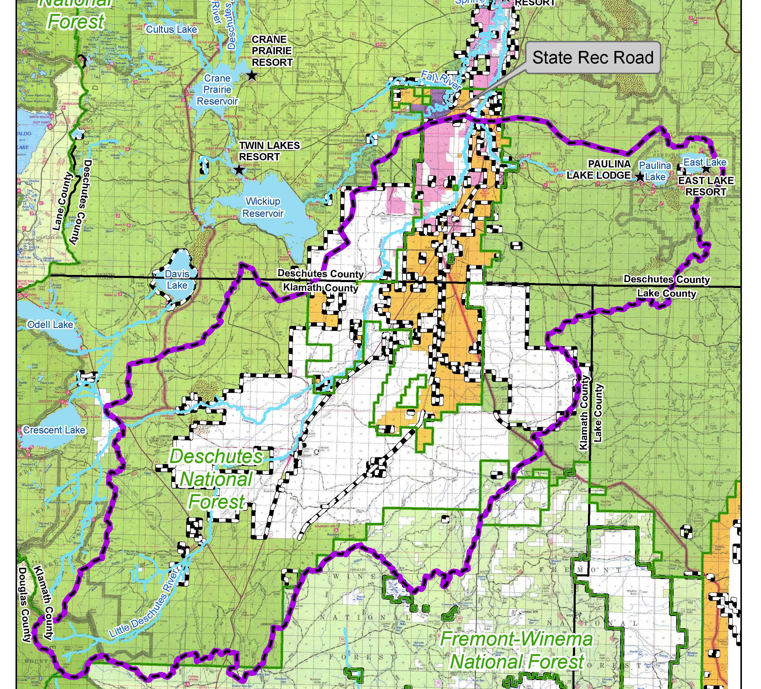
Upper Deschutes Forest Health Investment Project

Slide 13
Indian Ford Watershed

