Slide 1
Total Maximum Daily Load (TMDL), ODA’s WQ Program, and Implementation Plans
Kevin Fenn, WQ and SWCD Program Manager
Oregon Dept of Agriculture

Slide 2
What is the Ag Water Quality Program??

Slide 3
Federal Clean Water Act (CWA, 1972)
Objective: restore and maintain integrity of nation’s waters
Each State develops program to address WQ
EPA delegated WQ authority in Oregon to DEQ

Slide 4
Oregon Agency Roles Under CWA
DEQ:
Sets beneficial uses, parameters to monitor, WQ standards
Identifies impaired waters AKA “303(d) list”
Develops and implements Total Maximum Daily Loads (TMDLs)
Lead for urban storm water, municipal / industrial wastewater, transportation, non-ag point sources, federal land
ODF:
Lead for forestry (private and non-federal land)
Designated Management Agency (DMA) for TMDLs
ODA:
Lead for agriculture (private and non-federal land)
DMA for TMDLs

Slide 5
Ag WQ Program History
1993 - Senate Bill 1010 (Agricultural Water Quality Management Act, ORS 568.900-933):
ODA will prevent and control water pollution from ag activities
1995 - Senate Bill 502 (ORS 561.190-191):
ODA has lead authority to regulate ag water quality
ODA will write rules that regulate farming practices
Program must achieve water quality standards set by DEQ
1996 to 2004 - 38 Area Plans and Area Rules developed:
ODA
Local Advisory Committee (LACs)
Local Management Agencies (SWCDs)

Slide 6
ODA and SWCD Roles
ODA:
Revise Area Plans and Area Rules
Regulatory role, e.g. compliance investigations
Partner with agencies and organizations
Oversee SWCD Scope of Work (SOW)
SWCDs:
Local Management Agency (LMA)
Voluntary role
SOW funding to implement Ag WQ Program:
Landowner engagement and technical assistance
Coordinate with local partners
Seek funding and implement projects (OWEB, NRCS, etc.)
Monitoring

Slide 7
Ag WQ Area Plans and Area Rules
Area Plans (voluntary) show how ODA and agriculture will achieve:
Water Quality Standards
Total Maximum Daily Loads
Area Rules (regulatory; OAR 603-095):
Landowners are required to achieve compliance
ODA uses enforcement when necessary
Area Plans + Area Rules must achieve WQ standards and TMDLs

Slide 8
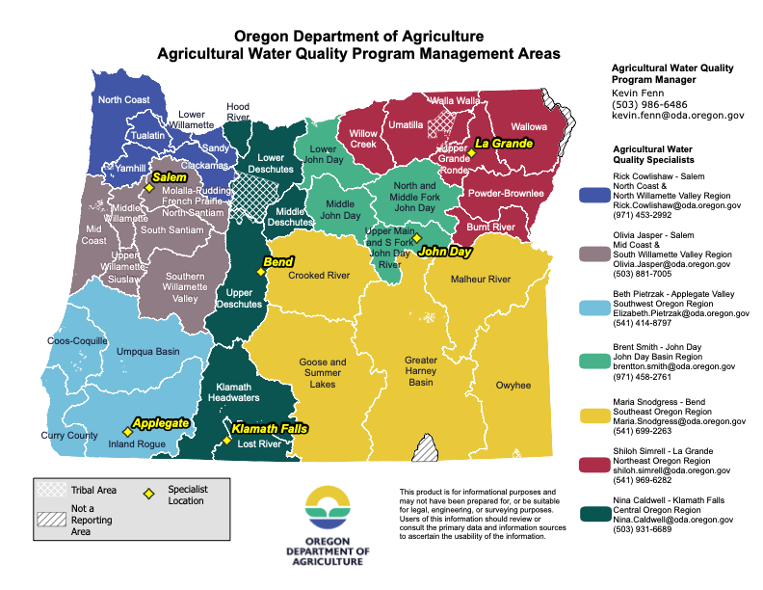
38 Ag WQ Management Areas:
Area Plan (voluntary)
Area Rules (regulatory)

Slide 9
What is an ODA TMDL Implementation Plan?

Slide 10
Designated Management Agencies (DMA)
For example, the Yaquina TMDL DMAs:
Agriculture – Oregon Dept of Agriculture
Forest - Oregon Dept of Forestry
County – Lincoln County
Railroad – Portland & Western Railroad
Roads – Oregon Dept of Transportation
Federal Lands – US Bureau of Land Management
All DMA’s required to create an implementation plan!

Slide 11
Five Major Components to an Implementation Plan
Are in addition to Area Plans and include the following:
Communicate - issues and strategies
Strategize - Develop strategies and priorities for addressing TMDL
Measure - Each strategy has a ‘metric’ to monitor progress
Time – Each strategy has a metric and a target schedule
Adapt - Review progress and adjust strategies

Slide 12
What are the Sources of Pollutants?
For example, the Yaquina or Powder TMDL – Bacteria:
Bacteria
Livestock pasture runoff
Livestock livestock direct stream access
Failing septic systems
Notes:
Temperature = pollutant is solar radiation. Could list reasons – lack of shade, lack of stream structure

Slide 13
Where does it come from?
For example, the Yaquina TMDL:
DMA | Stream Miles with vegetation ht <3ft | Acres of Riparian vegetation ht < 3ft
Oregon Dept of Agriculture | 10.2 | 121.0
Oregon Dept of Forestry | 6.1 | 63.0
Lincoln County | 2.8 | 39.4
Portland & Western Railroad | 1.0 | 14.9
Oregon Dept of Transportation | 0.3 | 6.9
US Bureau of Land Management | <0.1 | 2.8
Total | 20.4 | 247.9

Slide 14
TMDL Goal – What’s the Target?
For example, the Yaquina TMDL – Bacteria and Solar Radiation:
Pollutant | Source | Reduction Needed
Solar Radiation | Insufficient height and density of riparian vegetation; altered bank and channel morphology | 76%
Phosphorous | Livestock grazing and management | 50%
Bacteria | Livestock grazing and livestock in and around streams | 83%
Notes:
Mercury reduction – 86 or 95 for TSS. Temperature TMDLs will have reductions as well.

Slide 15
What are some strategies for getting there? Examples: Yaquina TMDL
Management Strategies
Livestock management Upland erosion control techniques Riparian fencing (or other livestock exclusion) Stream crossing improvements (culverts/structures/fords removed or replaced with bridge or hardened ford) Water gap development Livestock stream access/crossing creation or improvement Livestock off channel watering Livestock sacrifice area improvements Elk management for natural seasonal movements Incorporate nutrient loading and nutrient management plans in Ag Area Plan

Slide 16
When can we get there? Example: Yaquina TMDL
Assessment Year | Bacteria Load Reduction (%)
Year 5 - 2029 | 15 – 60%
Year 10 - 2034 | 40 – 90%
Year 15 - 2039 | 50– 95%
Year 20 - 2044 | 60 – 98%
Notes:
There is a long term goal associated with where we want to get to. Must have timelines associated with strategies. How, why, and when for each strategy.

Slide 17
Integrate Current Activities into Plan
Landowner workshops, handouts, communication
Landowner technical assistance
Implementations recorded!
SIA’s, Focus Areas
Area Plan activities
Rule Updates needed?
Ag practice strategies documented & prioritized
Notes:
The expectation for ag landowners are to comply with Ag Rules.

Slide 18
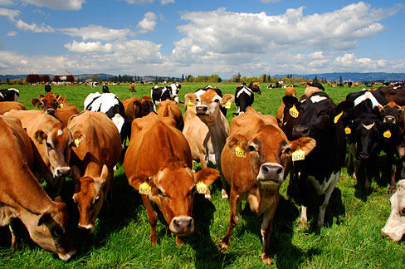
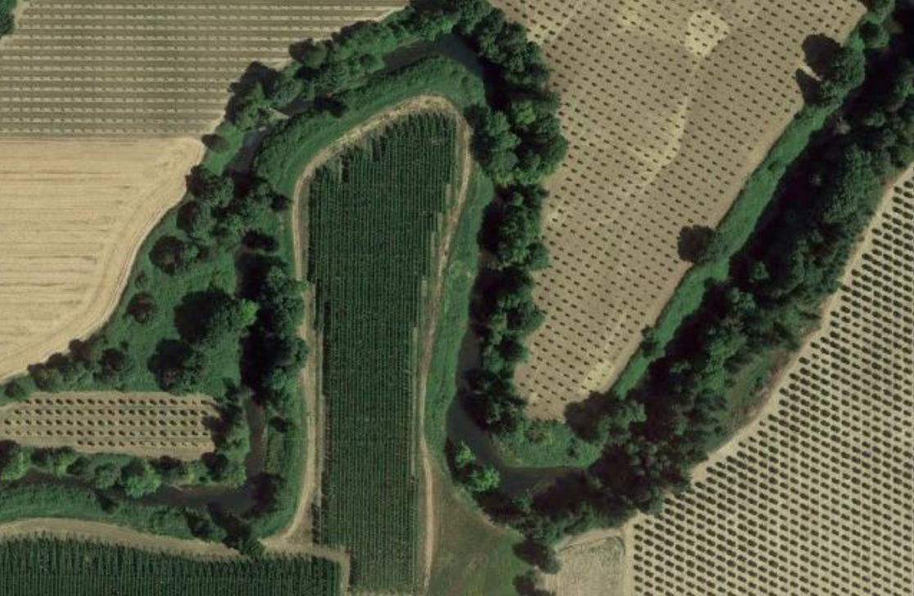
Ag WQ Area Rules (Outcome Based)
Waste Rule
Agricultural landowners must not pollute ground or surface water, discharge wastes into waters of the state, or place any wastes in a location where they are likely to enter waters of the state (ORS 468B.025)
Wastes include excess soil, manure, fertilizer, or other substances that can pollute water
Waters of the state can include ponds, groundwater, canals, ditches, rivers
Streamside Vegetation Rule
Agricultural landowners must allow vegetation to establish and grow along:
Streams that flow all year (perennial), to provide shade, stabilize banks, and filter out pollutants from overland flows
Streams that flow part of the year (intermittent), to stabilize banks and filter out pollutants from overland flows

Slide 19
Implementation Plan Creation
IMPLEMENTATION MATRIX (Step 1)
Excel spreadsheet of Strategies
Each Strategy Consists of: Purpose Who will execute
Money (dollars) needed Metric to Measure Progress Timeline Adaptive Measures
IMPLEMENTATION PLAN (Step 2)
Provides TMDL Background
Provides TMDL Goals
Narrative of Implementation Matrix
Provides More Details of Strategies
Notes:
How we track the work and funds that go into the plan. This is the building blocks for the Implementation Plan. Outreach, SIAs, BMPs. Mercury is the first one implemented. Plan is the narrative to go along with the matrix. Also includes the resources needed section. We don’t have the resources to fully implement a plan. Existing staff are at full capacity. We get the rule or TMDL and no money to implement.

Slide 20
Is The Plan Adequate?
ODA submits the Implementation Plan to DEQ for approval.
Looking for ‘Reasonable Assurance’ that an implementation plan strategies
Exist
Are technically feasible
Have a high likelihood of implementation
Notes:
Supposed to be reviewed at 5 years. Annual reporting

Slide 21
After Plan Completion …
Annual Reports are submitted by ODA to DEQ
Implementation Plans are reviewed and updated every 5-Years

Slide 22
Coming Soon - ODA TMDL Requirements!
Year | Area | Number of 5-yr Implementation Plans | Number of Annual Reports
2023 | Willamette Mercury | 1 | 0
2024 | Yaquina | 2 | 1
2025 | Willamette, Sandy, Powder, Lower Willamette, South Umpqua | 6 | 2
2026 | Willamette Main, Rogue, John Day, North Umpqua | 10 | 7
2027 |  | 10 | 10
2028 | Lower Grande Ronde, Mid Columbia | 12 | 10
2029 | Malheur, Walla Walla, Willow Creek | 15 | 12
2030 |  | 15 | 15
2031 | Lower Deschutes, Upper Deschutes | 16 | 15
2032 |  | 16 | 17

Slide 23
Thank You!
Kevin Fenn: ODA Water Quality and SWCD Program Manager; kevin.fenn@oda.oregon.gov
(503) 510-8214
Brian Creutzburg: DEQ Basin Coordinator and Alternative Compliance Specialist; brian.creutzburg@deq.oregon.gov

