Slide 1
Net Carbon Sequestration Potential and Soil Health in Agriculture
Mike Badzmierowski, Ph.D.
ODA – Soil Health Specialist
OACD Annual Meeting – November 2nd, 2022
mike.badzmierowski@oda.oregon.gov

Slide 2
Net carbon sequestration
The net additional storage of carbon from atmospheric carbon dioxide after accounting for any greenhouse gas losses.
mike.badzmierowski@oda.oregon.gov
Notes:
Feeds and provides habitats for diverse soil organisms, including those that help fight plant pests and diseases.
Makes it easier for plant roots to thread through the soil to find water, air and nutrients. (reduces soil density)
Holds water in sandy (dry) soils and helps with drainage and oxygen availability in clayey (wet, heavy) soils.
Provides holding places for nutrients that plants need

Slide 3
Soil organic carbon/matter
Soil organic matter - the portion of soil composed of living and dead things in various decomposition stages such as plant inputs and microbes (<2 mm).
A matrix of carbon, hydrogen, and oxygen and essential nutrients such as nitrogen, phosphorus, calcium, sulphur, potassium, magnesium, etc.
mike.badzmierowski@oda.oregon.gov
Notes:
Feeds and provides habitats for diverse soil organisms, including those that help fight plant pests and diseases.
Makes it easier for plant roots to thread through the soil to find water, air and nutrients. (reduces soil density)
Holds water in sandy (dry) soils and helps with drainage and oxygen availability in clayey (wet, heavy) soils.
Provides holding places for nutrients that plants need

Slide 4
Soil organic matter/carbon theory is transitioning
The understanding of soil organic matter/carbon formation and loss has changed dramatically in the last 15 years.
Chemical complexity aka “recalcitrance” of plant litter and microbial material was thought to cause slow organic matter/carbon turnover as it was thought to be impervious to microbial decay.
With advancement in technologies, the soil science community has found there are no specific plant compounds that are selectively preserved.

Slide 5
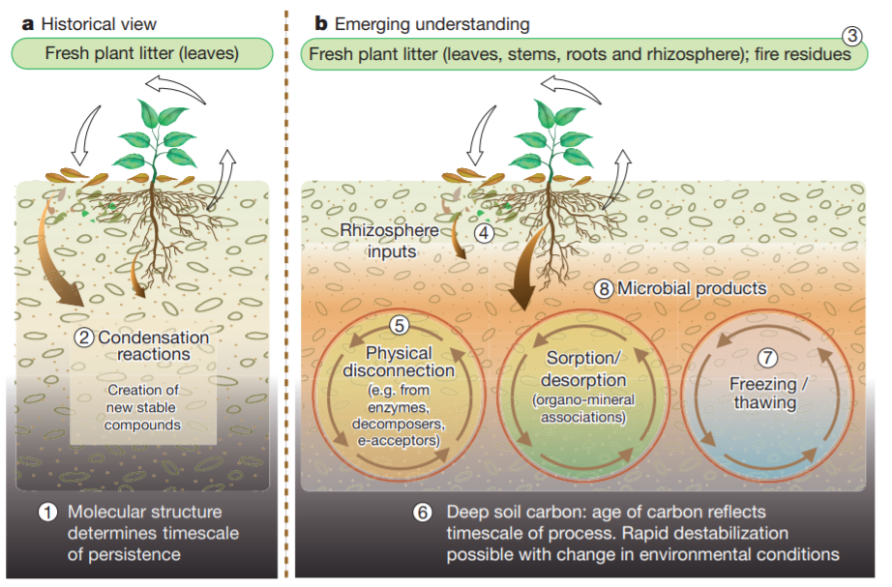
How does some soil organic matter/carbon persist for centuries?
Chemical and physical protection mechanisms restrict the access of microbial decomposers to organic matter.
“Physio-chemical protection” has replaced “chemical recalcitrance” as the principal mechanism to long-term soil organic matter/carbon persistence.
Figure from: Schmidt, M., Torn, M., Abiven, S. et al. Persistence of soil organic matter as an ecosystem property. Nature 478, 49–56 (2011). https://doi.org/10.1038/nature10386

Slide 6
Best literature for current understanding latest soil organic carbon theory
Popkin, G. A soil science revolution upends plans to fight climate change. 2021. Quanta Magazine. https://www.quantamagazine.org/a-soil-science-revolution-upends-plans-to-fight-climate-change-20210727/
Lehmann, J., & Kleber, M. (2015). The contentious nature of soil organic matter. Nature, 528(7580), 60-68.
Schmidt, M., Torn, M., Abiven, S. et al. Persistence of soil organic matter as an ecosystem property. Nature 478, 49–56 (2011). https://doi.org/10.1038/nature10386
Waring, BG, Sulman, BN, Reed, S, et al. From pools to flow: The PROMISE framework for new insights on soil carbon cycling in a changing world. Glob Change Biol. 2020; 26: 6631– 6643. https://doi.org/10.1111/gcb.15365
Kögel-Knabner, Ingrid, and Cornelia Rumpel. "Advances in molecular approaches for understanding soil organic matter composition, origin, and turnover: a historical overview." Advances in Agronomy 149 (2018): 1-48.
Lehmann, J., Hansel, C.M., Kaiser, C. et al. Persistence of soil organic carbon caused by functional complexity. Nat. Geosci. 13, 529–534 (2020). https://doi.org/10.1038/s41561-020-0612-3
Kleber, M. (2010). What is recalcitrant soil organic matter?. Environmental Chemistry, 7(4), 320-332.

Slide 7
Practices on agricultural lands best suited for greenhouse gas reduction
Soil carbon sequestration should not be the primary objective, but a possible co-benefit as a result of improved soil management practices and soil health
Increasing perennial crops, riparian area beyond what is regulated, tree planting, efficiency of nitrogenous fertilizers, reduction of fuel usage, are the most concrete ways to reduce greenhouse gas emissions
mike.badzmierowski@oda.oregon.gov
Notes:
12,000+ years of cultivated agriculture has reduced global soil carbon by ~116 Gt¹ equivalent to more than a decade of the present rates of industrial emissions

Slide 8
Environmental constraints
To build soil organic matter/carbon water and nitrogen (a lot) is needed
Groenigen et al. (2017) concluded that the stated 4p1000 goal of sequestering 1200 Tg C yr^{–1} in agricultural soils is unlikely to be met, due to stoichiometric constraints
There is increasing evidence that soil carbon stocks will decrease with increasing temperatures
Declining stocks will most probably be the result of the combined effect of significantly (i) higher temperatures, causing elevated rates of microbial decomposition/respiration and (ii) drier conditions, causing lower soil moisture conditions, which hampers plant growth and hence reduces C input (Meersmans et al., 2016)
Carbon saturation
GHG pulsing with increased precipitation intensity

Slide 9
What do soil carbon scientists think about carbon sequestration in agriculture?

Slide 10
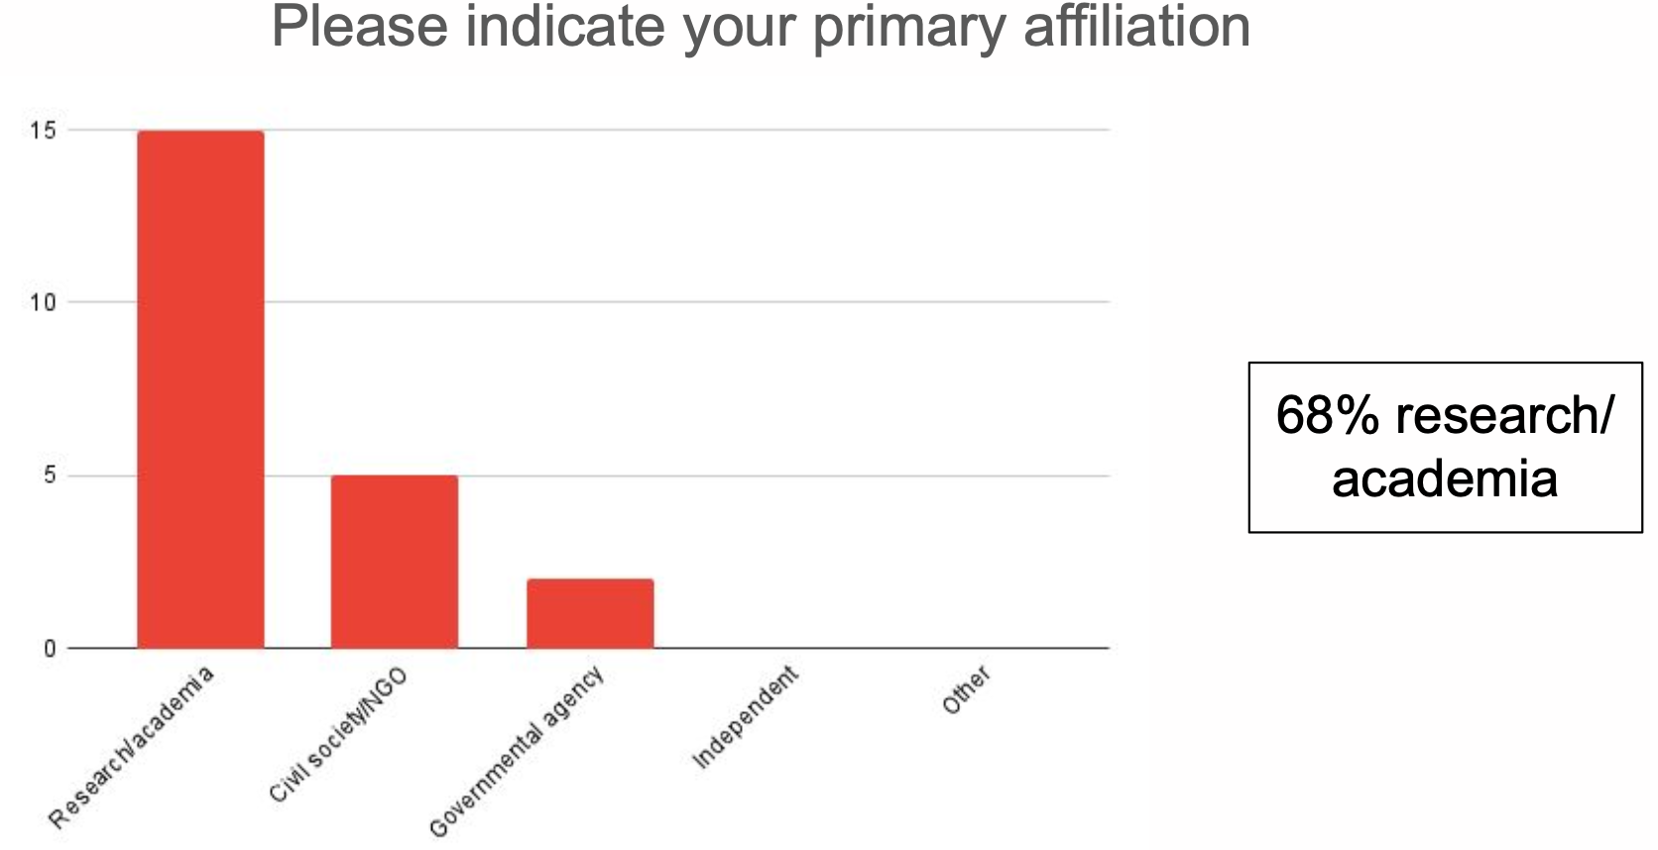
What do soil carbon scientists think about net carbon sequestration in agriculture?
Brown et al. 2022 assessed soil carbon scientists' views on soil carbon in croplands, while taking into consideration net GHG mitigation that result from specific management practices
Brown et al. 2022. Assessing views on soil carbon in croplands: Final report
Notes:
Participants were selected from leading environmental organizations and academic institutions actively working on soil carbon issues

Slide 11
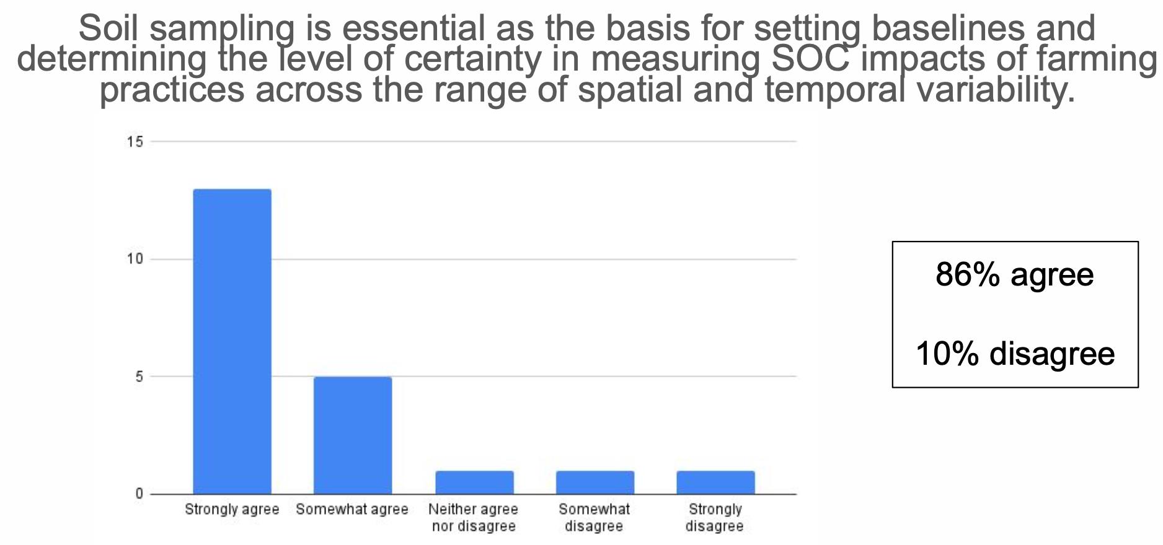
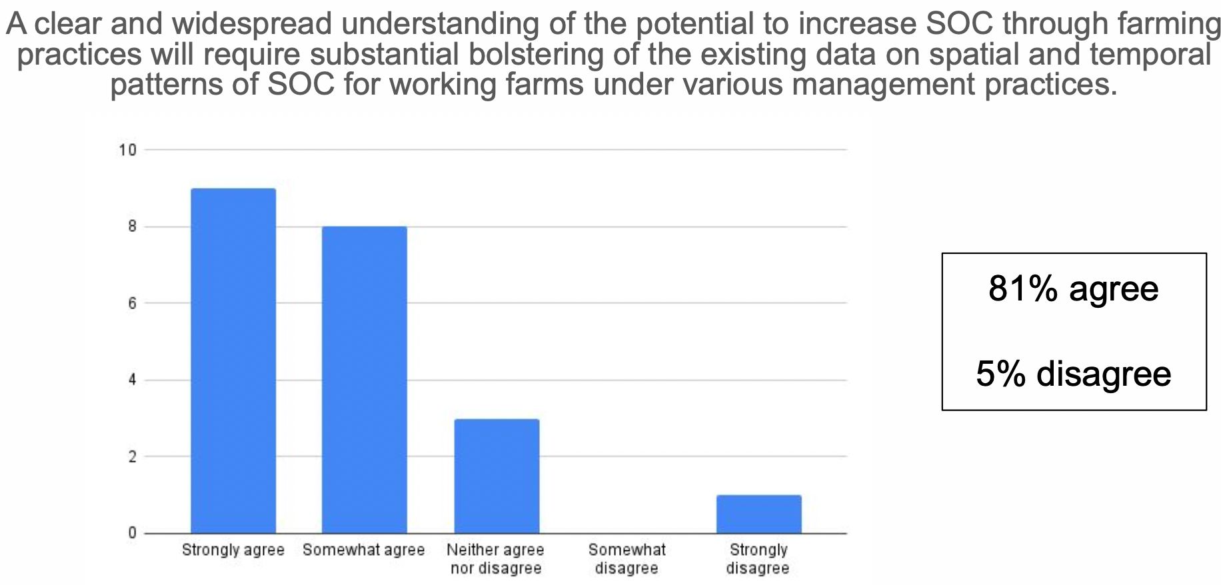
More data needed
Many scientists believe soil carbon dynamics under real field conditions have not been studied adequately
Soil sampling seen as most appropriate basis for setting baselines for soil carbon and measuring changes over time
Other techniques, such as measurement and modeling based on proxy variables and remote sensing data, were seen as useful ways to supplement and extend (but not replace) the usefulness of sampling data
Brown et al. 2022. Assessing views on soil carbon in croplands: Final report

Slide 12
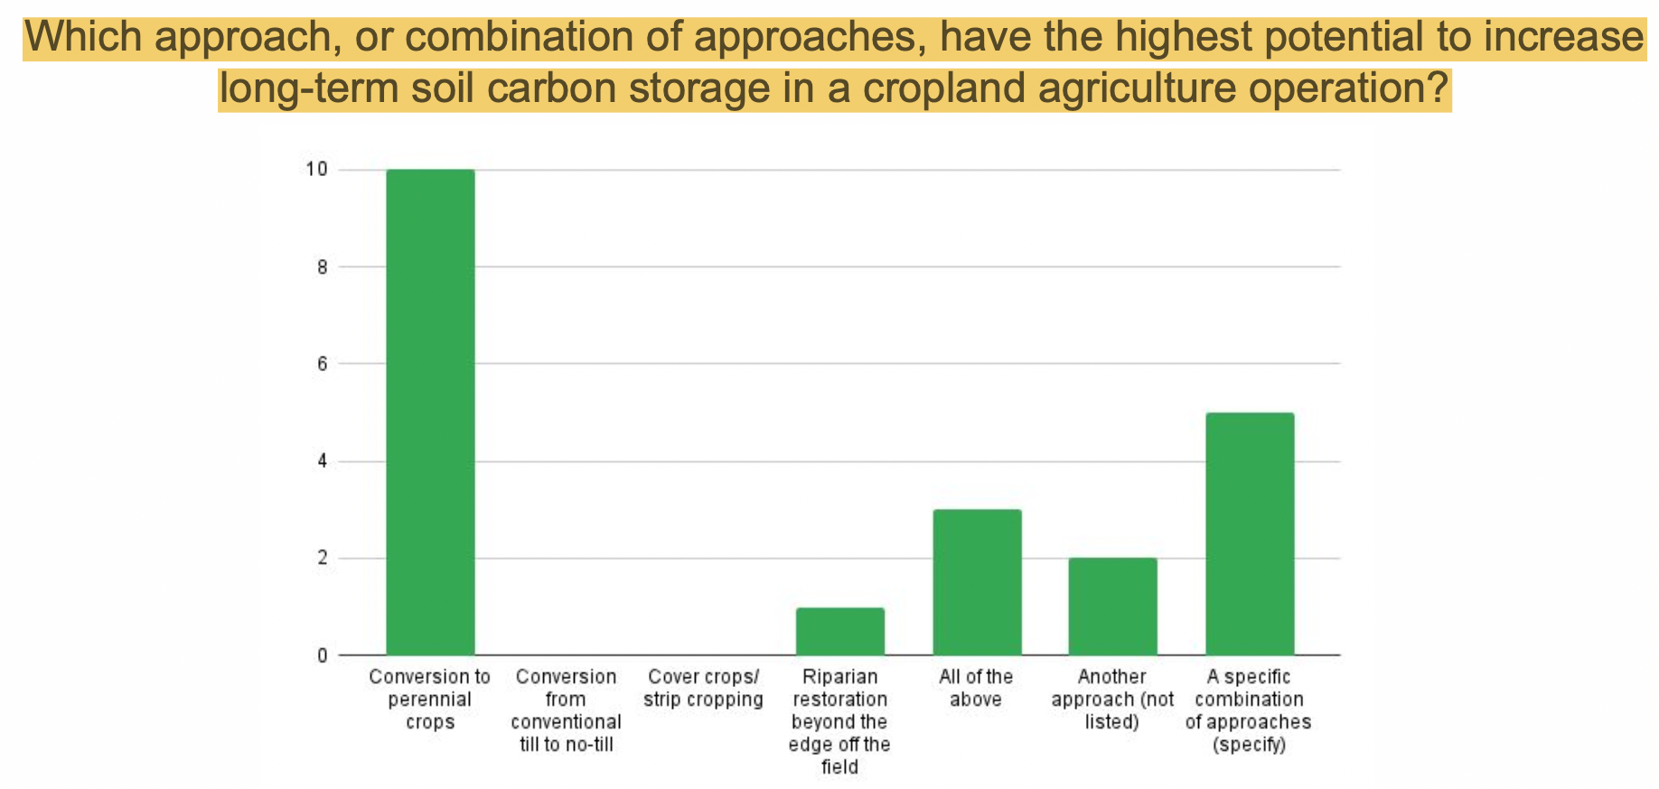
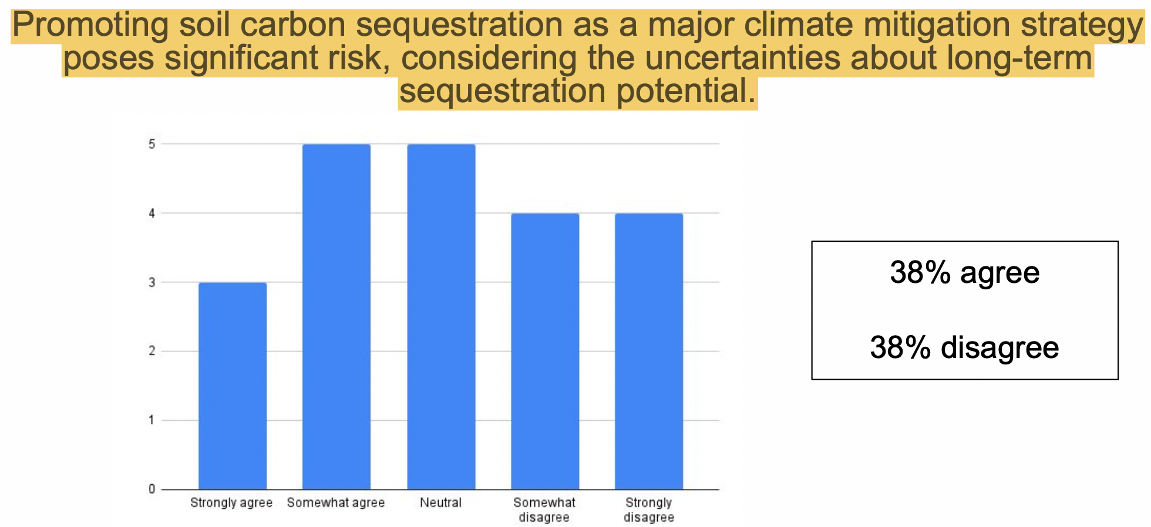
What do soil carbon scientists think?
Scientists largely agreed that soil health should potentially be the main rationale for improved management practices
Participants emphasized need to track fluxes of all GHGs associated with management practices in croplands and noted that consideration of soil carbon alone could fail to accurately quantify the climate effects of cropland management
Experts reinforced that rates of carbon increases are far too nuanced and varied across different geographies to reliably predict the quantity of sequestration that would occur due to any agricultural management practice
Brown et al. 2022. Assessing views on soil carbon in croplands: Final report
Notes:
principal focus of our work was practices that could be implemented in annual cropland agriculture, with the aim of maintaining productivity while also sequestering carbon.

Slide 13
Trade-offs
“There are no solutions, there are only trade-offs; and you try to get the best trade-off you can get, that's all you can hope for.”
– Thomas Sowell

Slide 14
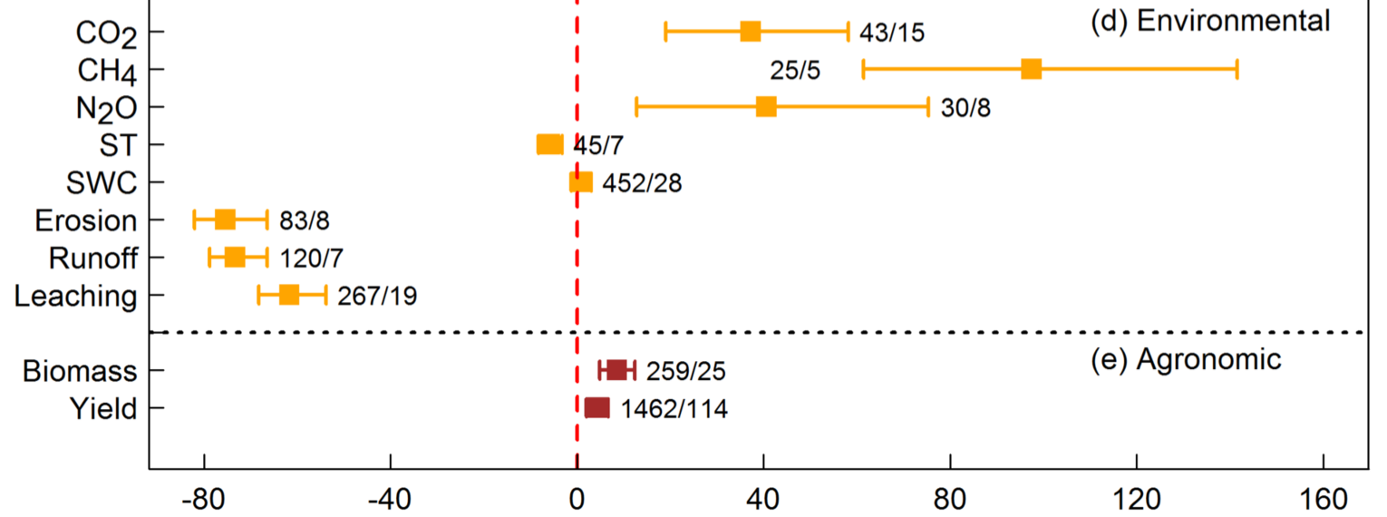
Trade-offs and cover crops
% change
Meta-analysis by Jian et al. A calculator to quantify cover crop effects on soil health and productivity (2020), comparing cover cop treatments vs. no cover crop

Slide 15
Trade-offs and no-till
No-till (and to a lesser extent reduced tillage) reduces erosion and runoff, improves soil structure and water retention, but appears to result in decreased soil organic carbon stocks¹ and increase nitrous oxide emissions²
Cai et al. Declines in soil carbon under no tillage can be alleviated in the long run. 2022.
Huang et al., 2018. What are the effects of no-tillage systems on greenhouse gas emissions and crop yield?

Slide 16
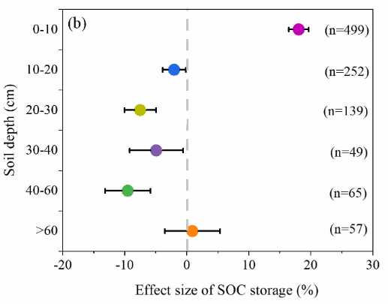
Trade-offs and no-till cont.
Cai et al. (2022) performed a meta-analysis of 1061 pairs of published experimental data comparing no-till and conventional tillage. No till increased surface (0-4 in) soil organic carbon stocks but decreased stocks in deeper depths (4-24 in)
This led to a decrease in stocks in the entire profile for 14 years until no-till was able to close the gap on stock losses

Slide 17
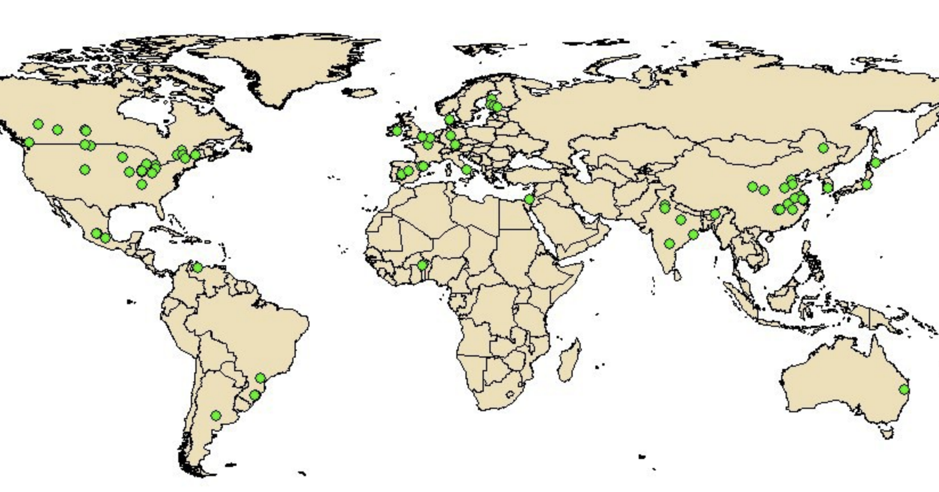
No-till vs conventional GHG emissions
Huang et al., 2018. What are the effects of no-tillage systems on greenhouse gas emissions and crop yield?
Higher N₂O emissions in no-till is usually ascribed to enhanced soil microbial activity (denitrification) due to increased soil moisture and decreased soil aeration
Notes:
Overall changes in soil greenhouse gas (GHG) emissions and crop yields between NT and CT. Numerals indicate the number of observations. * represents p < 0.05

Slide 18
Trade-offs and no-till cont.
There has been substantial evidence that practices such as no-till may not increase soil carbon stocks but rather redistributes soil carbon in the profile.
It is poor practice for soil sampling protocols to only account for the top 30 cm.
The most popular soil carbon model (COMET-Farm/Planner) is only calibrated to the top 20 cm where there is a gain in soil carbon and can bias results
We must require protocols to dig deeper using equivalent soil mass

Slide 19
Future potential pathway
Enhanced weathering
Silicate minerals exposed to the weather have been sequestering atmospheric carbon and turning it into rock since the dawn of time, but normally takes thousands of years
This period can be cut to two years by grinding silicate rocks into a fine powder, thus increasing its surface area and its contact with CO₂ when applied to land
Silicates are the main ingredient in most igneous (volcanic) rocks (~15% of Earth’s land surface)
Tradeoff – some igneous rocks may pose heavy metal risks
Notes:
Biochar – scalability?

Slide 20
Interpreting Scientific Research

Slide 21
Evidence reviews
Evidence reviews in conservation and environmental science are a vital tool to support decision making
The value of evidence reviews to end-users is strongly dependent on review objectivity (minimizes bias, individual judgement, or prejudice) and comprehensiveness¹
Where these qualities lack, there is potential to misinform and result in policies that have unwanted/unforeseen consequences and/or wasted research investment. This includes selection of primary data that supports an adopted position/belief by review authors
The reliability of evidence reviews has been a concern in many sectors which is why the health sector deemed ‘systematic review methodology’ as the gold standard for collecting and synthesizing evidence.
Recently the Collaboration for Environmental Evidence has developed protocols for environmental reviews to meet systematic review standards and publishes reviews in their journal “Environmental Evidence”
O’Leary et al. 2016. “The reliability of evidence review methodology in environmental science and conservation

Slide 22
Traditional Reviews
Systematic Reviews
Review Question/Topic
Generally broad or unclear
Well-defined, specific research question (often PICO based)
Protocol
No protocol included
A peer-reviewed protocol
Study Search
Searches may be ad hoc, based on familiar literature, not exhaustive/comprehensive
Attempts to find all published/unpublished literature on research question & is documented/reported
Study Selection
Often lack inclusion & exclusion criteria
Explicitly states inclusion/exclusion reasons based on established protocol
Assessing included studies quality
Often do not consider study quality or biases in a study design
Systematically assess risk of bias of individual studies and overall quality of evidence
Results/Data Synthesis
Conclusions are more qualitative and may not be based on study quality
Conclusions made on quality of studies, provide recommendations, identifies knowledge gaps, can include meta-analysis
Notes:
Ad hoc = defined on the fly

Slide 23
Low Quality and Transparency
Beillouin et al. 2021 analyzed 192 meta-analyses of soil organic carbon stocks or concentrations and found that most demonstrated low quality and transparency.
Fohrafellner et al. 2022 (pre-print) found similar conclusions that of 31 meta-analyses studying the effects of different management practices on soil organic carbon, only 1 was found to be of high quality (which was published in Environmental Evidence)
This issue has been reported for the last decade. Philibert et al. 2012 reviewed 73 meta-analyses in agronomy and found none satisfied all 8 of their pre-defined criteria for high-quality and only 3 satisfied 6 criteria
O’Leary et al. 2016 assessed 92 evidence reviews and found reviews performed poorly in objectivity, transparency, and comprehensiveness with a median score of 2.5/39. This was found across all subject areas. Reviews that used meta-analytical techniques were higher than narrative syntheses (median 18.3 and 2.0, respectively)
Beillouin et al. 2021 "A global overview of studies about land management, land‐use change, and climate change effects on soil organic carbon."
Fohrafellner et al. 2022 “Quality assessment of meta-analyses on soil organic carbon.”
Philibert et al. 2012 “Assessment of the quality of meta-analysis in agronomy.”
O’Leary et al. 2016. “The reliability of evidence review methodology in environmental science and conservation

Slide 24
CEEDER DATABASE EXAMPLE
Collaboration for Environmental Evidence Database of Evidence Reviews (CEEDER) provides an independent assessment, conducted to preset quality criteria, of the reliability of each synthesis with respect to its use in decision making.
https://environmentalevidence.org/ceeder/

Slide 25
Take Away Points
Net carbon sequestration in agriculture should be viewed as a co-benefit to healthy soil practices and not the primary driver
We need more data! If the goal is climate mitigation, continuous long-term GHG data should be priority
There will be trade-offs to choices!
Understanding the quality behind the data is important for proper decision-making and policy implementation
mike.badzmierowski@oda.oregon.gov

