Slide 1

Hood River SWCD
Collaborating for a Pesticide Education Program
Kris Schaedel
Conservation Program Manager

Slide 2
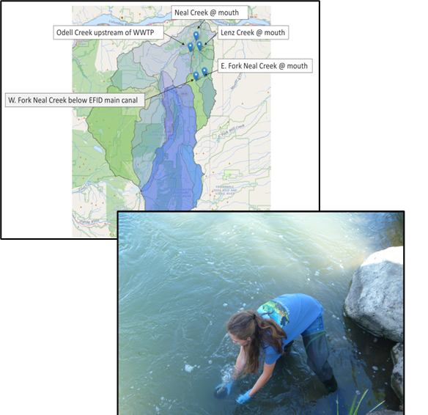
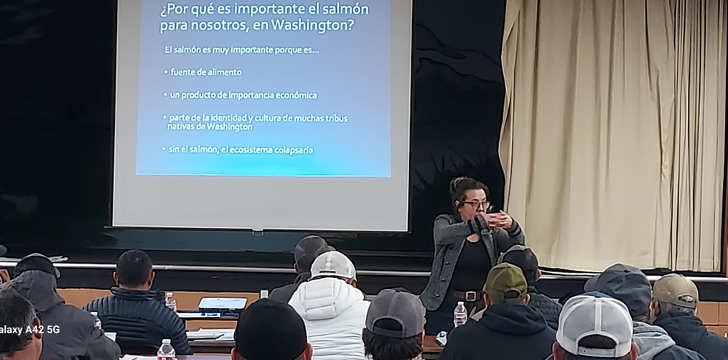
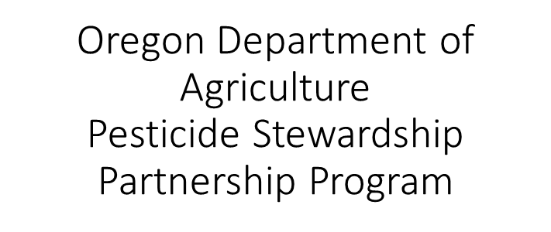
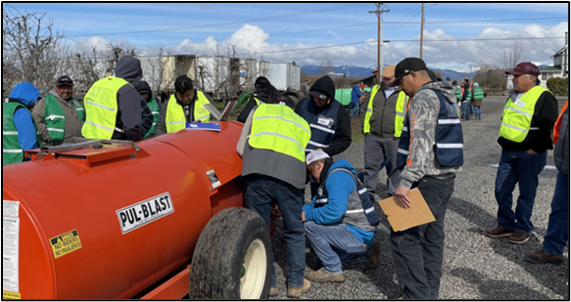
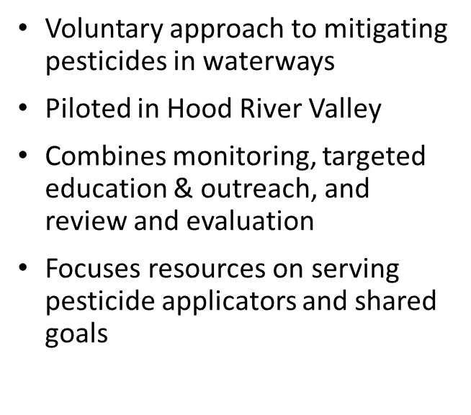
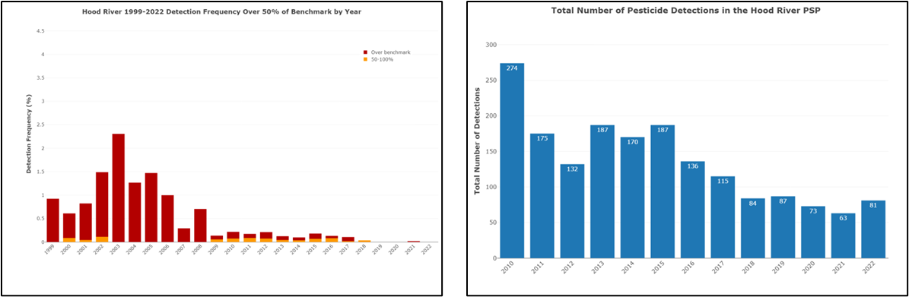

Slide 3
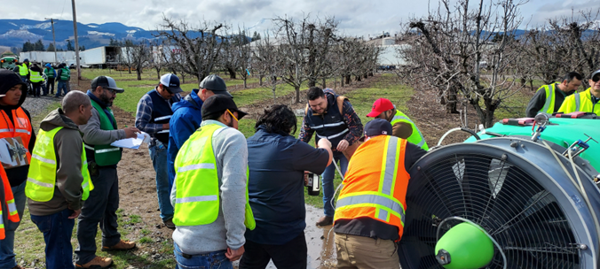
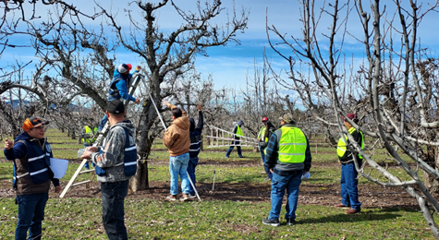
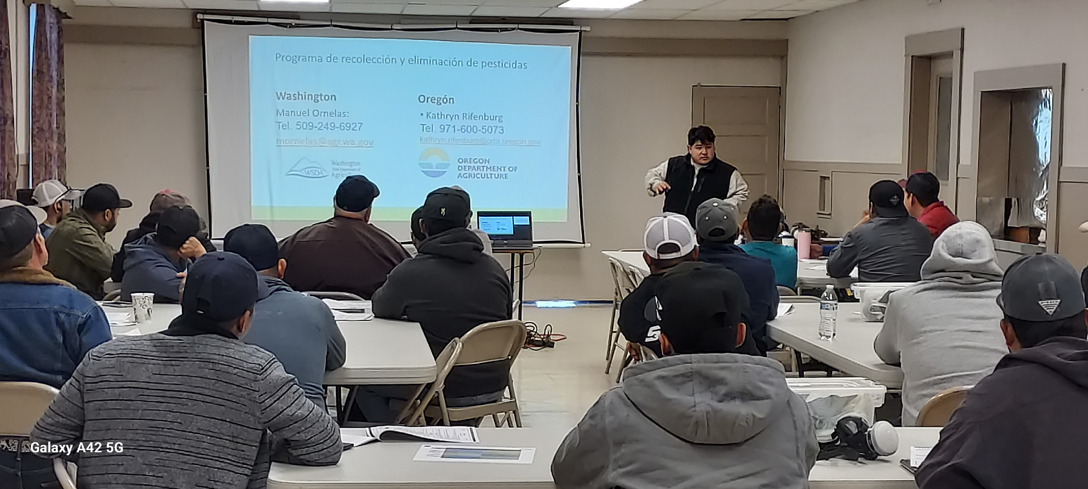
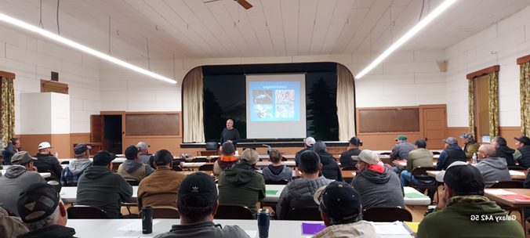
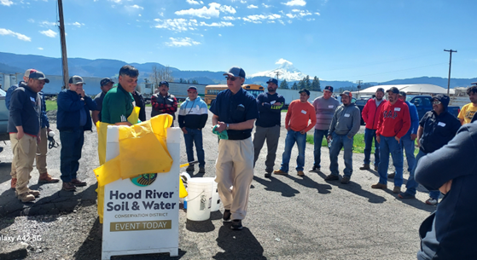
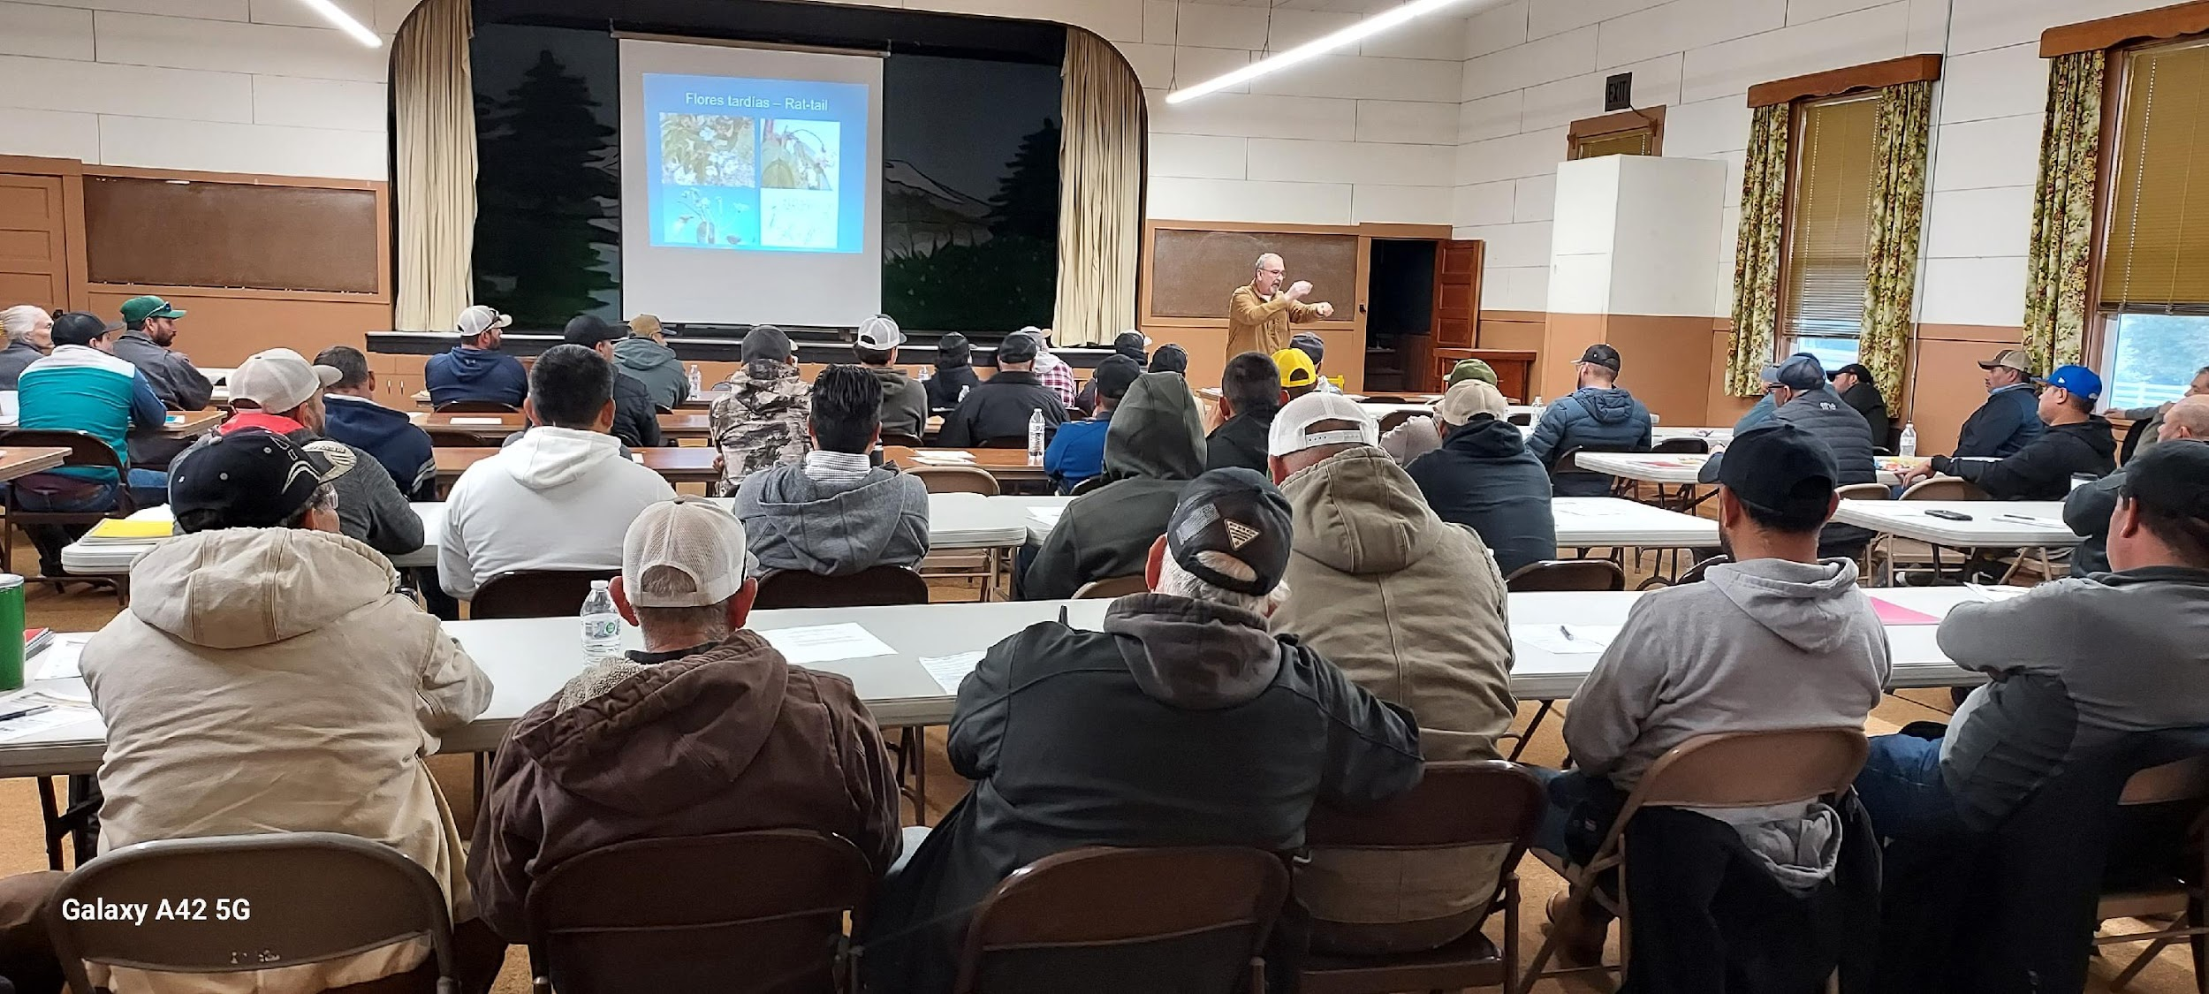
Workshops and Trainings
….building the program

Slide 4
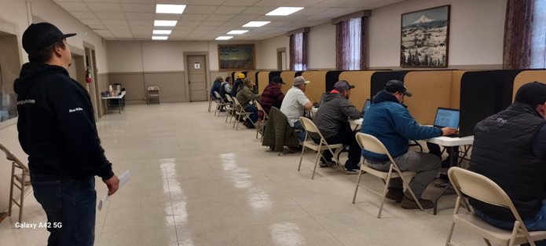
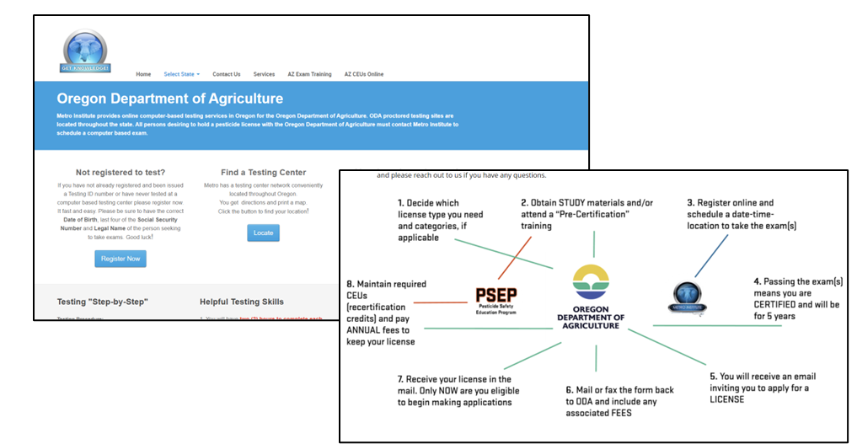
Pesticide Test Preparation, Access, and Administration in Oregon
Community college or university testing centers
No bilingual registration, little bilingual capacity at testing centers and the practice test and instructions are only in English
Hood River- ~50-70 mile commute
  CGCC Test was offered 1 x week, twice a day on 3 computers with no bilingual support.
Available only on a computer and registration is through a third party
The test is 100 questions and default time is 2 hours

Slide 5
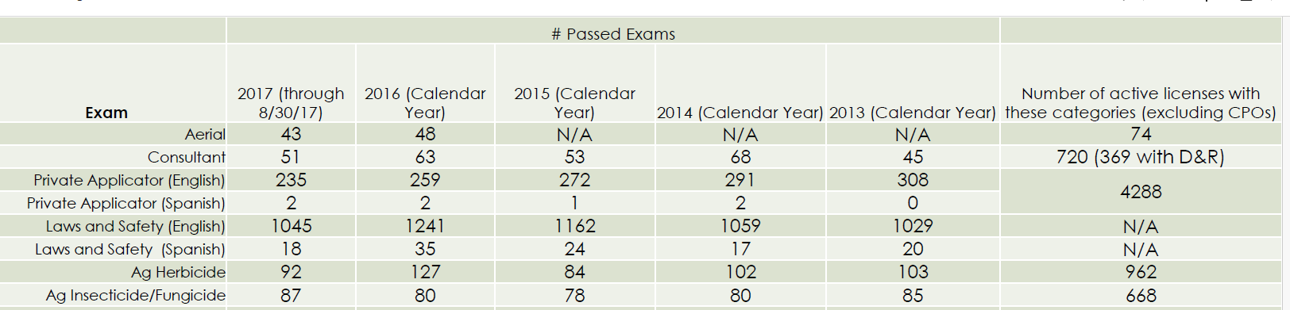
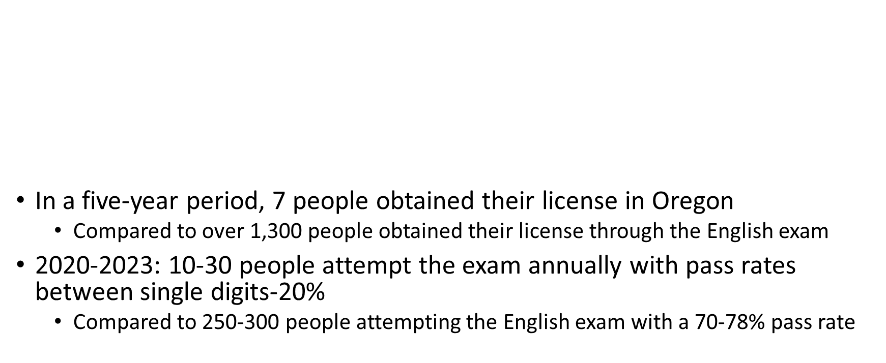
Assessment of Exam Performance in Oregon

Slide 6
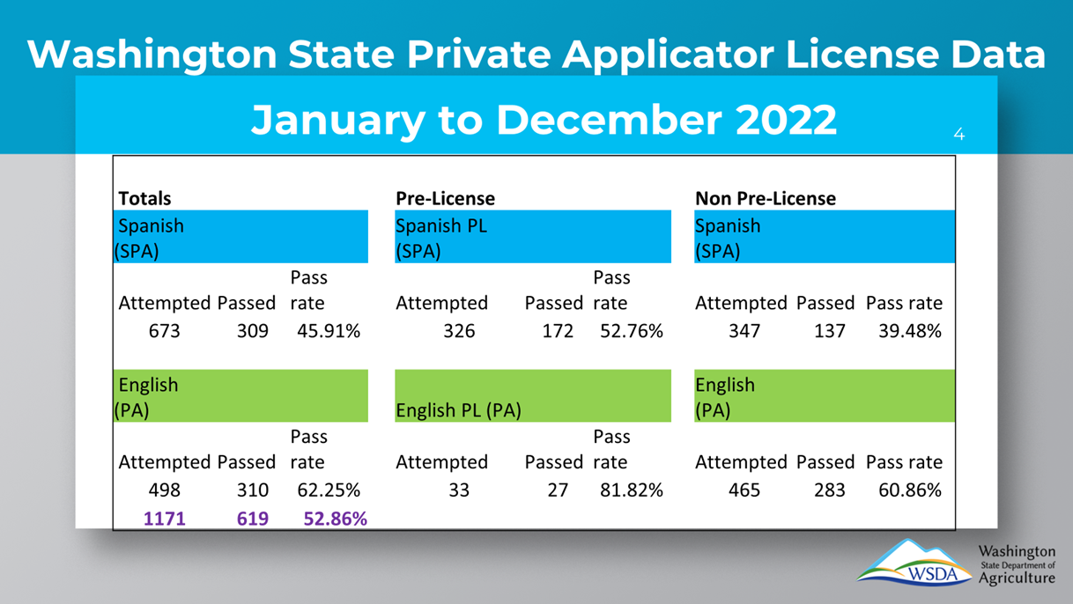

WSDA Testing and Licensing Program
Reciprocity in Oregon
Paper and can be proctored on-site in a bilingual capacity
60 questions 3 hours
Test has been reviewed with educators and industry to utilize plain language and remove trickiness or confusing terminology

Slide 7

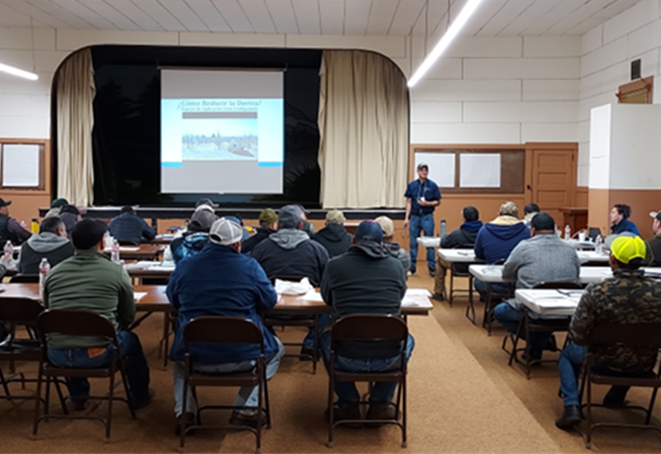
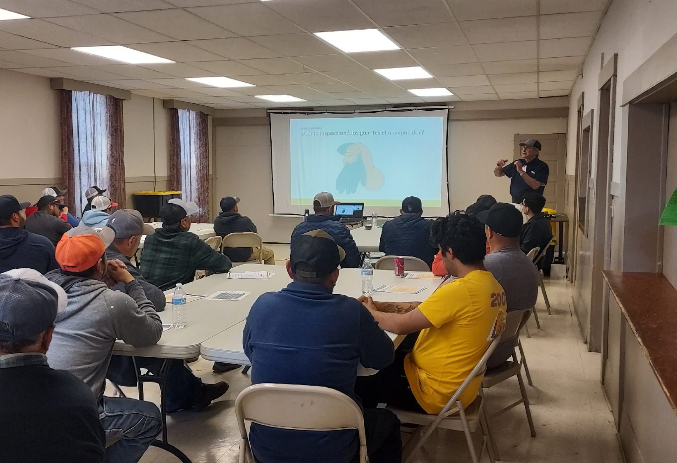
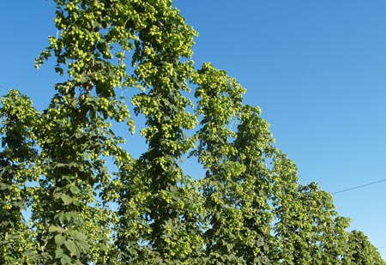


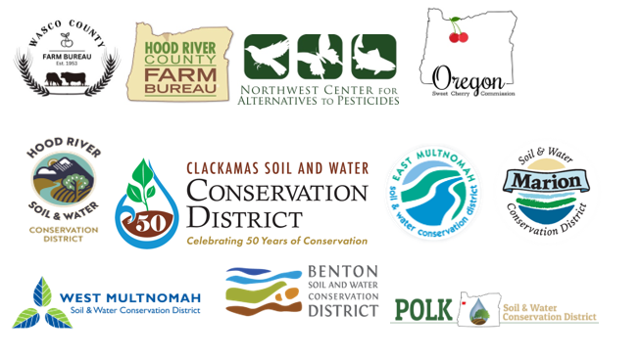

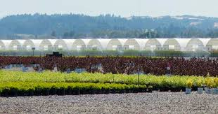
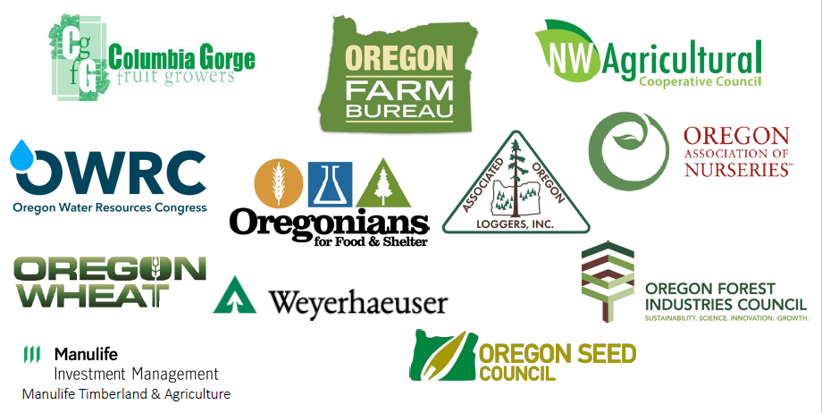
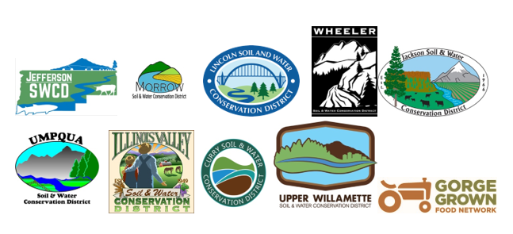
Moving forward into 2025 and beyond …
Working with OACD to put forth legislation in 2025 that would allocate state general funds to the Oregon Department of Agriculture to support 2 FTE Spanish language pesticide educators and capacity to their testing and licensing department

Slide 8


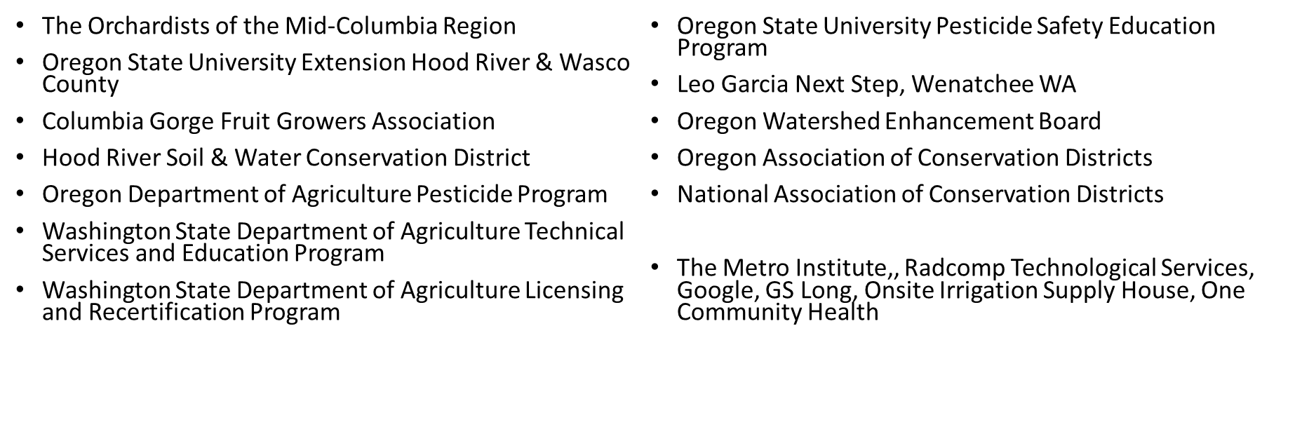
Thank you &
Acknowledgements
Questions?

