Slide 1
Oregon’s 100 Year Water Vision

Slide 2
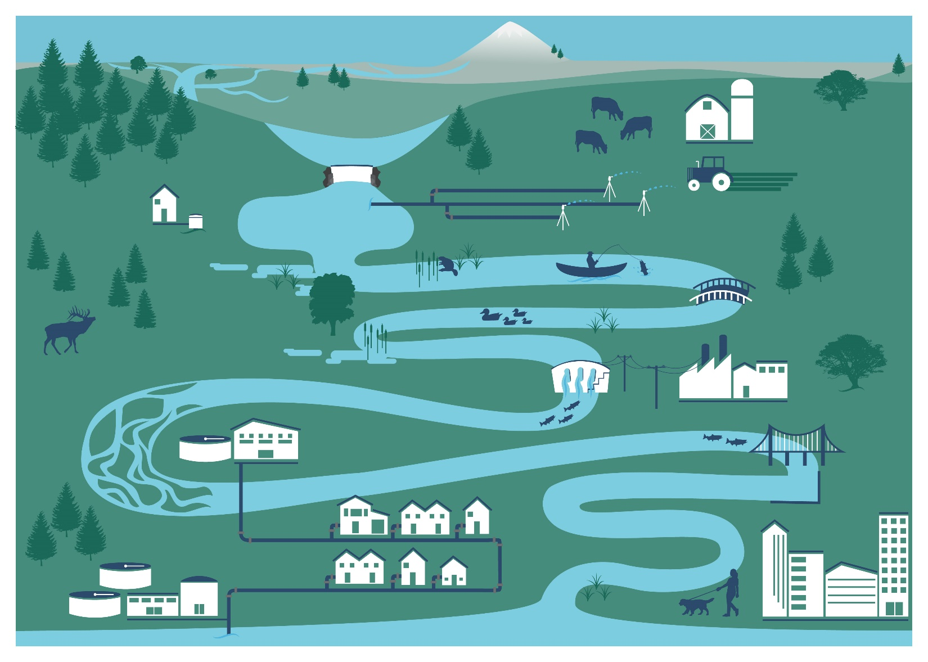
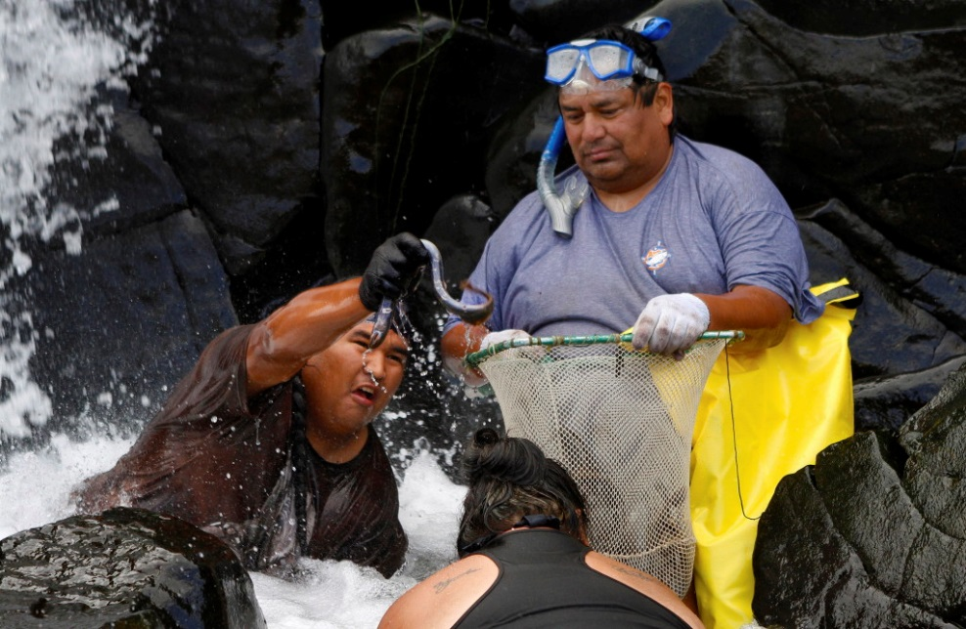
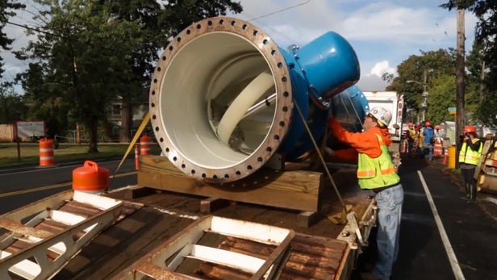
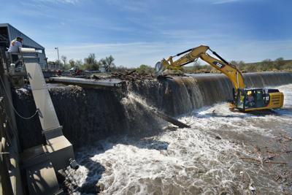
Health
Environment
Economy
Safety

Slide 3
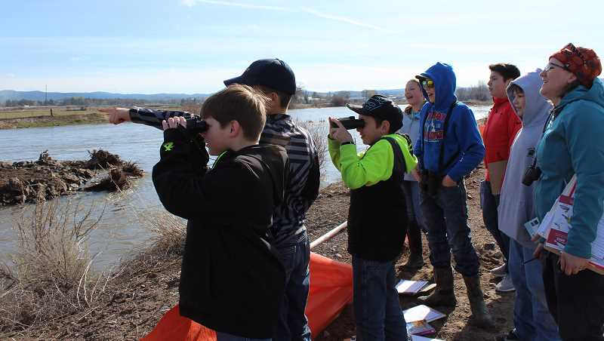
Problem Statements
Natural & Built Infrastructure:
Modern water supply & conservation
Resilient built and natural infrastructure
Upgraded systems
Coordination
Strong community capacity
Access to water data
Investments
Notes:
8 Community Conversations
Technical Workshop
75 interviews
Specific survey for infrastructure providers

Slide 4
www.oregonwatervision.org

