Slide 1

Opening intro

Slide 2
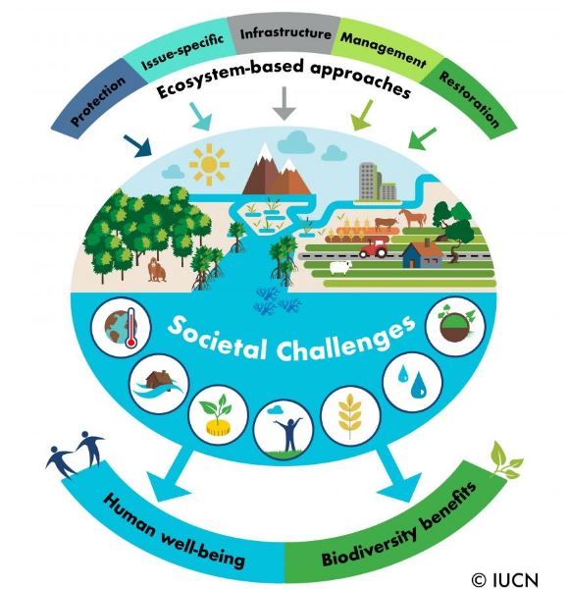
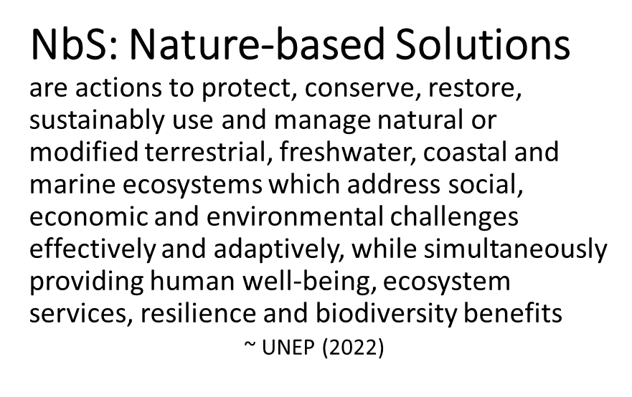
NbS defined
They include practices and strategies such as:
➔ NCS: Natural Climate Solutions
➔ EbA: Ecosystem-based Adaptation
➔ NI: Natural Infrastructure
➔ FLR: Forest Landscape Restoration
➔ Eco-DRR: Ecosystem-based Disaster Risk Reduction
➔ Agroecology: polyculture, permaculture, & agroforestry
➔ Ecosystem management, restoration, & conservation

Slide 3
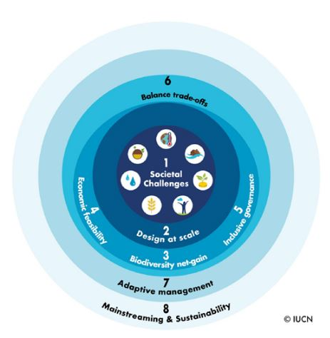
NbS global standards
Global standards for NbS
Include addressing societal challenges:
Climate change mitigation & adaptation
Disaster risk reduction
Economic & social development
Human health
Food & water security
Environmental degradation & biodiversity loss

Slide 4
NCS
Natural Climate Solutions (NCS)
are actions that increase carbon storage and/or avoid greenhouse gas emissions by conserving, restoring, or improving the use or management of ecosystems.
While maximizing the climate mitigation potential of nature, they also provide co-benefits including:
Improved soil
Improved air and water quality
Increased biodiversity habitat
Increased resilience to climate change
Forests & Woodlands | Reforestation Avoided Forest & Woodland Conversion Natural Forest Management Improved Forest Plantations Deferred Timber Harvest Avoided Wood Fuel Harvest Fire Management
Agriculture | Biochar Nutrient Management Compost Amendments Cover Crops Trees in Croplands aka Agroforestry Conservation & Regenerative Agriculture Grazing: Animal Management / Legumes / Improved Feed / Optimal Intensity Improved Manure Management Improved Rice Cultivation
Grasslands & Shrublands | Grassland Restoration Avoided Grassland Conversion Sagebrush Restoration Avoided Sagebrush and Brushland Conversion
Riparian Reforestation | Interior and Coastal
Urban | Reforestation Grassland/Pollinator Restoration
Wetlands & Peatlands | Peatland Restoration/Re-wetting Avoided Peatland Impacts/Loss Avoided Coastal Wetlands Impacts/Loss Tidal Wetland Restoration & Reconnecting/Re-wetting
Intertidal Zone | Seagrass Restoration Avoided Seagrass Loss
Compiled from: Griscom, et al. (2017) Natural Climate Solutions. https://www.pnas.org/content/114/44/11645 • Cameron, et al. (2017) Ecosystem Management and Land Conservation can Substantially Contribute to California’s Climate Mitigation Goals. https://www.pmas.org/content/114/48/12833 • Fargione, et al. (2018) Natural Climate Solutions for the United States. https://advances.sciencemag.org/content/4/11/eaat1869 • Graves, et al. (2020) Potential Greenhouse Gas Reductions from Natural Climate Solutions in Oregon, USA. https://journals.plosone/article?id=10.1371/journal.pone.0230424 • USFWS Climate Change Adaptation Program and Nature-based Solutions for Forest Adaptation (2022) https://www.forestadaptation.org/learn/training-and-workshops

Slide 5
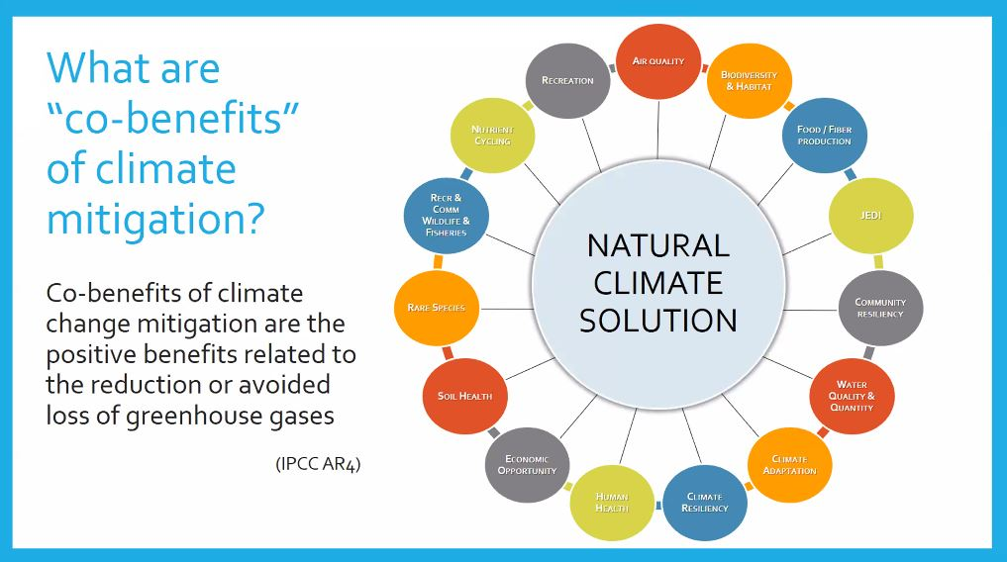
NCS co-benefits
SOURCE: USFWS Climate Change Adaptation Program and Nature-based Solutions for Forest Adaptation (2022) https:/forestadaptation.org/learn/training-and-workshops

Slide 6
NbS co-benefits
Primary NbS Benefits Identified in the NbS Benefits Explorer
SOCIO-ECONOMICS
Improved/maintained:
Climate adaptation & mitigation
Livelihood opportunities
Human health
Agriculture/agricultural output
Religious/spiritual settings
Microclimate regulation
Food security
Recreation/tourism opportunities
Property/land value
Opportunities for education/ scientific study
BIODIVERSITY & ENVIRONMENT
Improved/maintained:
Aquatic habitat availability & quality
Terrestrial & aquatic habitat connectivity
Support for local pollinators
Natural pest control
Abundance and diversity of native plant & animal species
Improved/increased terrestrial habitat availability & quality (including soil health)
WATER QUALITY & QUANTITY
Reduced/avoided surface runoff & associated erosion
Improved/maintained:
Surface water storage
Groundwater recharge & storage
Flow regime
Flood protection and mitigation (inland & coastal)
Surface water & ground water quality
CARBON
Improved/maintained carbon sequestration
Reduced carbon emissions
Brill, Gregg, et al. (2021). Benefit Accounting of Nature-Based Solutions for Watersheds: Guide United Nations CEO Water Mandate and Pacific Institute. Oakland, California. www.ceowatermandate.org/nbs/guide (from Table 4)

Slide 7
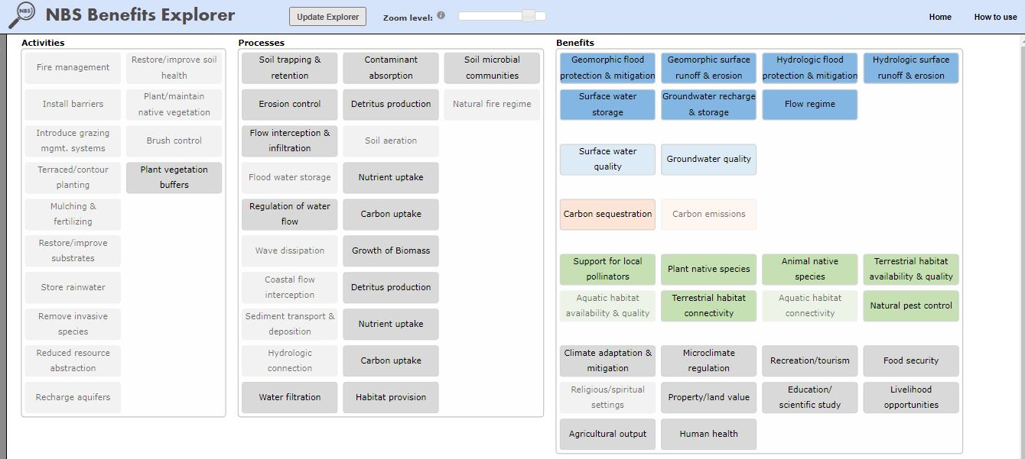
NbS benefits explorer
NbS Benefits Explorer Tool
Results for “Plant Vegetation Buffers” from Agricultural Management
(Hovering over selected activities, processes, or benefits provides additional details.)
nbsbenefitsexplorer.net

Slide 8
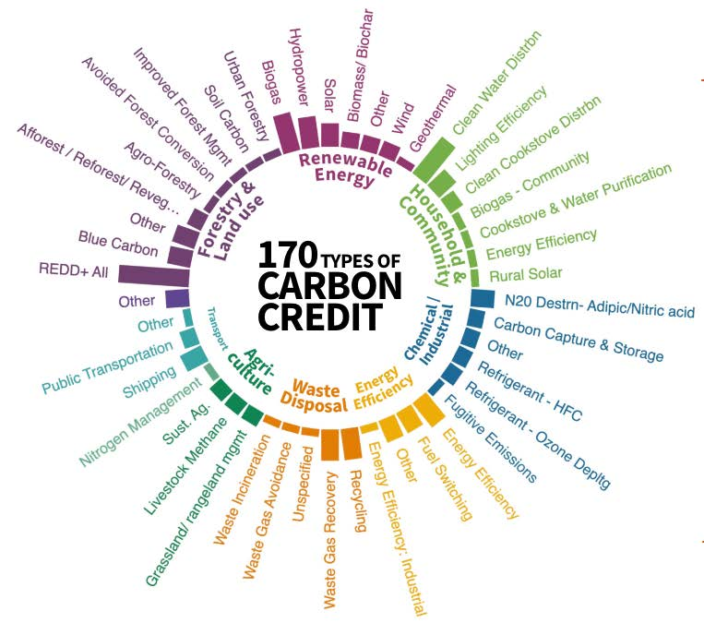
VCM
More learning ahead…
Minimum Standards Required by the VCM:
Additionality: “Reduction/sequestration must be additional to any that would occur without the project.”
Permanence: Relating to length of storage & risk of loss
Leakage: Unintended greenhouse gas (GHG) emissions that may result directly or indirectly from the project
Co-Benefits: Environmental &/or societal benefits such as improved habitat/ biodiversity protection, water quality, training, jobs, recreation, education, reducing climate-related risks, etc.
Ecosystem Marketplace (2022). State of the Voluntary Carbon Market Q3 2022. https://www.ecosystemmarketplace.com/publications/state-of-the-voluntary-carbon-markets-2022/

Slide 9

Thank you!
Questions?
brucebuckmaster@charter.net
Image: by Chrissie28IWish! via The Guardian/Environment Gallery • 5/2012

