Slide 1
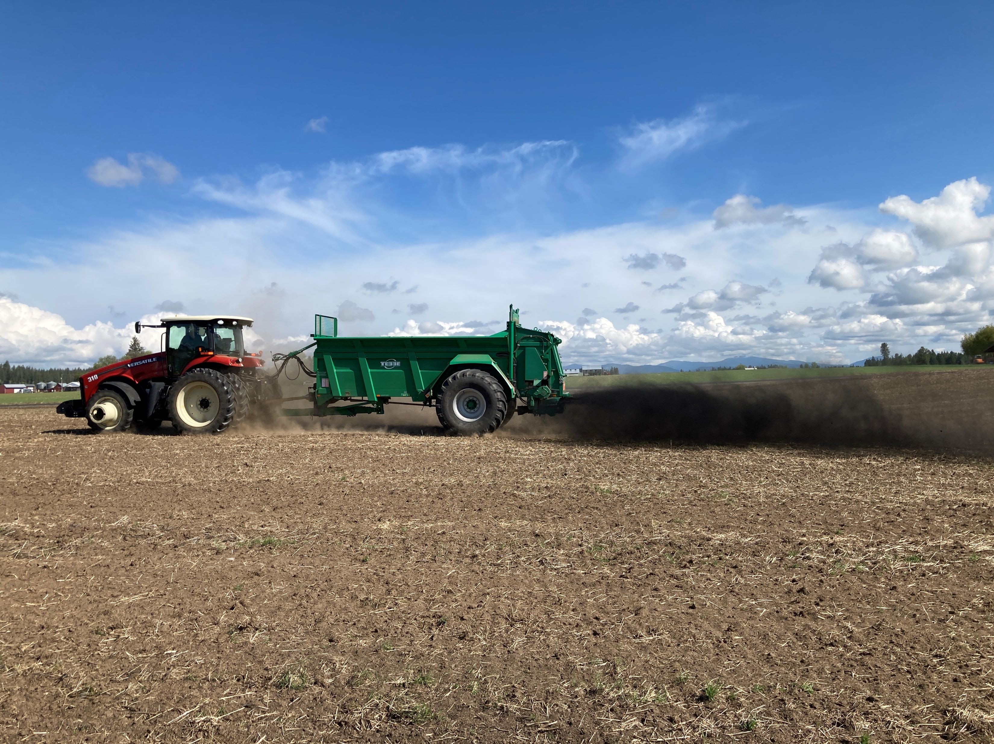
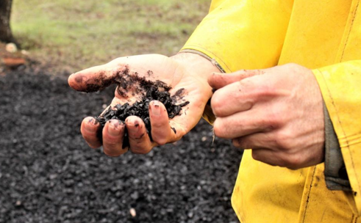
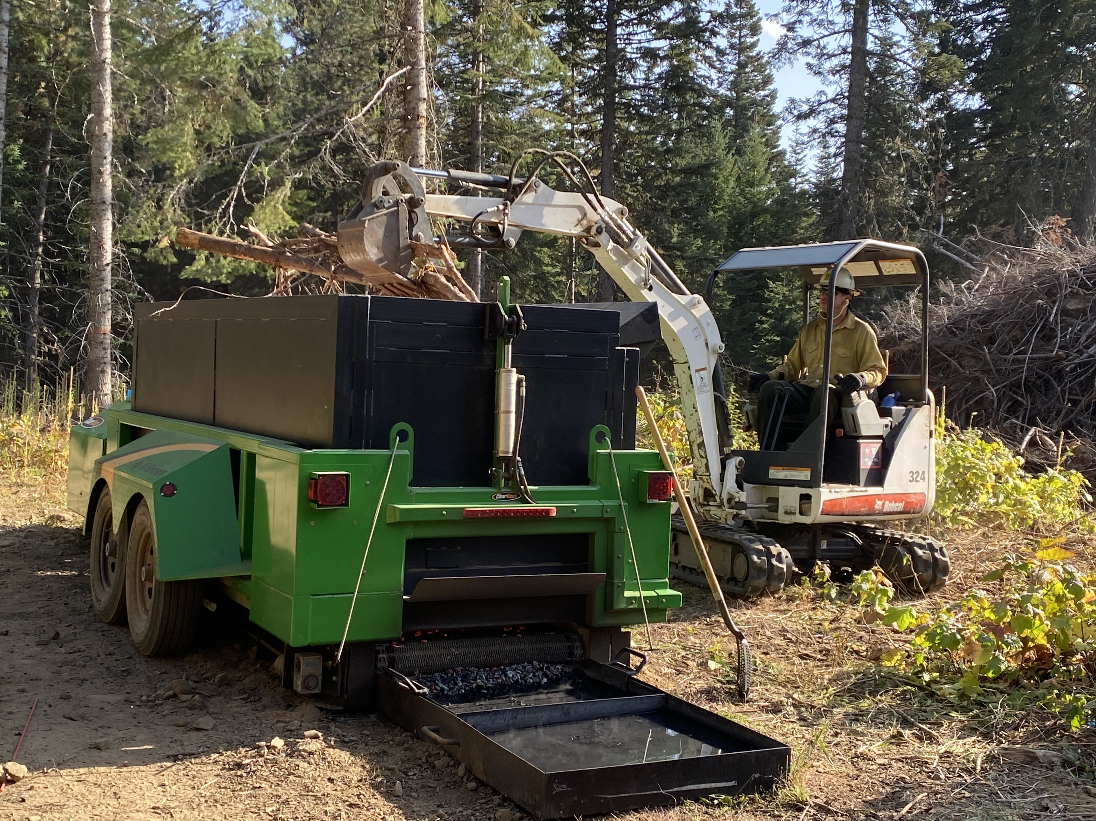
BIOCHAR 101 FOR CONSERVATION DISTRICTS:
Production and Applications Overview
Oregon Association of Conservation Districts Annual Meeting
October 17, 2023
Myles Gray, P.E.
Program Director
US Biochar Initiative

Slide 2
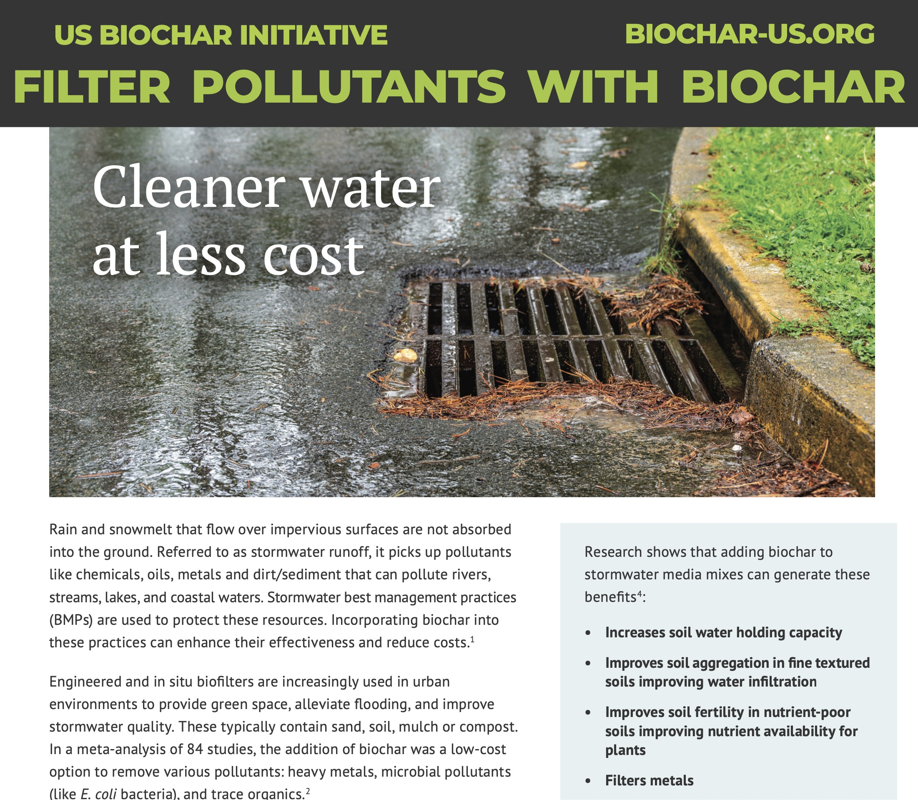
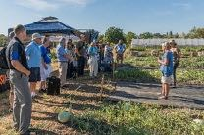
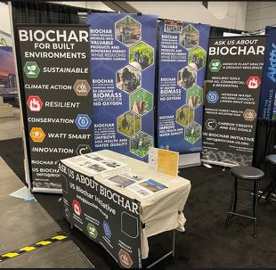
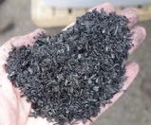
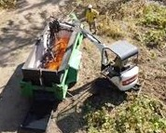
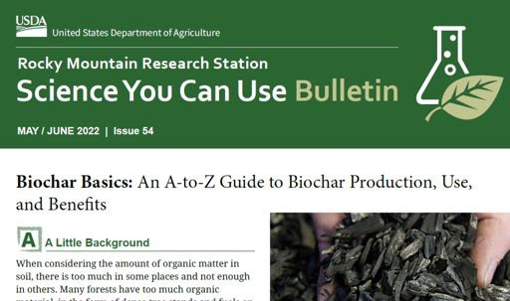
ABOUT USBI
Established 2009
In-field Workshops
Fact Sheets
USBI is a not-for-profit organization promoting
the sustainable production and use of biochar
through research, policy, technology & doing it!
Online Producers Directory
Activities:
North America Conferences, Workshops, Demos, Fact Sheets, Newsletter, Website,
Provider Directory, Social Media, Biochar Advocacy, Referrals, Forestry Partner, Technical Advisory Team, Research, Outreach & Education, biochar.groups.io
Trade shows & Conferences
Equipment & Technology Development
USFS Biochar Basics bit.ly/3NCtv78
Content Contributor
USBI – Oregon Association of Conservation Districts Annual Meeting – October 2023
Notes:
The US Biochar Initiative is a non-profit association of scientists, engineers, farmers, and biochar producers dedicated to the promotion and use of biochars which are safe, stable and sustainable. We promote biochars through networking, education and demonstration. USBI assists in outreach and education, market development, and in the development and demonstration of carbonization systems. We publish in a newsletter, website, and on social media. We host an internet discussion list, conduct workshops and webinars. We provide market and technical support to biochar producers and users thanks to support from USDA Forest Service.. And we are preparing market and use guidelines courtesy of the University of Nebraska and the USFS Wood Innovation Program. We enjoy the collaboration of organization like the USDA Agricultural Research Service and Natural Resource Conservations Service. USDA ARS is developing a Biochar Atlas decision tool for biochar use in agriculture. Throughout the year we make many presentation to promote biochar to local, regional and national organizations..

Slide 3
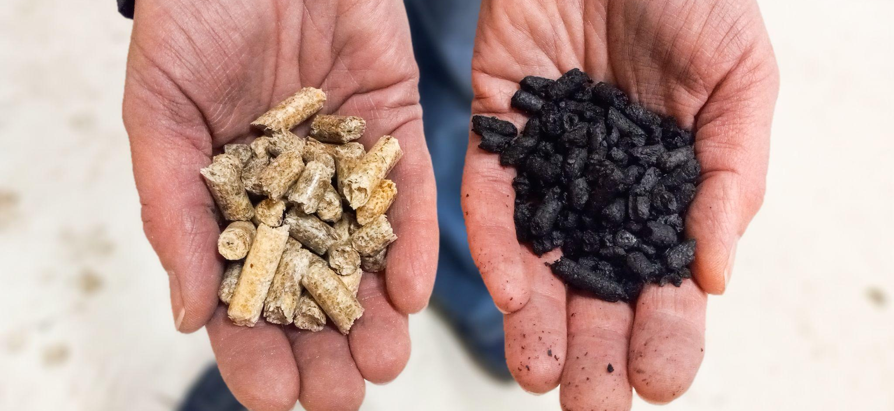
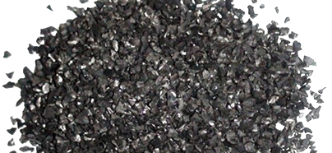
WHAT IS BIOCHAR?
Granular black carbon, like charcoal
Produced via pyrolysis: heating without oxygen
Resistant to decay for 100’s - 1,000’s years
Effective as a soil amendment
When produced from waste biomass it can be part of an approach to:
Produce renewable biomass energy
Remove carbon from the atmosphere
Create valuable environmental and agriculture materials
USBI – Oregon Association of Conservation Districts Annual Meeting – October 2023

Slide 4
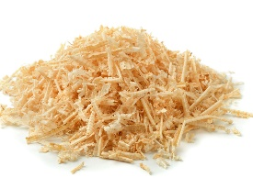
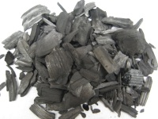
THE BIOCHAR APPROACH Sequestration of waste biogenic carbon
Typical Management
Biochar Approach
CO₂
Heat / Power
Natural Decomposition
Combustion
~40% of the source carbon captured as biochar
CO₂
CH₄
_{~25x GHG effect}
CO₂
Heat / Power
CH₄
Pyrolysis
Vapors = ~60% of C
~90%+ source carbon equivalent emitted to atmosphere
Vapor Combustion
Biochar = ~40% of C
Waste Biomass: Sawdust, forestry slash, wood chips, ag residues, etc.
Biochar Carbon Removal
USBI – Oregon Association of Conservation Districts Annual Meeting – October 2023

Slide 5
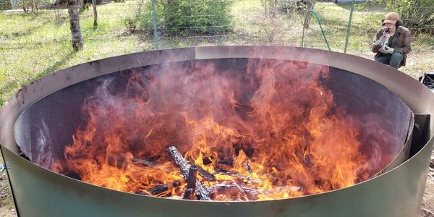
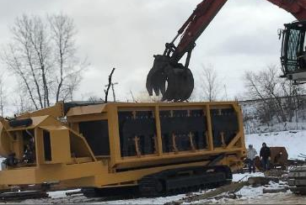
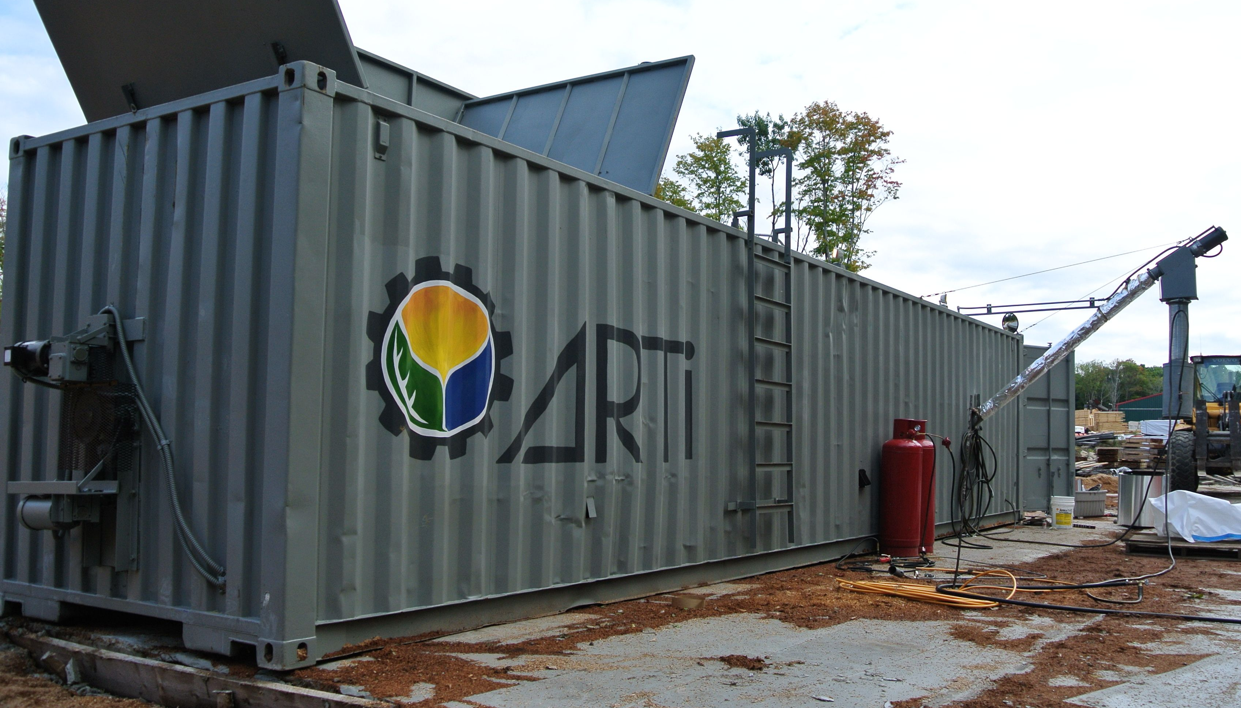
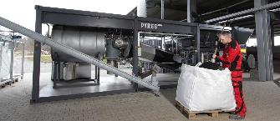
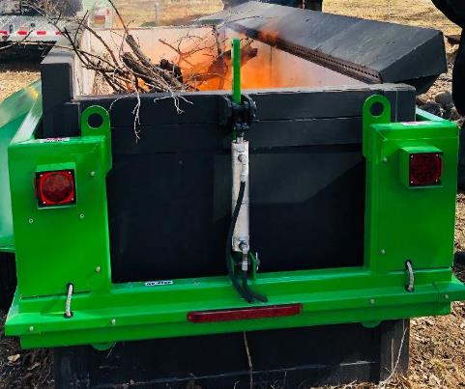
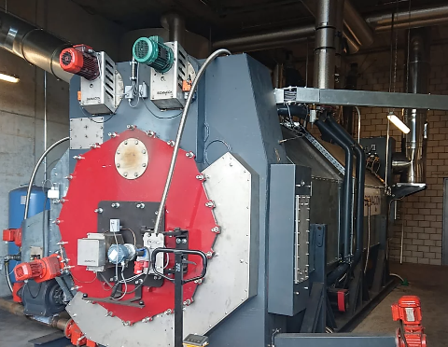
BIOCHAR PRODUCTION From In-Woods to On-Farm to Industrial
“Ring of Fire”
Wilsonbiochar.com
Carbonator 6050
tigercat.com
ARTIchar
artichar.com
Pyreg 500
Pyreg.de
CharBoss
airburners.com
Biomacon
Biomacon.com
Oregon Biochar Solutions
Chardirect.com
USBI – Oregon Association of Conservation Districts Annual Meeting – October 2023

Slide 6
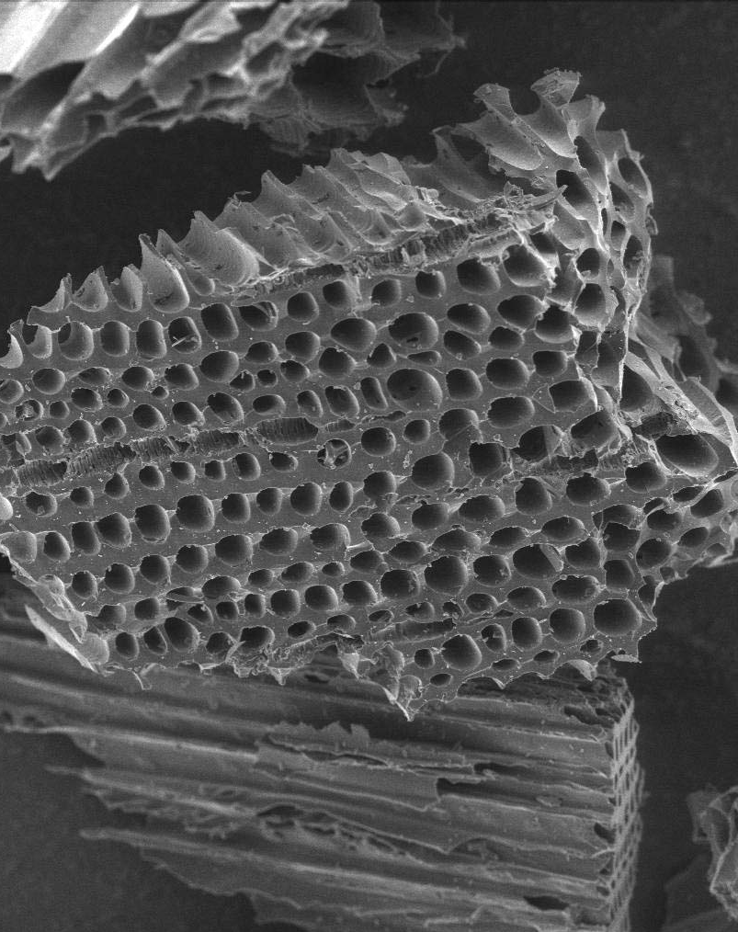
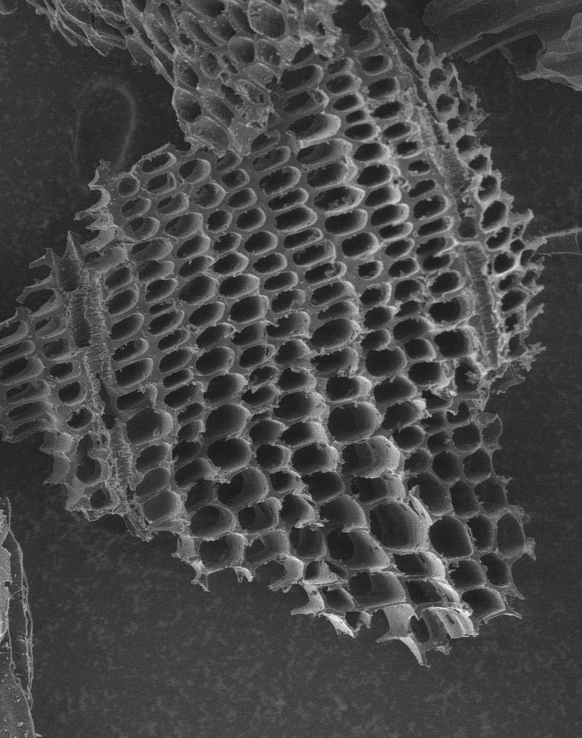
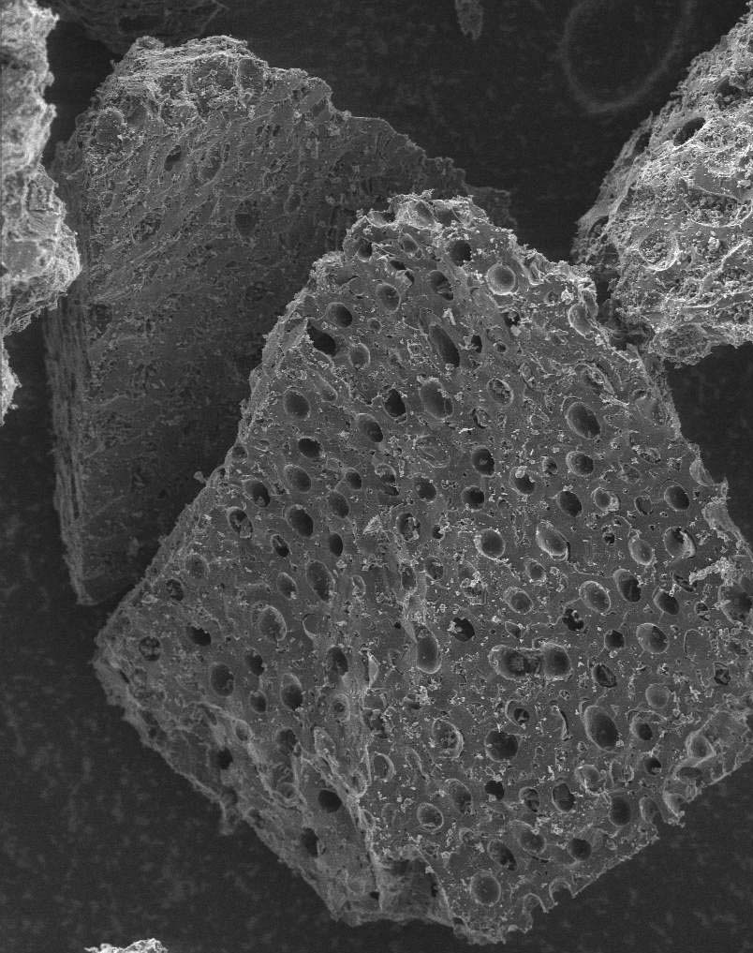
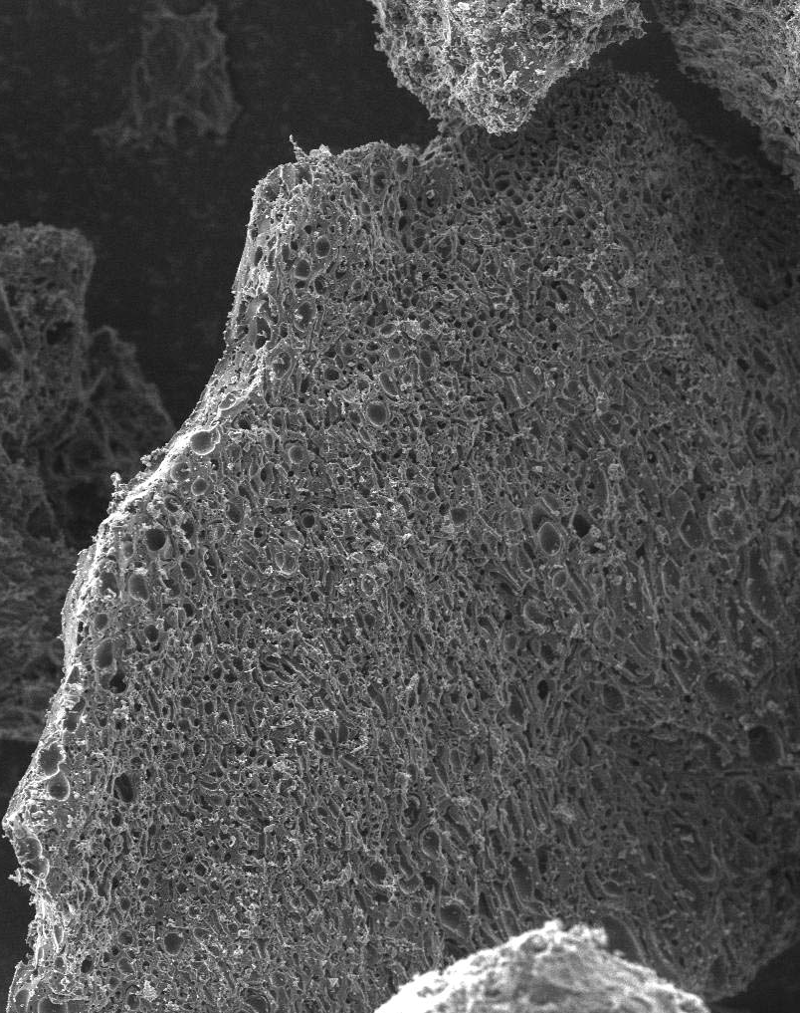
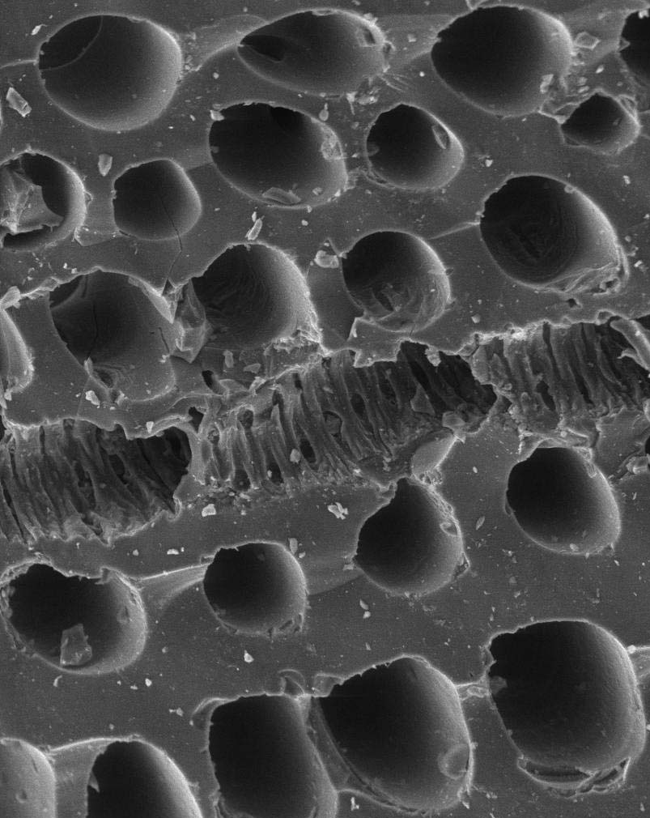
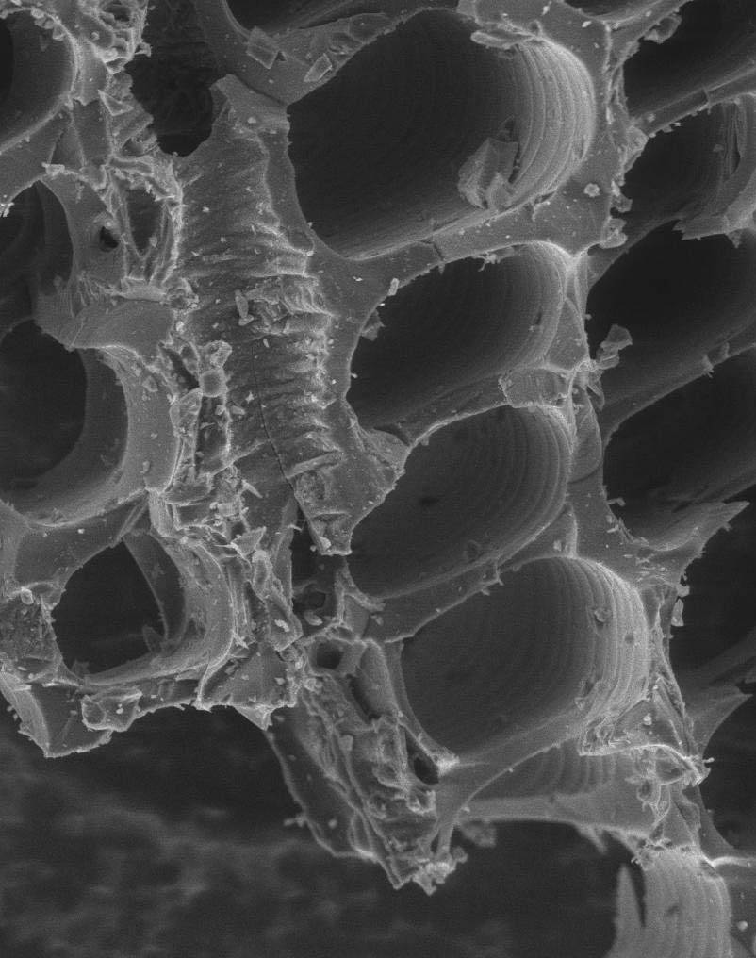
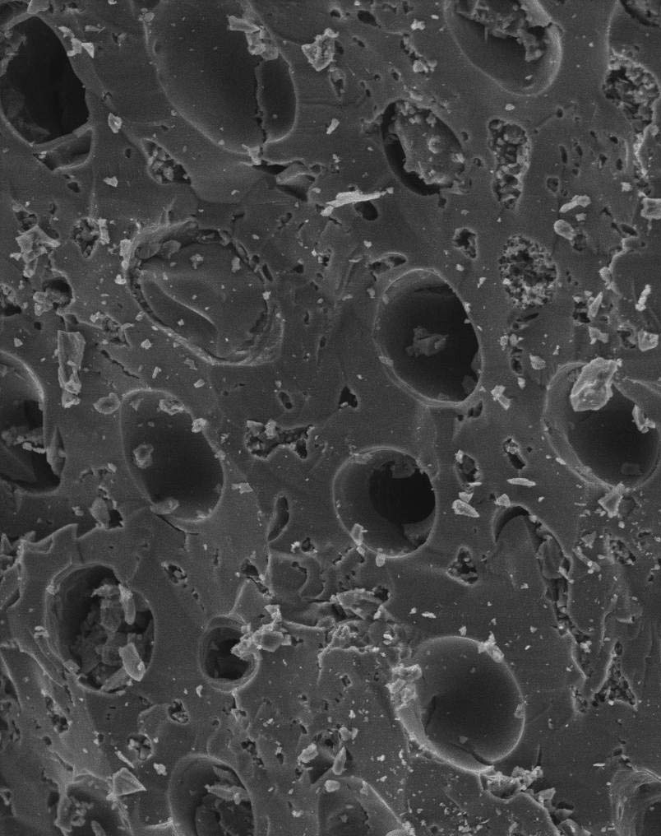
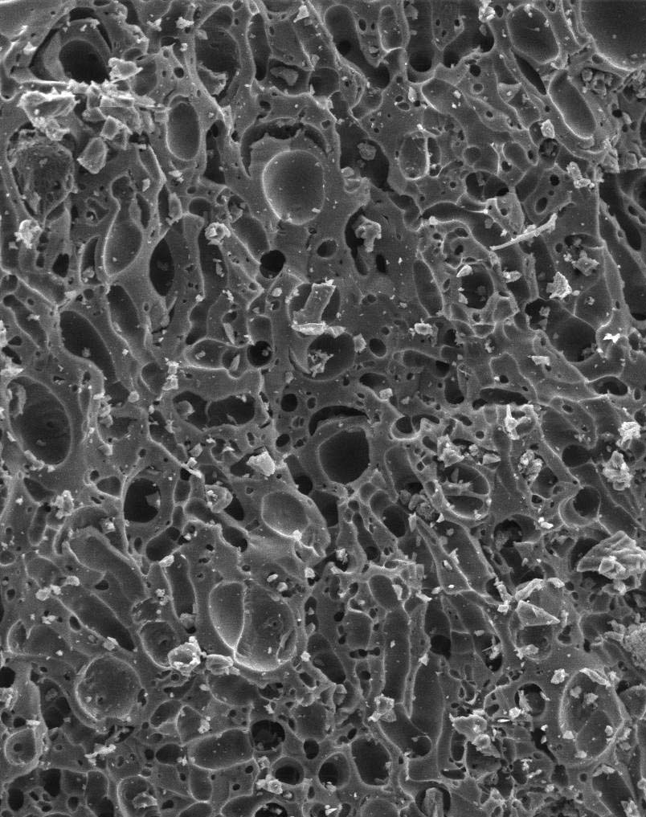
BIOCHAR IS NOT CREATED EQUAL Properties depend on feedstock and production process
Douglas-fir 500 °C
Douglas-fir 650 °C
Hazelnut shells 500 °C
Hazelnut shells 650 °C
Top Row Scale
100 µm
Bottom Row Scale
20 µm
USBI – Oregon Association of Conservation Districts Annual Meeting – October 2023

Slide 7
BIOCHAR AS A SOIL AMENDMENT A Climate-Smart Soil Health Practice
Improved Soil Health:
Direct and indirect increases in soil carbon
Reduced bulk density
Increased water holding
Reduced nitrate leaching
Compatible with high disturbance crops
Increased crop yields
Increase nutrient use efficiency and reduced fertilizer demand
Reduced agricultural GHG emissions (N₂O)
Liming benefit from ash content
Biochar is a long-term investment
USBI – Oregon Association of Conservation Districts Annual Meeting – October 2023

Slide 8
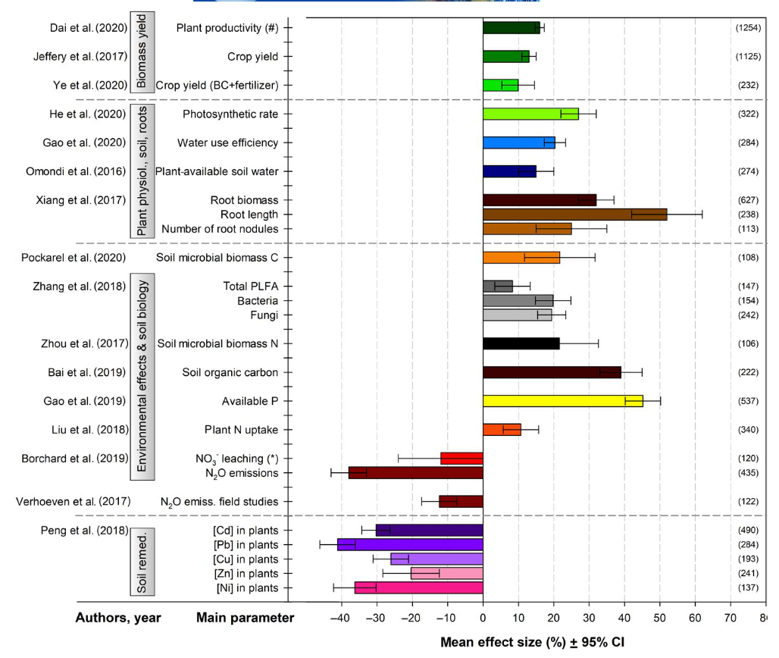
BIOCHAR AS A SOIL AMENDMENT Research Summary
Thousands of research papers published since ~2005
Dozens of meta-analyses
Data presented from Schmidt et al., 2021: “Biochar in Agriculture: A Systematic Review of 26 Global Meta-Analyses”
USBI – Oregon Association of Conservation Districts Annual Meeting – October 2023

Slide 9
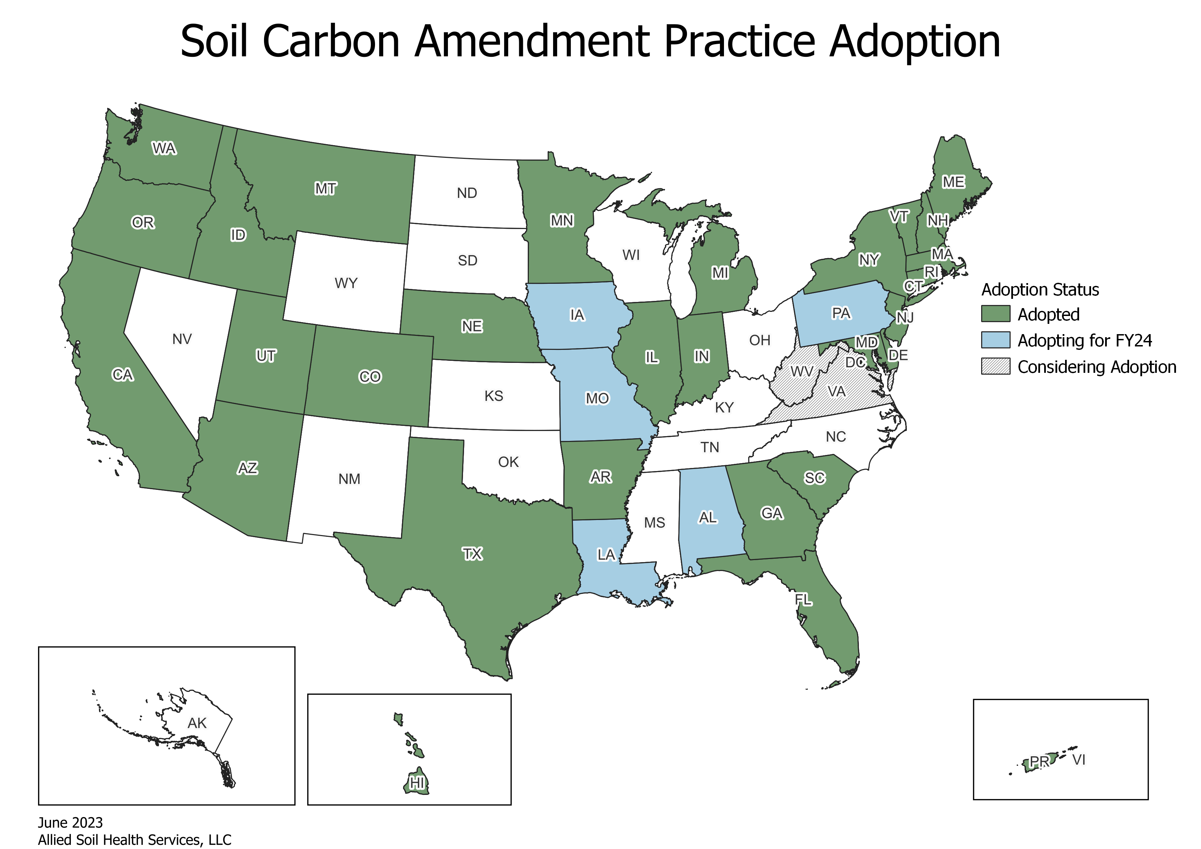
BIOCHAR FOR CONSERVATION DISTRICTS NRCS Conservation Practice Standard 336
Soil Carbon Amendment (336) provides direct funding to growers to deploy biochar and/or compost
Intent is to increase soil carbon and increase microbial habitat (resource concerns)
336 is new, but has been adopted in Oregon
USBI and USDA ARS are building out the Biochar Atlas decision-support tool for NRCS, CDs, and growers
USBI – Oregon Association of Conservation Districts Annual Meeting – October 2023

Slide 10
BIOCHAR FOR CONSERVATION DISTRICTS In-Woods and On-Farm Waste Management
Biochar presents an opportunity to reduce waste materials while generating additional revenue from carbon credits
Air-curtain burners offered by several manufacturers. USBI working with USFS to study air emissions.
Mobile biochar kilns for remote locations
USBI – Oregon Association of Conservation Districts Annual Meeting – October 2023

Slide 11
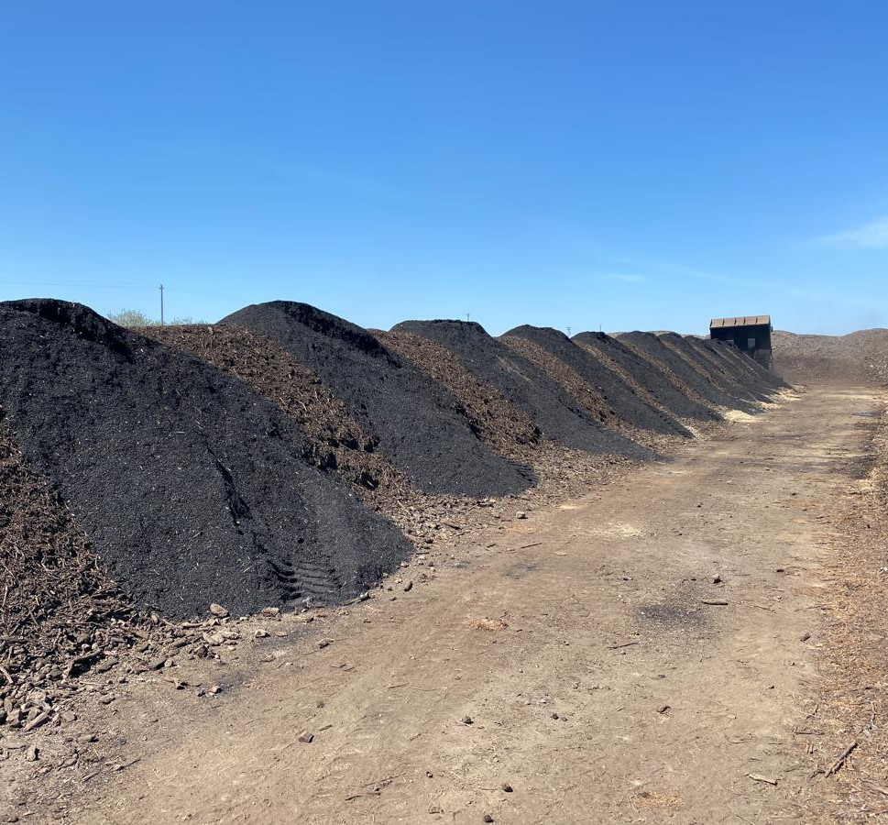
BIOCHAR FOR CONSERVATION DISTRICTS Co-Composting with Biochar
Increased composting rate, especially in less managed composting systems
Reduced GHG and ammonia emissions
Reduced odors from composting
Increased nutrient content in finished compost
Activation of biochar creates high cation exchange capacity that persists long after compost is degraded
USBI – Oregon Association of Conservation Districts Annual Meeting – October 2023

Slide 12
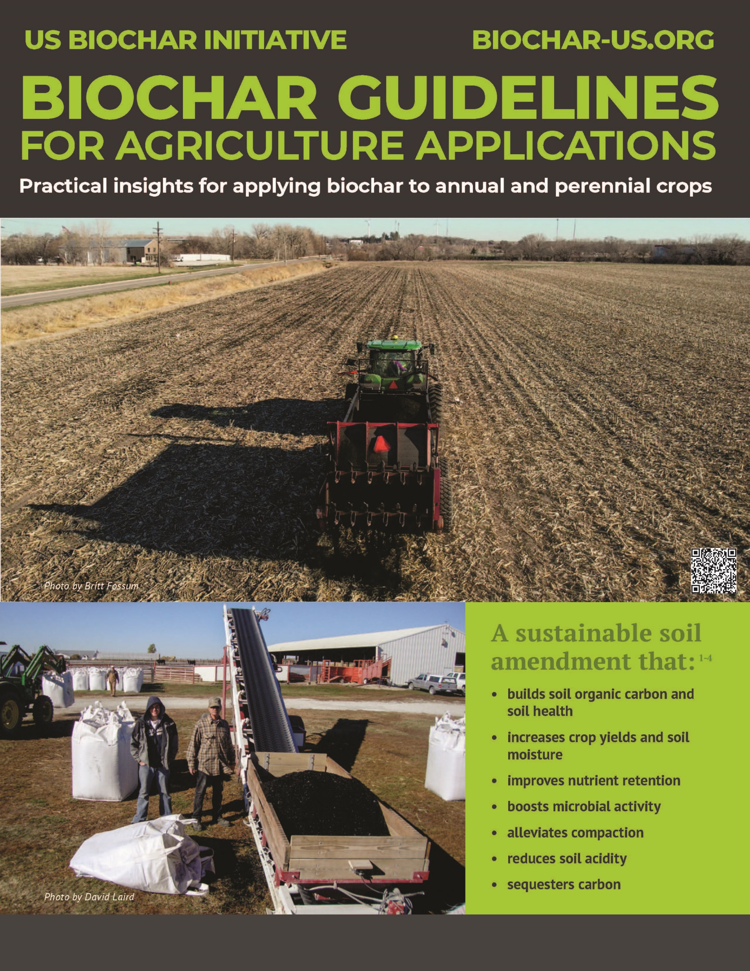
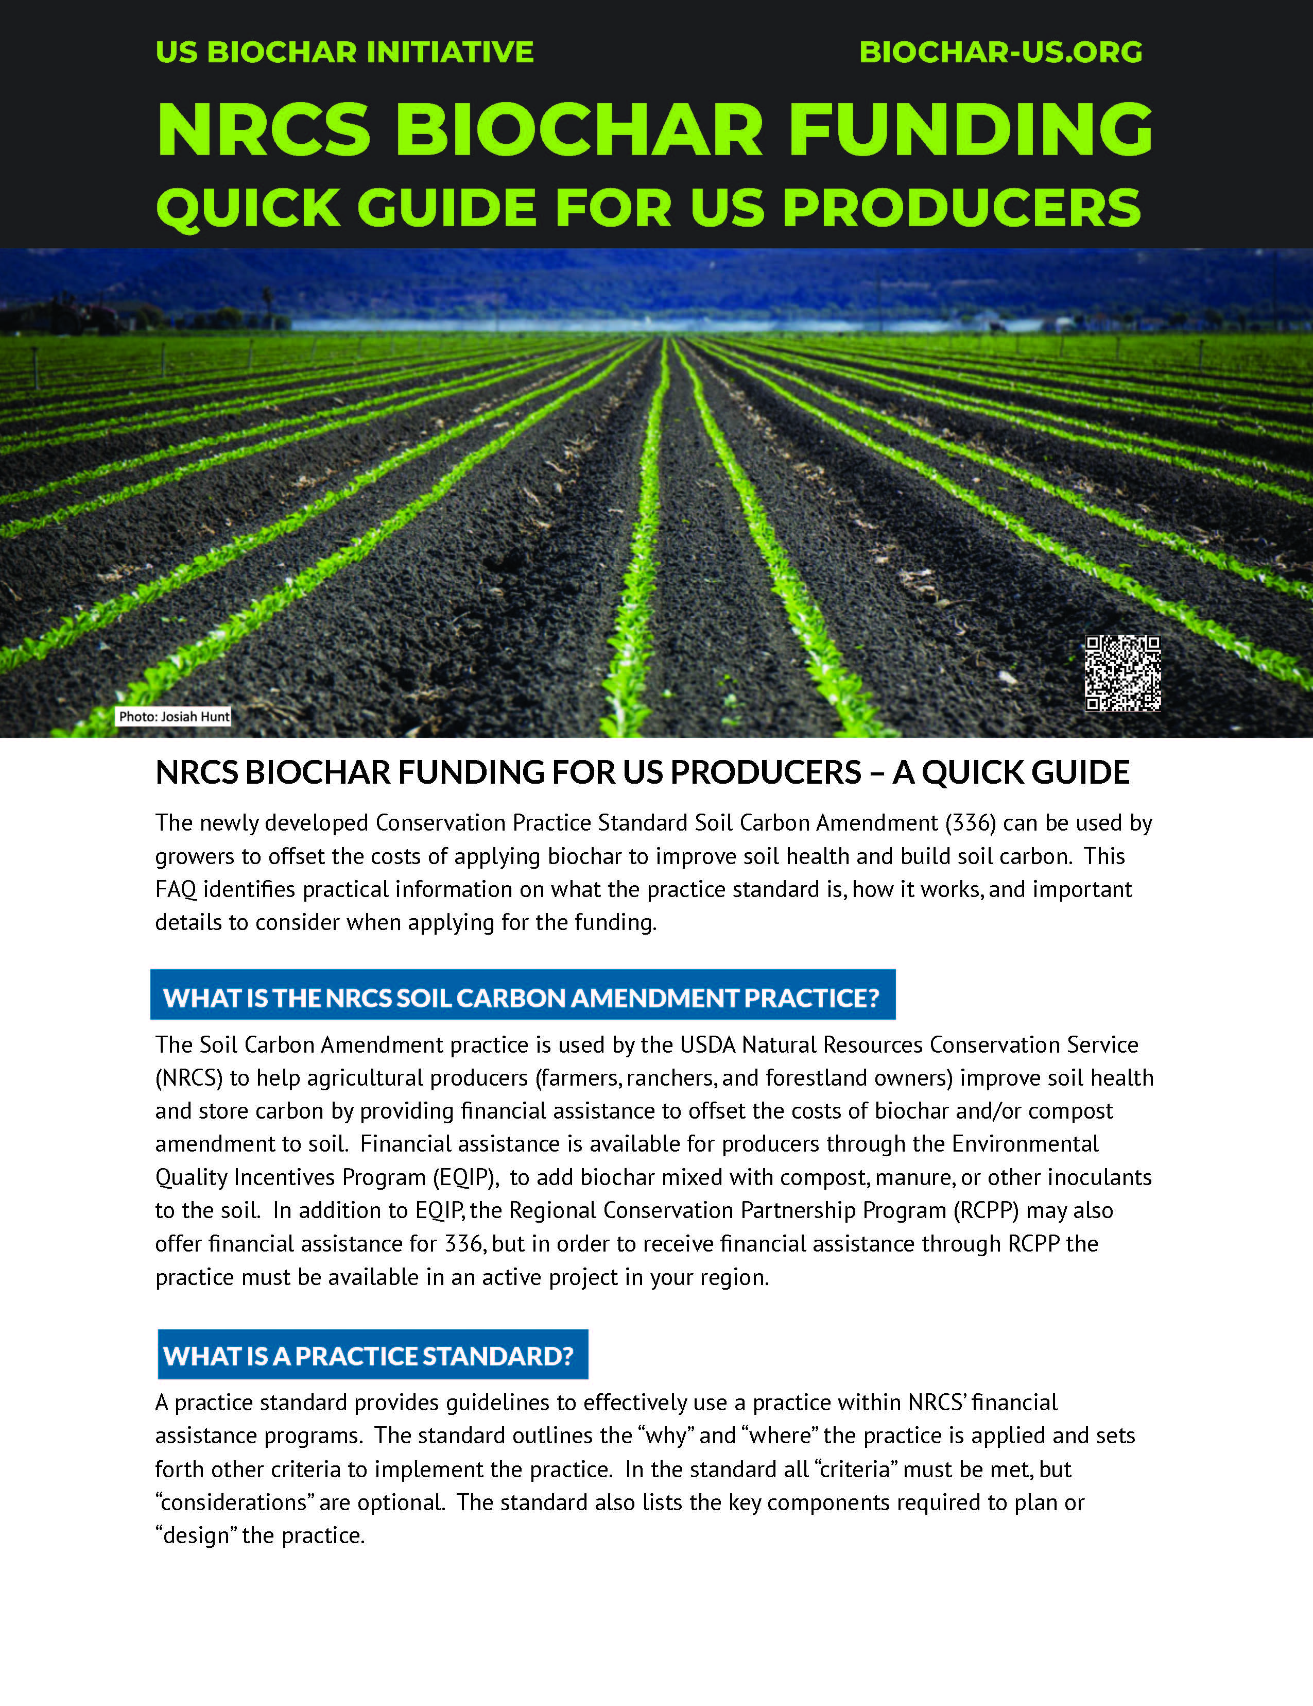
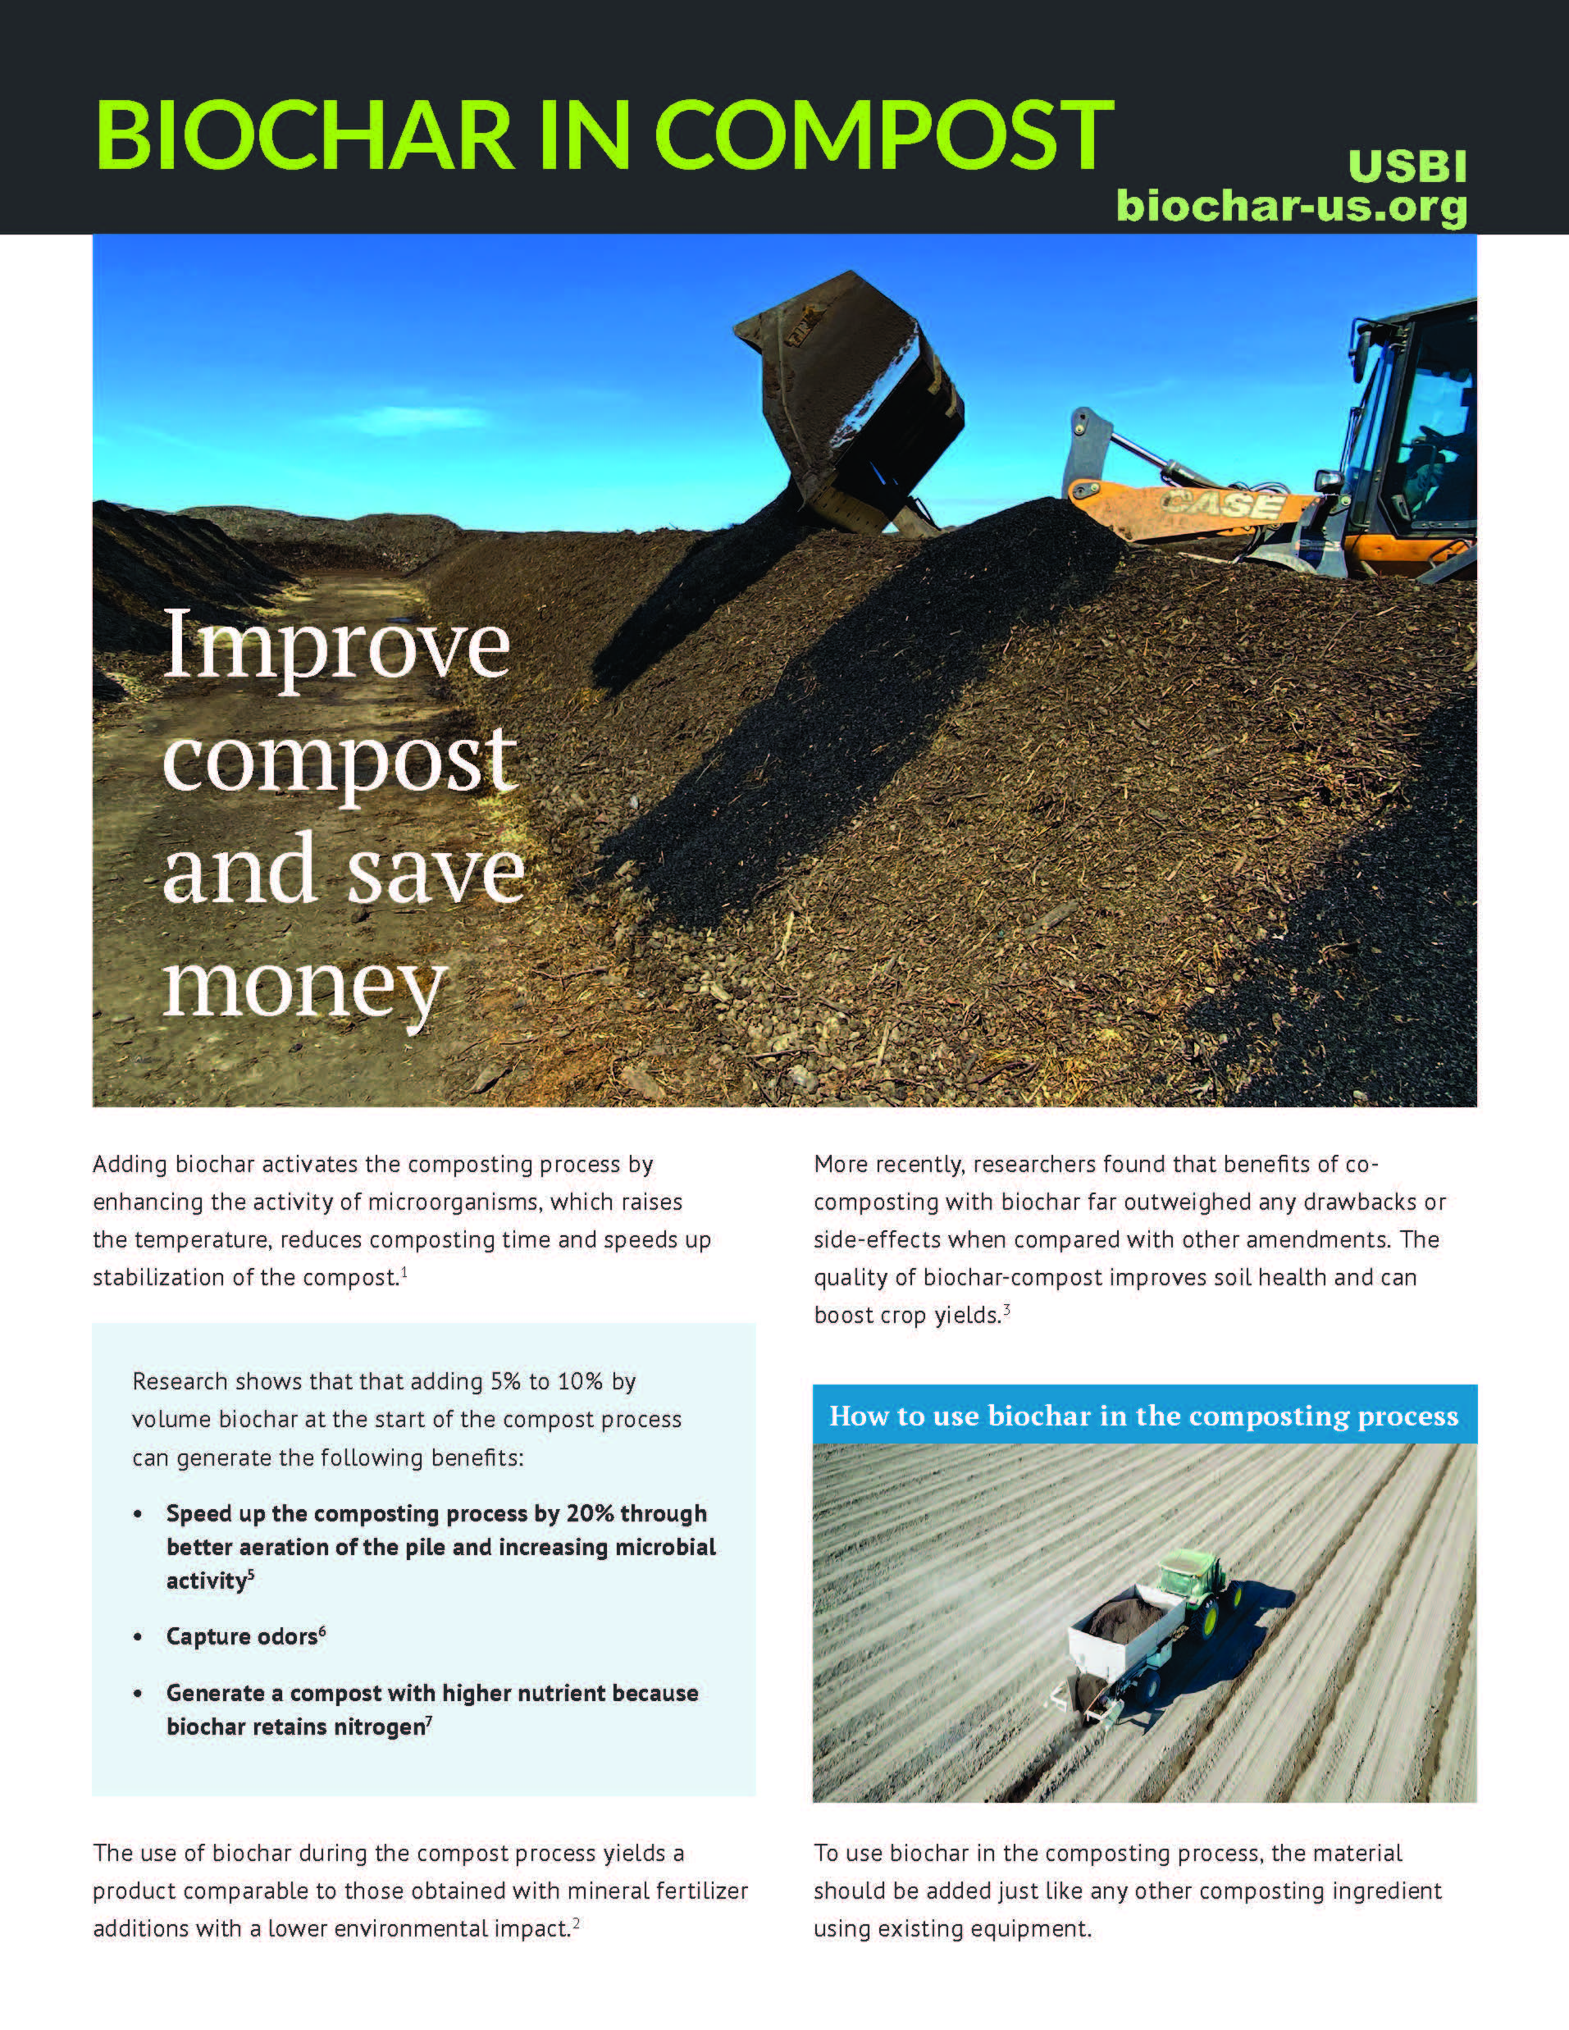
USBI FACT SHEETS AND GUIDANCE
Available at: https://biochar-us.org/type-resource/fact-sheet
USBI – Oregon Association of Conservation Districts Annual Meeting – October 2023

Slide 13
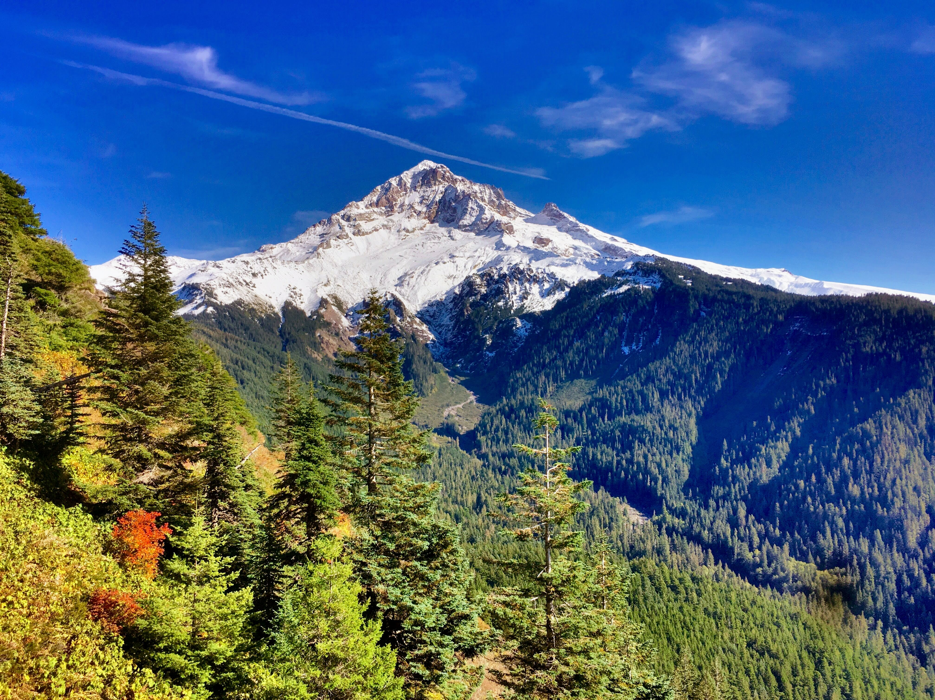
Thank you!
OACD Annual Meeting
October 17, 2023
Myles Gray, P.E.
Program Director
US Biochar Initiative
myles@biochar-us.org

Slide 14
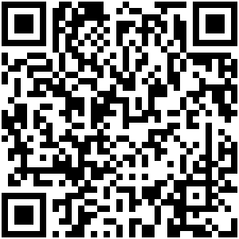
Connect
info@biochar-us.org
https://biochar-us.org instagram.com/usbiochar youtube.com/@USBiocharInitiative linkedin.com/company/us-biochar-initiative twitter.com/usbiochar
facebook.com/USbiochar biochar.groups.io
Learning Center & Fact Sheets
USBI – Biochar In Stormwater Management – MNBI – September 2023

